Slide 1
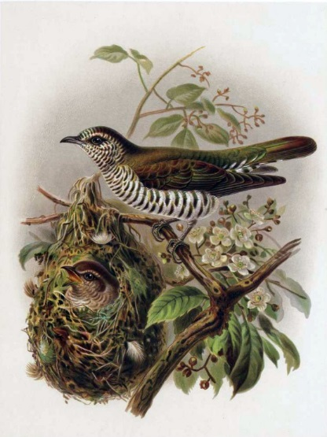
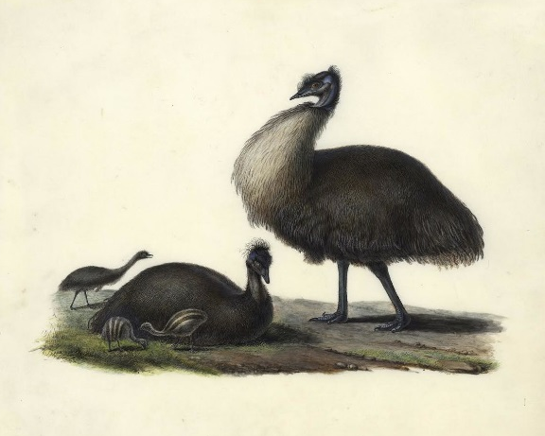

Facilitating recovery
Maximizing connectivity & productivity to safeguard King Island’s birdlife
David M Watson
Professor in Ecology

Slide 2
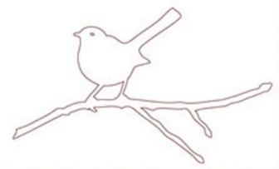
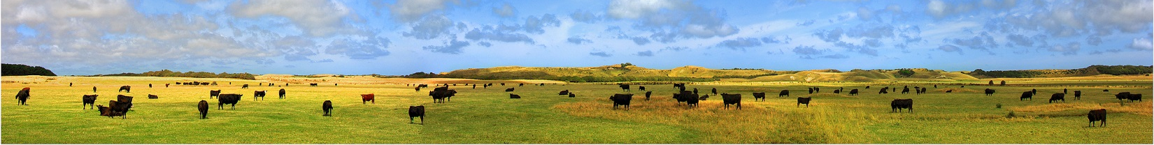
Outline
Lessons learned from the mainland: ‘Declining Woodland Birds’
Facilitation—improving habitat quality ( = ‘wildlife carrying capacity’) from the bottom-up
Connectivity conservation—increasing permeability of landscapes to safeguard wildlife populations over the long term
Reconciliation ecology—maximising the value of the places where we live, work and farm for wildlife

Slide 3
Outline
Lessons learned from the mainland: ‘Declining Woodland Birds’
Facilitation—improving habitat quality ( = ‘wildlife carrying capacity’) from the bottom-up
Connectivity conservation—increasing permeability of landscapes to safeguard wildlife populations over the long term
Reconciliation ecology—maximising the value of the places where we live, work and farm for wildlife

Slide 4
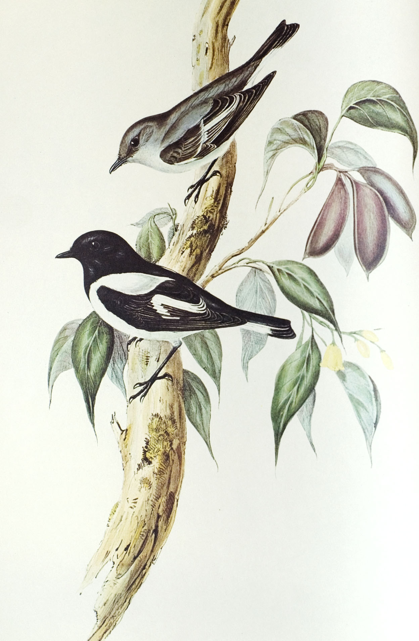
Declining insectivores
25/26 ‘Declining Woodland Birds’ eat insects; 17 forage on the ground*
Litter-dwelling insects and spiders are principal food
  Preferred prey groups sensitive to litter quality, depth and persistence
Could observed patterns in insectivores relate to fundamental changes in litter-fall?
Can we improve habitat quality from the bottom-up?
*Emu 111: 10—18

Slide 5
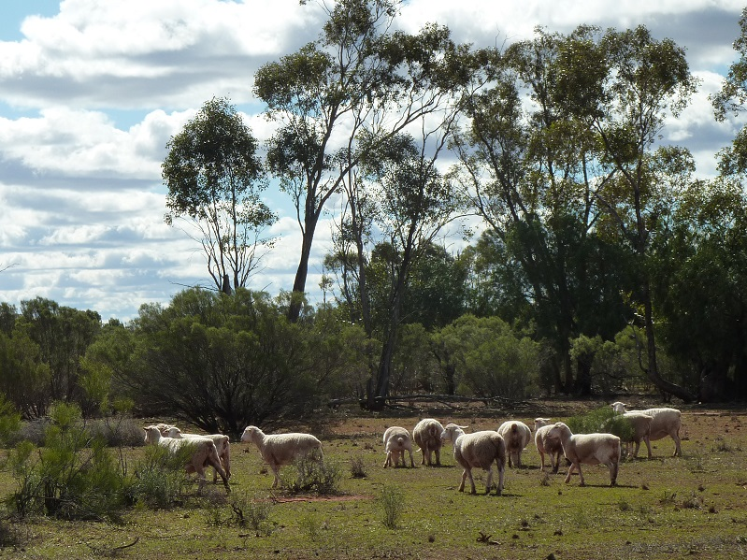
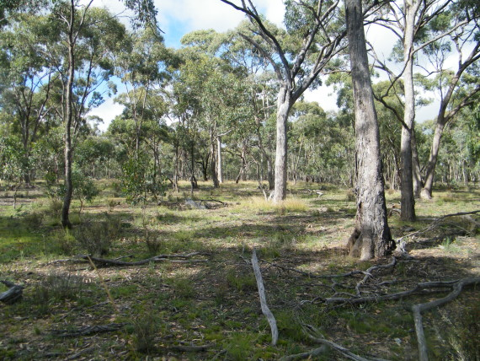
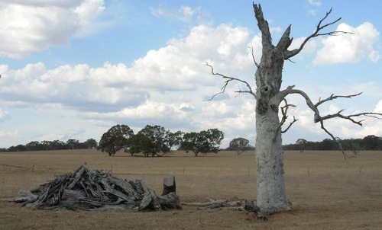
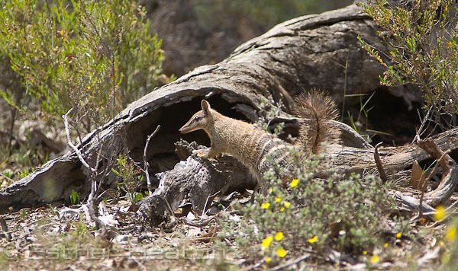

Slide 6
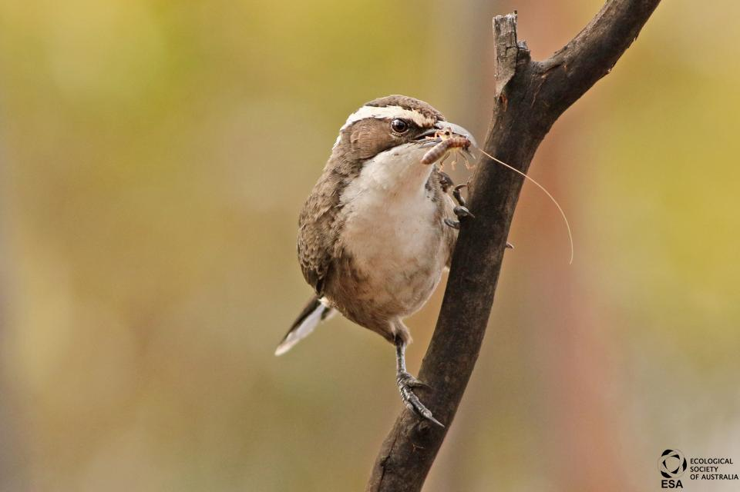

Slide 7
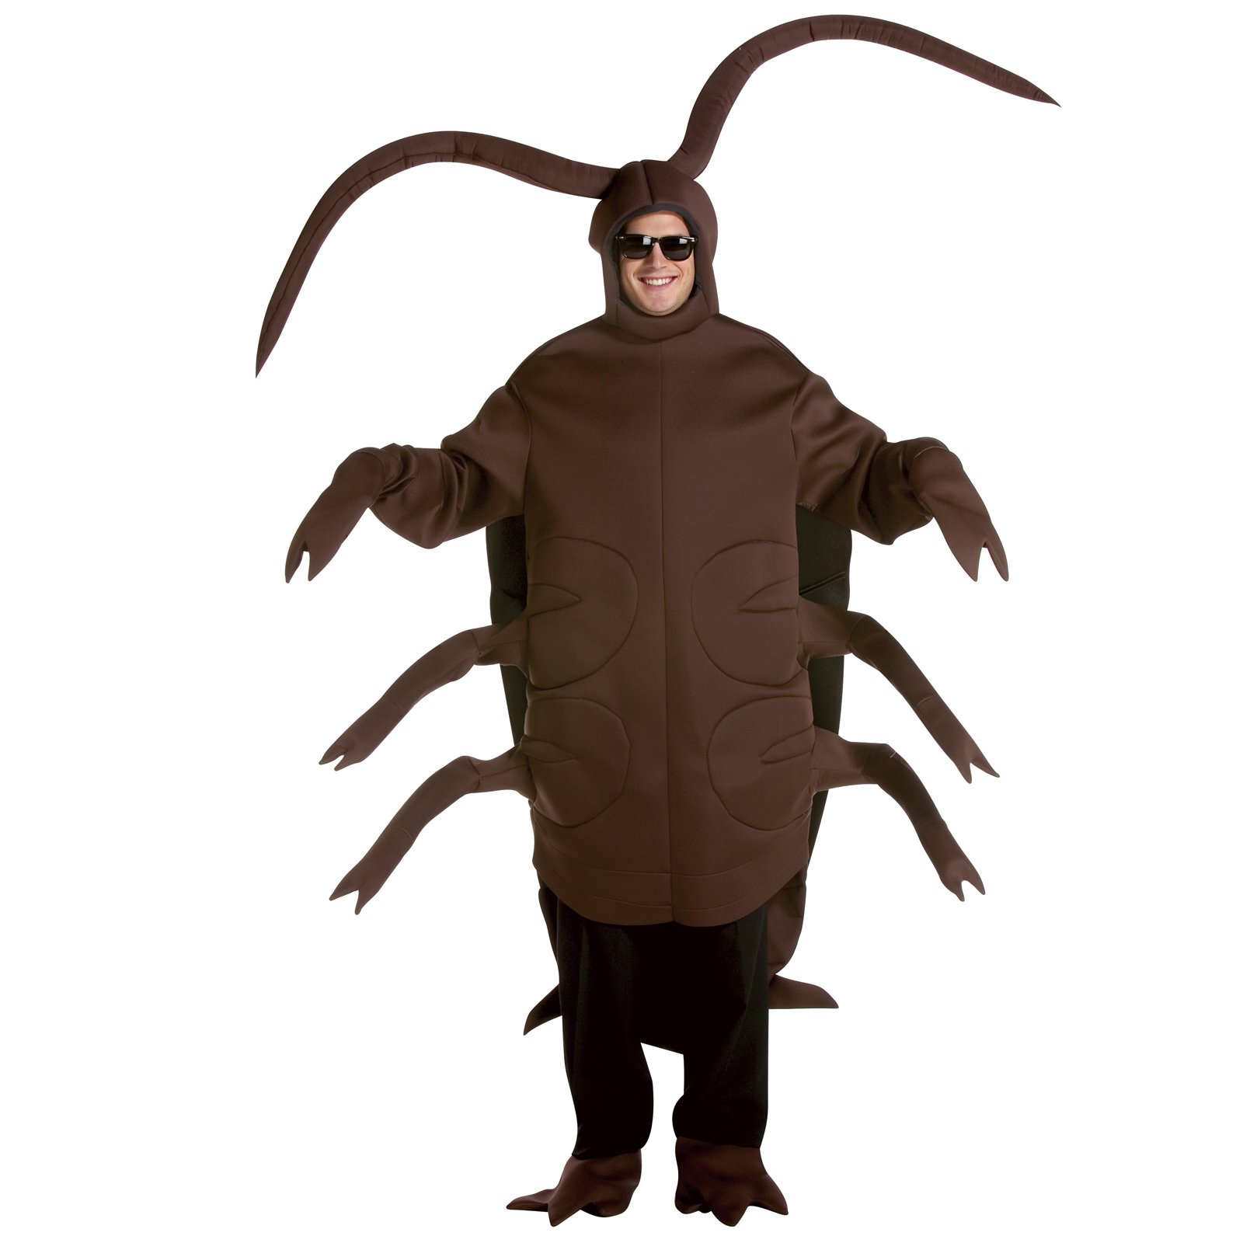

Slide 9
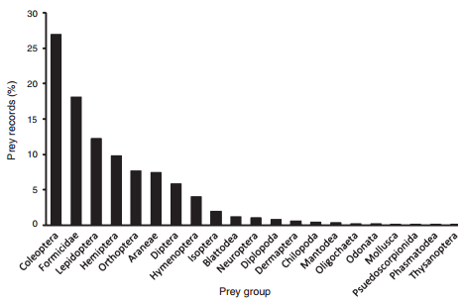
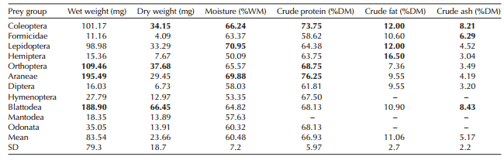
Bugs ain’t bugs
Declining woodland birds have clear dietary preferences*
Corresponds with nutritional quality
  Macronutrients (fat & protein)**
  Micronutrients (11 elements)
*Emu 112:149—56
**J Avian Biol. 46: 89—96

Slide 10
‘Tasties’
Bugs ain’t bugs
Declining woodland birds have clear dietary preferences*
Corresponds with nutritional quality
  Macronutrients (fat & protein)**
  Micronutrients (11 elements)
*Emu 112:149—56
**J Avian Biol. 46: 89—96

Slide 11
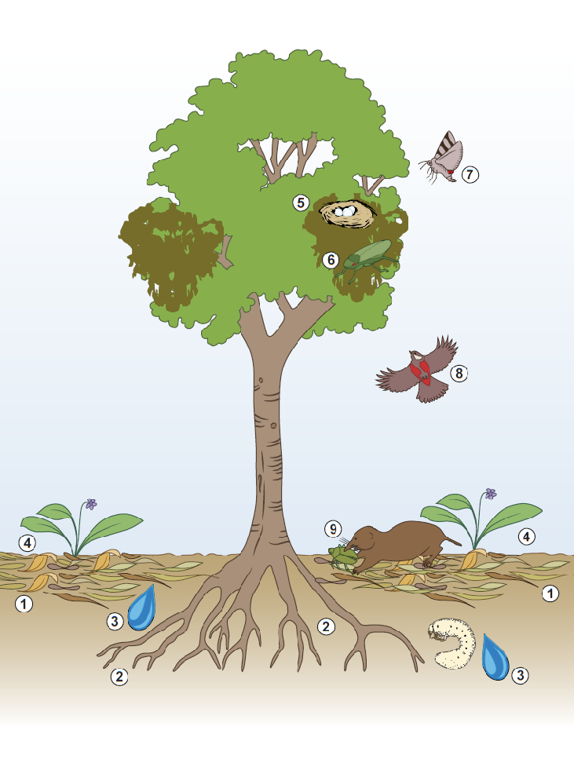
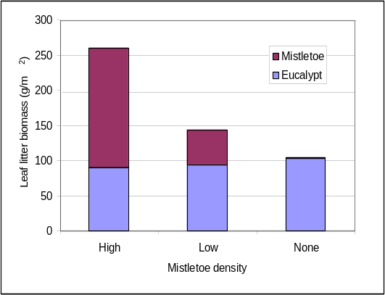
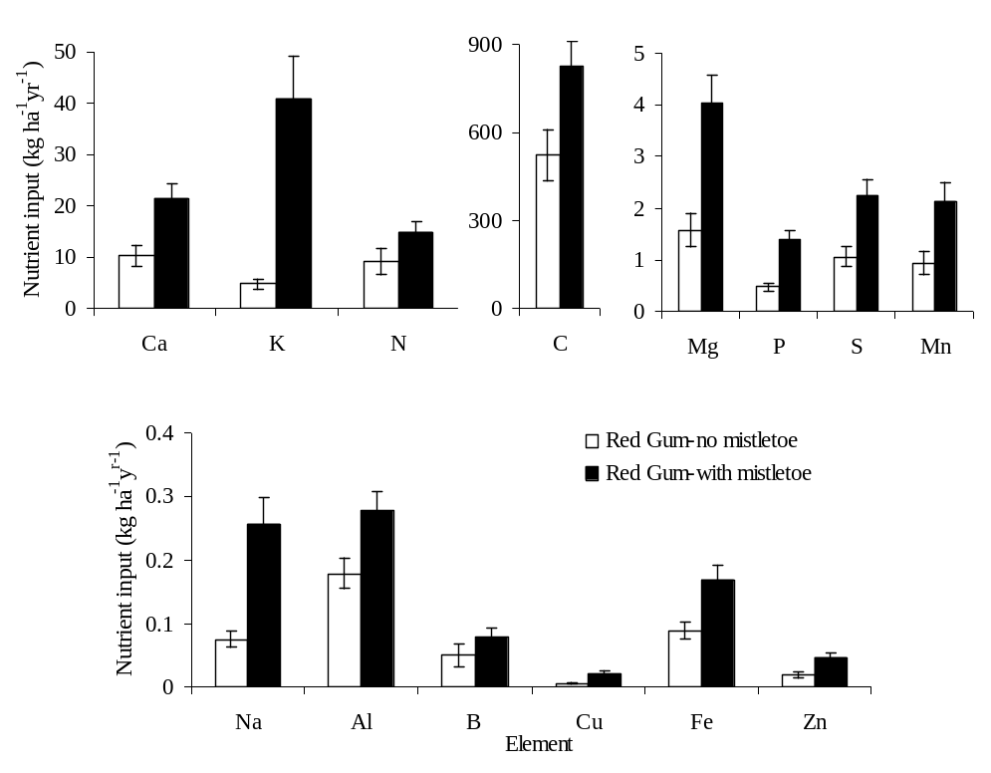
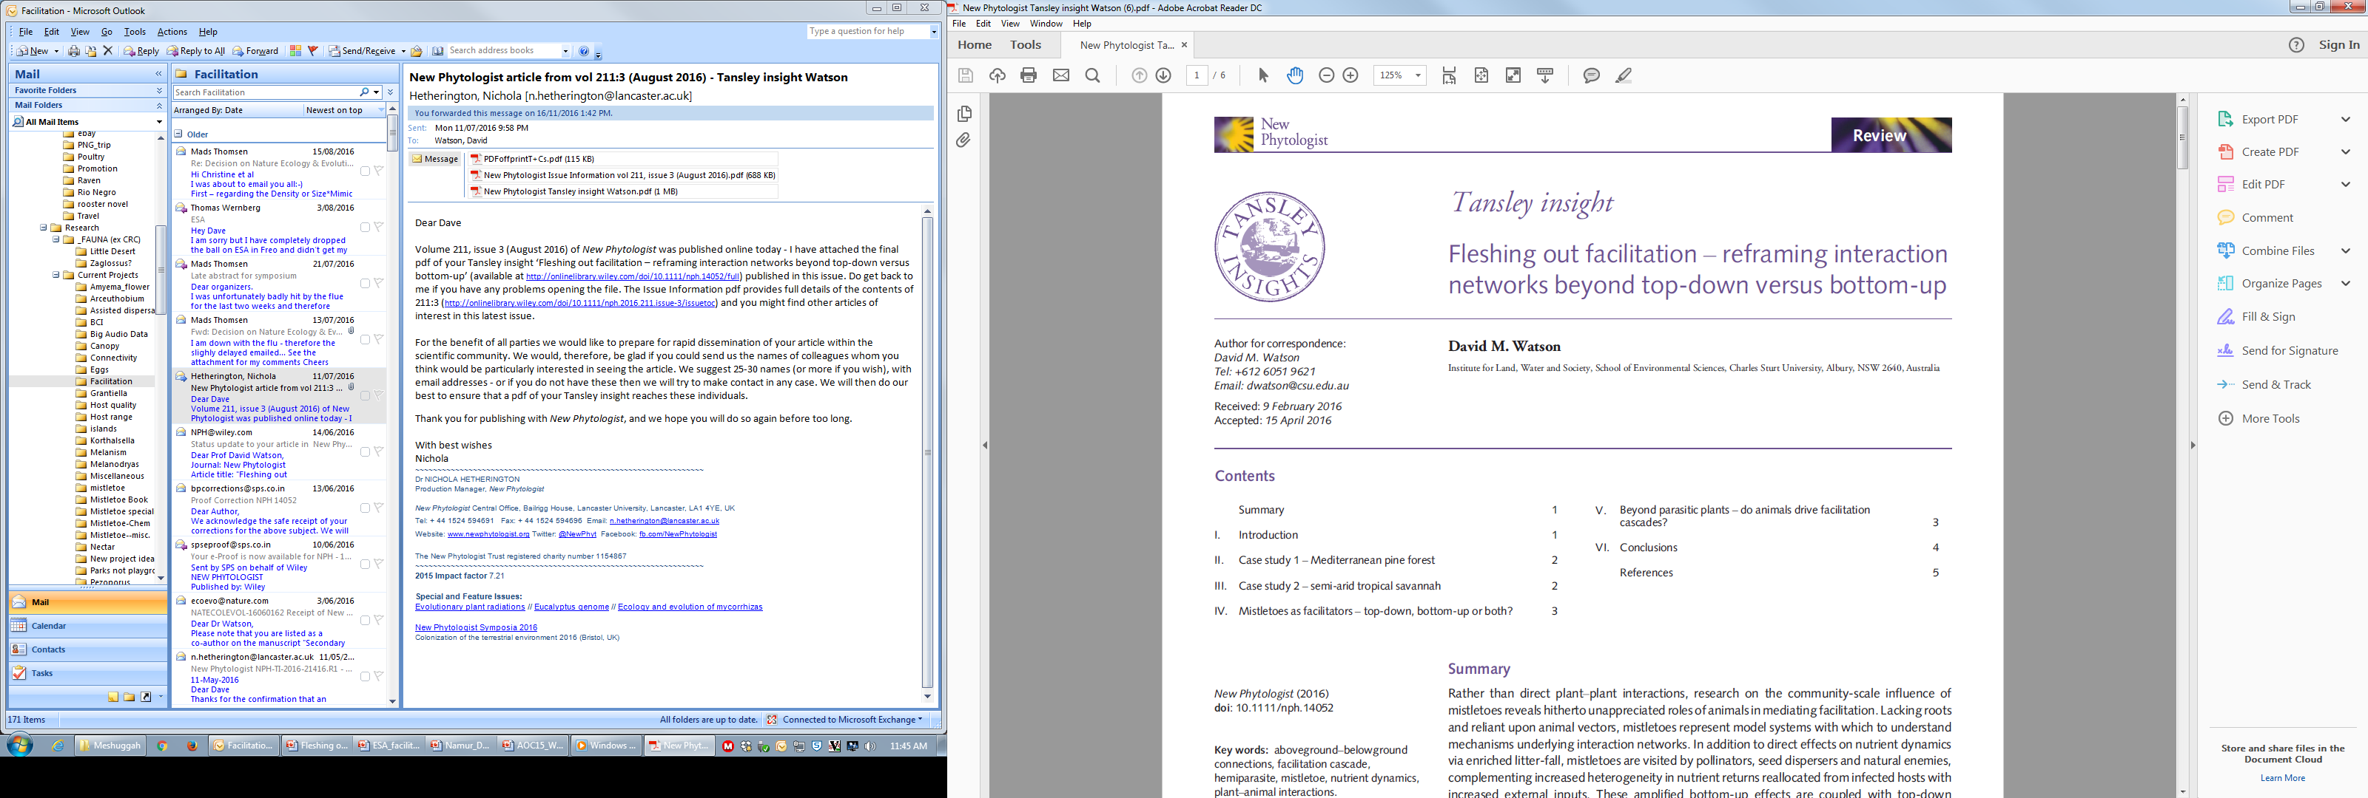
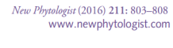
Mistletoe: dripping tap of enriched litter
More mistletoe = much more* litter
*Austral Ecology 35:713—21
Mistletoe litter has far more* nutrients
*Oecologia 154:339—47

Slide 12
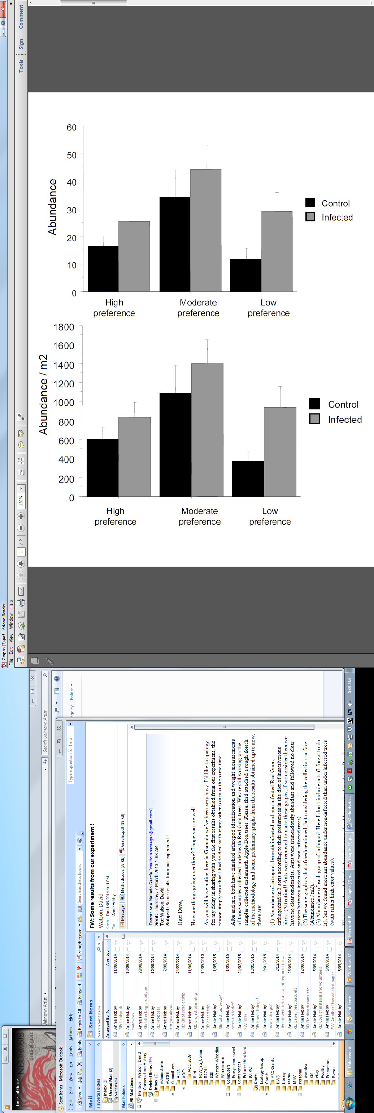
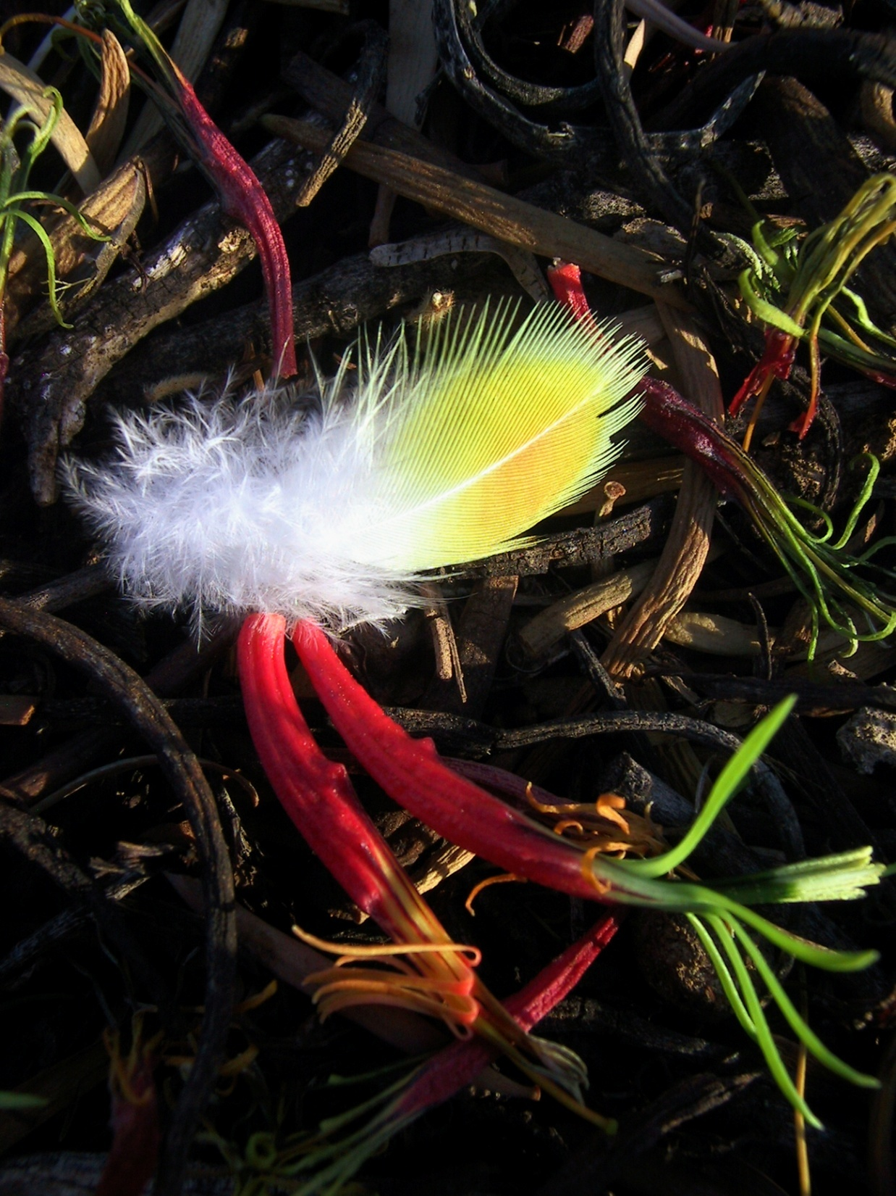
‘Tasties’
Mistletoe boosts bugs
20 pairs of infected and uninfected eucalypts (2 spp)
8 pitfalls per tree open for 38 days
Arthropods identified to order
  Grouped by preference
Significant overall difference
  1,120 more insects per m²
Mellado García, Hobby & Watson, in review

Slide 13
Mistletoe boosts bugs
20 pairs of infected and uninfected eucalypts (2 spp)
8 pitfalls per tree open for 38 days
Arthropods identified to order
  Grouped by preference
Significant overall difference
  1,120 more insects per m²
= 2.5 million more tasties per ha
Mellado García, Hobby & Watson, in review

Slide 14
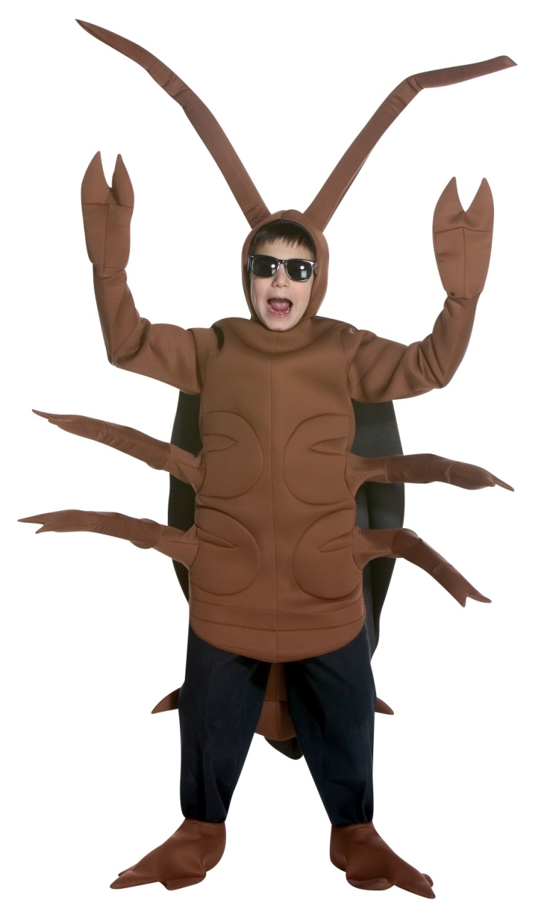
Mistletoe boosts bugs
20 pairs of infected and uninfected eucalypts (2 spp)
8 pitfalls per tree open for 38 days
Arthropods identified to order
  Grouped by preference
Significant overall difference
  1,120 more insects per m²
= 2.5 million more tasties per ha
Mellado García, Hobby & Watson, in review

Slide 15
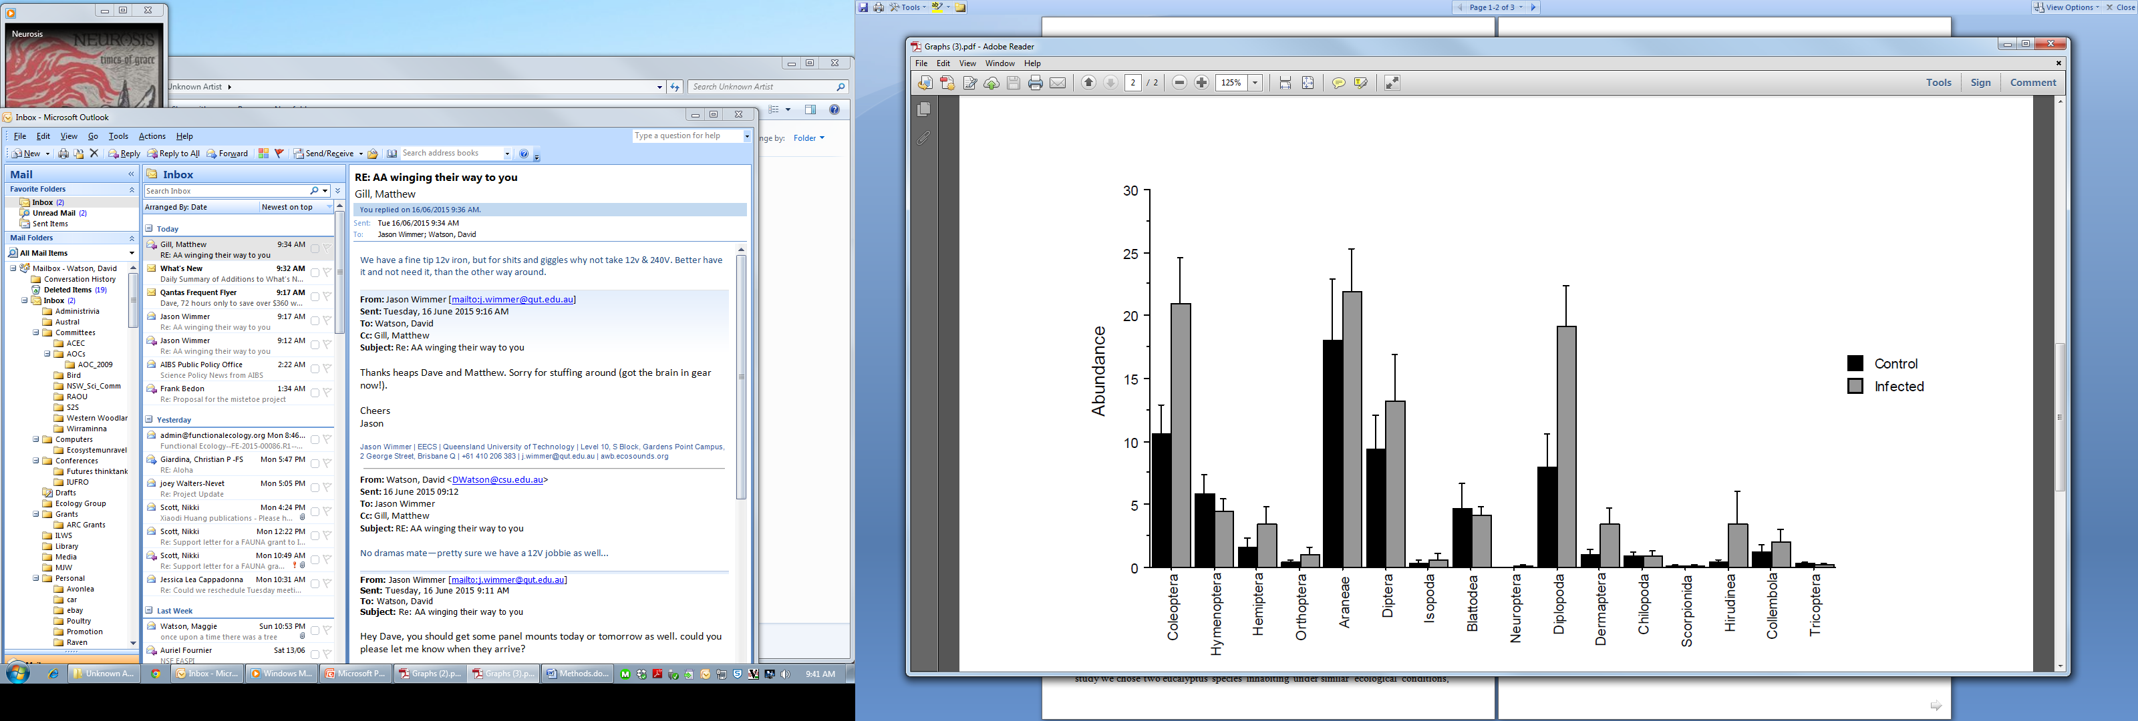


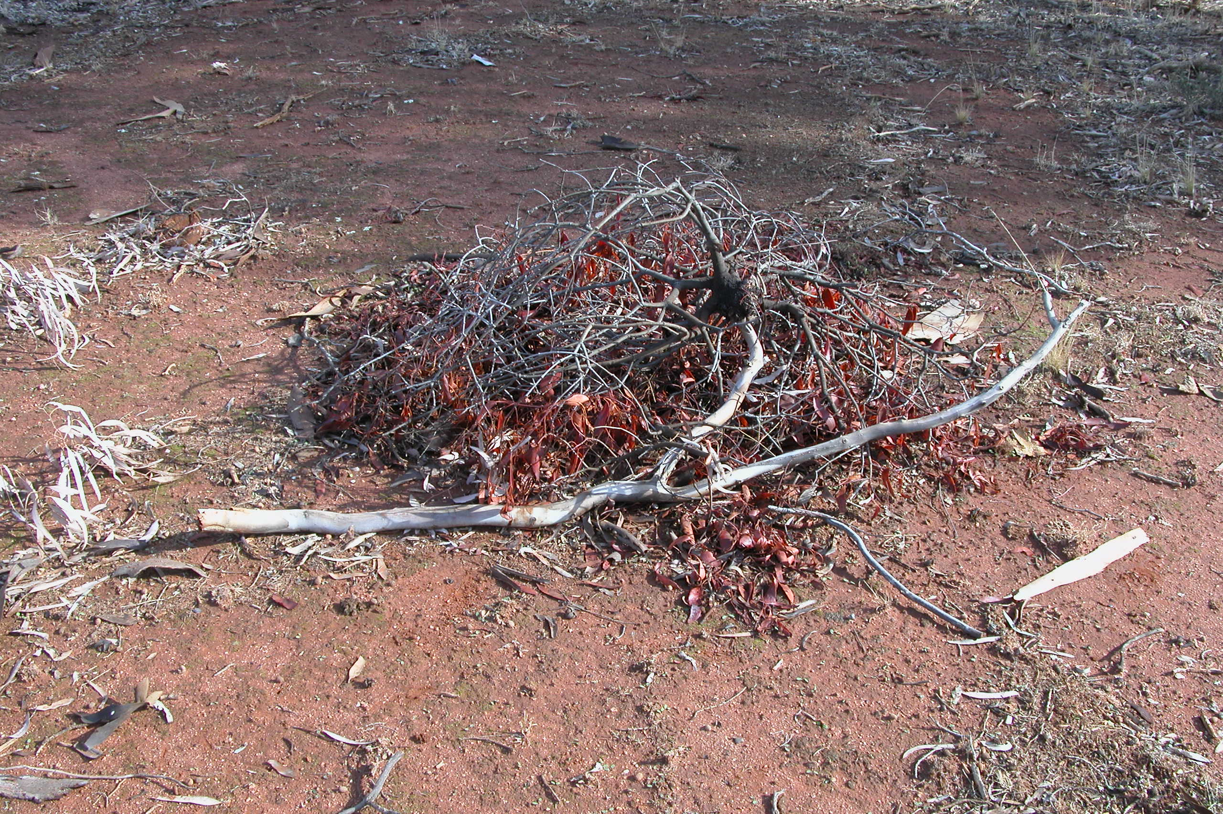


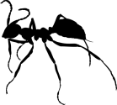
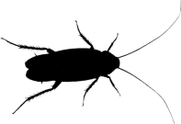
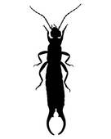



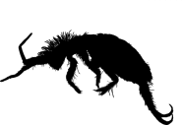





‘Litter-bugs’ = ecosystem amplifiers

Slide 16
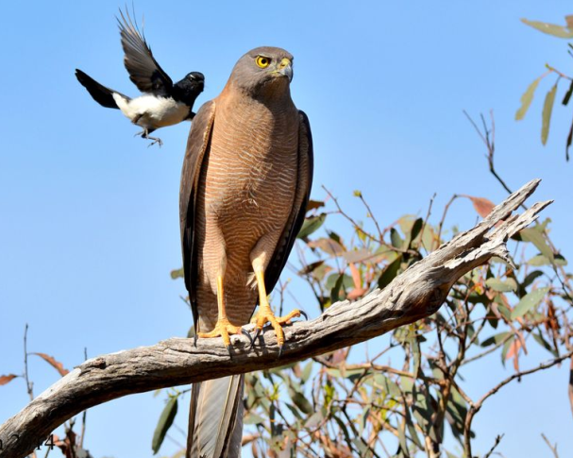
Mistletoe boosts bird diversity
Significant differences between treatment & control sites*; -20.9% vs. +4.7% (p=0.004); -26.5% vs. +10.2% (p=0.002)
net effect of removing mistletoe: lose 36.7% of original bird species in 3 years
*Proc Royal Soc B 279: 3853—60
Mistletoe-free Control Treatment

Slide 17
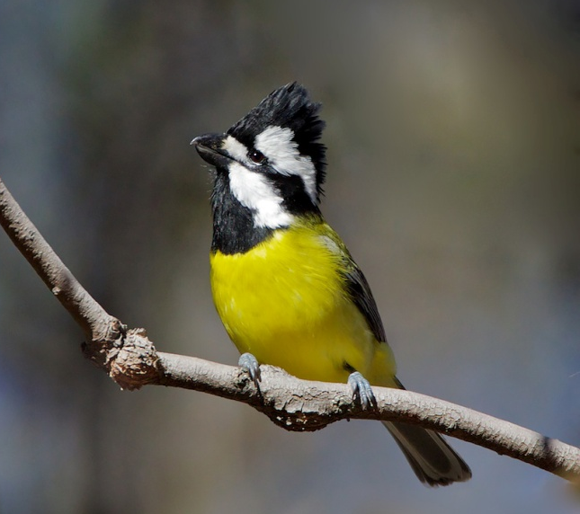
Mistletoe affects insectivores...
*PLOS One 10: e0142992
Mistletoe-free Control Treatment

Slide 18
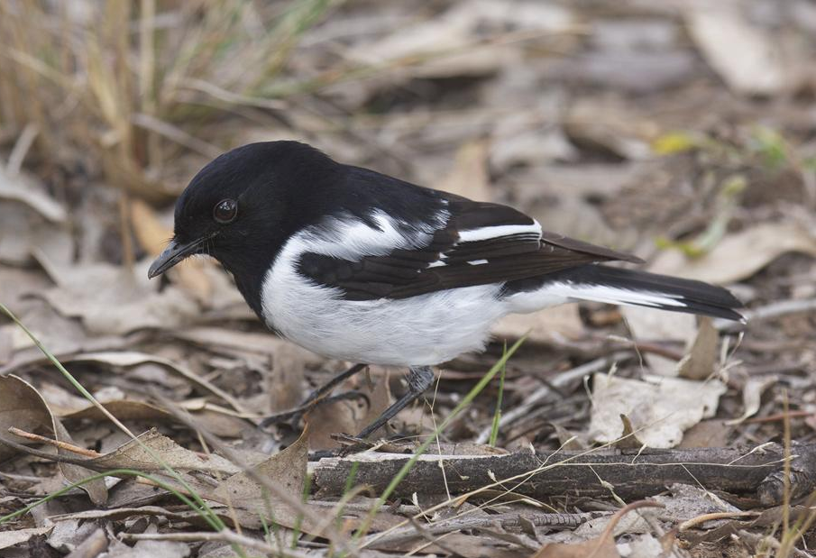
... especially ground foragers
Mistletoe-free Control Treatment
*PLOS One 10: e0142992

Slide 19
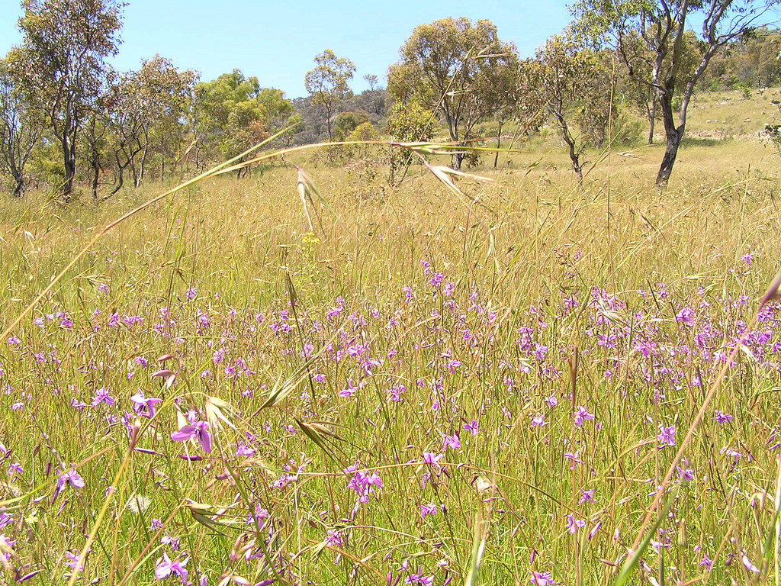
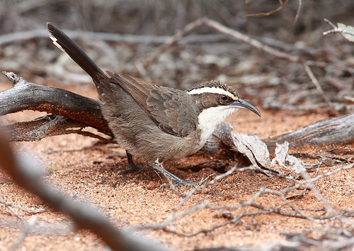

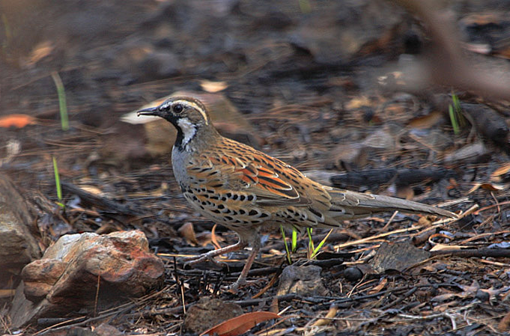

Slide 20
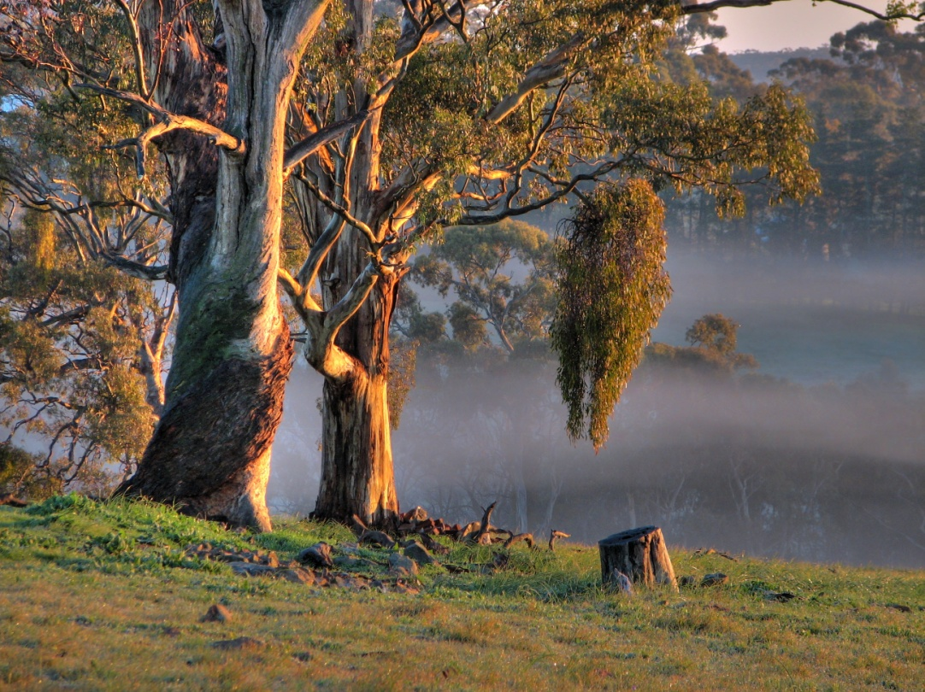
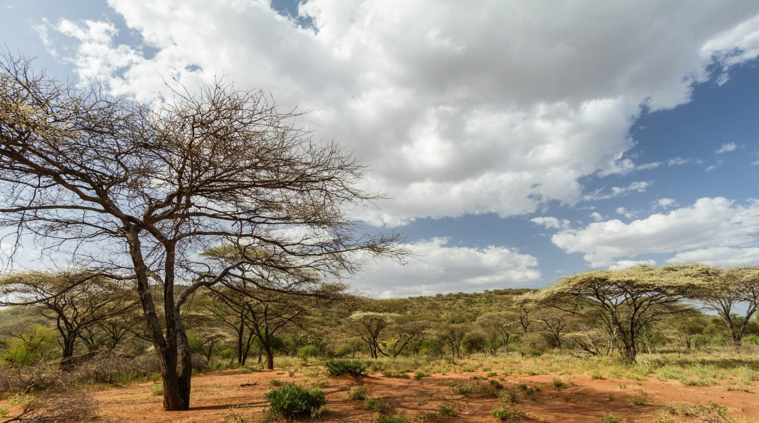
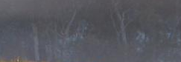

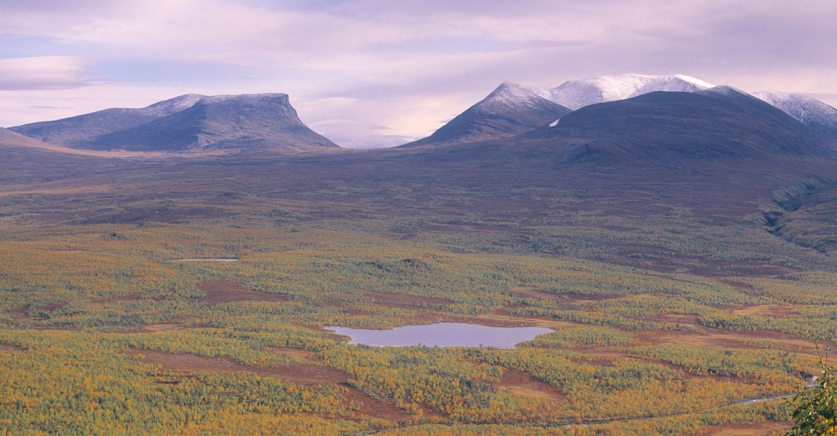
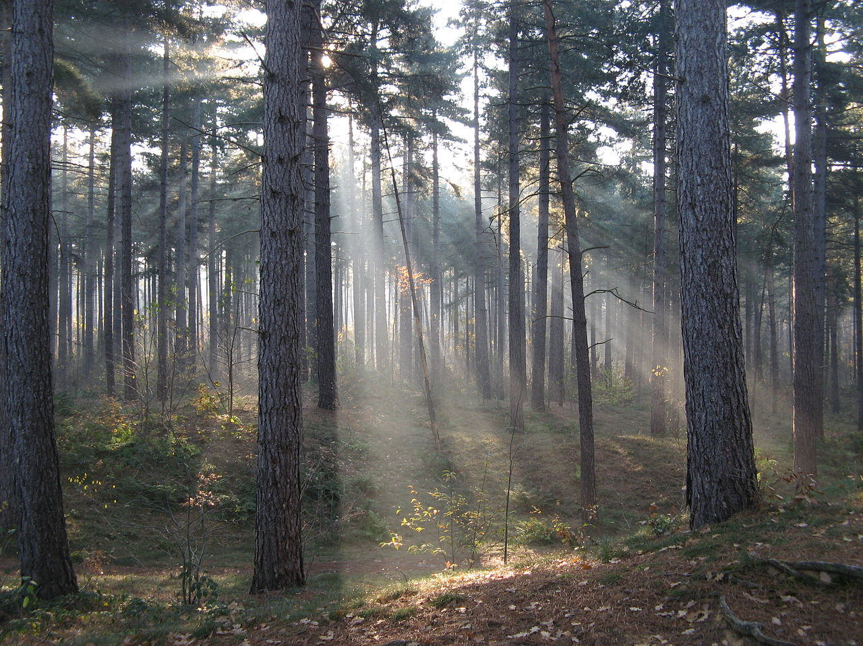

Slide 21
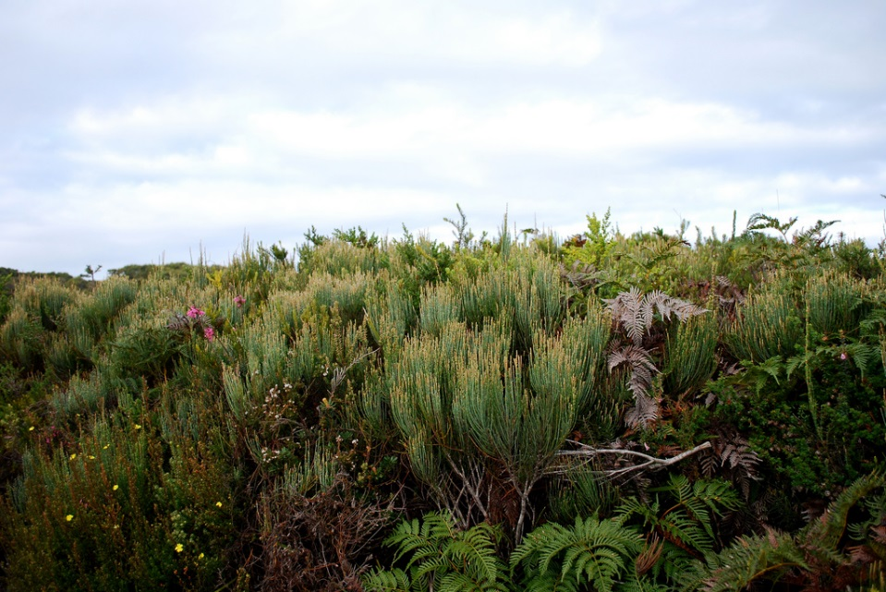
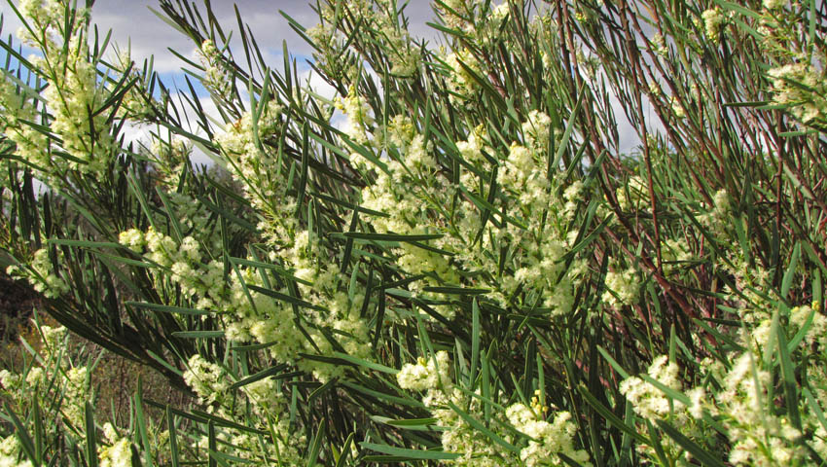
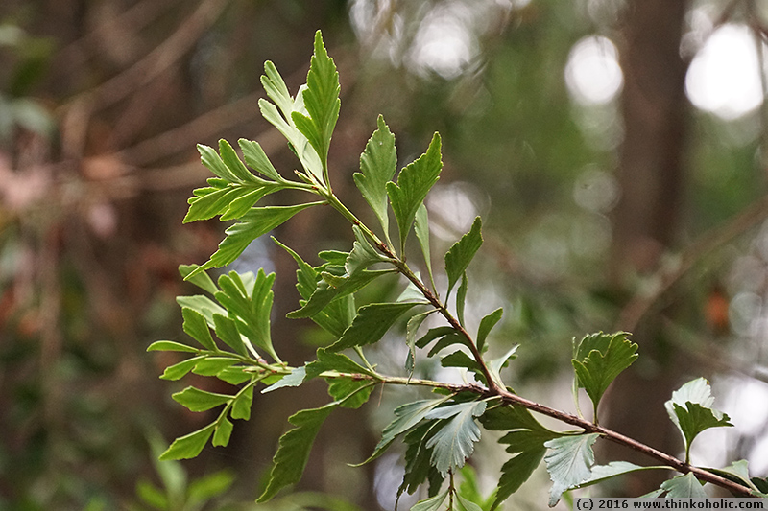
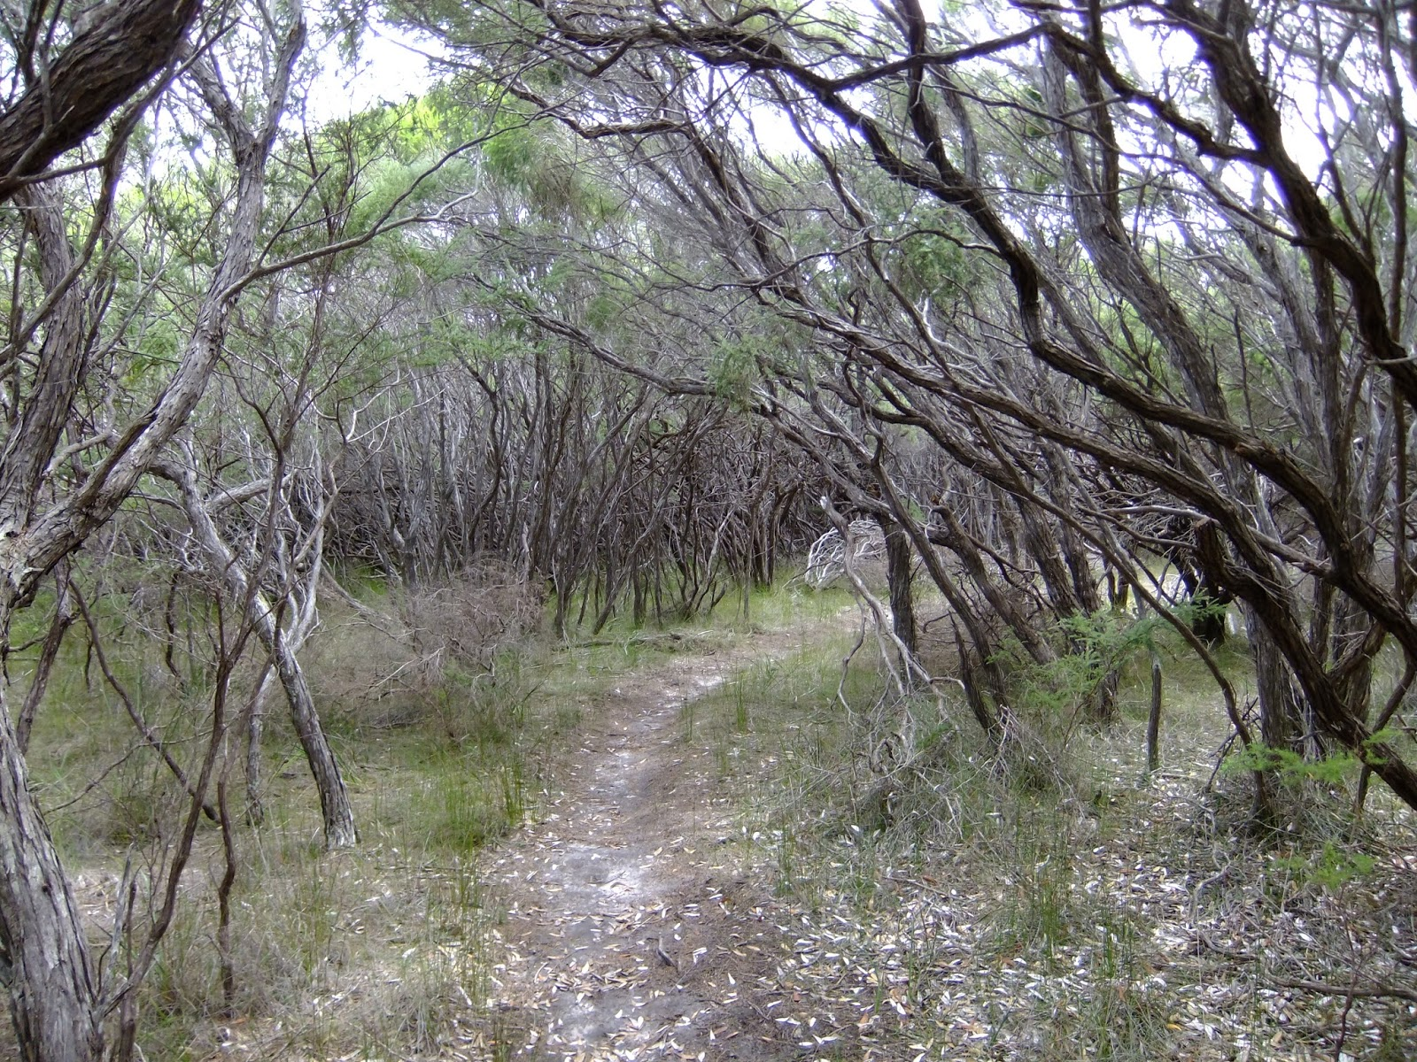

Slide 22
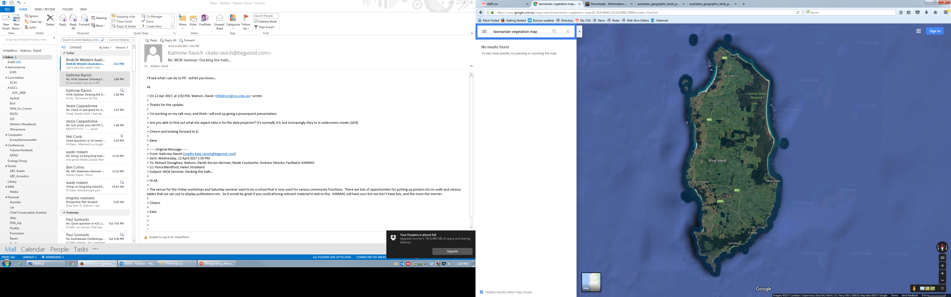
Reduce risk of extinction; increase resilience of populations; increase species richness

Slide 23
Reduce risk of extinction; increase resilience of populations; increase species richness
On ground actions to manage & restore connectivity (eg plant a corridor, manage scattered trees

Slide 24
Reduce risk of extinction; increase resilience of populations; increase species richness
?
On ground actions to manage & restore connectivity (eg plant a corridor, manage scattered trees

Slide 25
Reduce risk of extinction; increase resilience of populations; increase species richness
Long-term viability & evolutionary potential of species x, y, z in the landscape
Long
term outcomes
Actions
Actions to manage & restore connectivity (eg plant a corridor, manage scattered trees

Slide 26
Reduce risk of extinction; increase resilience of populations; increase species richness
Long-term viability & evolutionary potential of species x, y, z in the landscape
Long
term outcomes
Maintain / increase within- population movements, eg daily foraging
Maintain / increase among-population movements, eg dispersal
Maintain / increase whole-of--population movements, eg migration
Immediate outcomes
Actions
Actions to manage & restore connectivity (eg plant a corridor, manage scattered trees

Slide 27
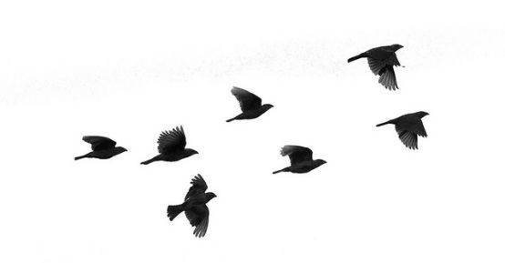
Reduce risk of extinction; increase resilience of populations; increase species richness
Long-term viability & evolutionary potential of species x, y, z in the landscape
Long
term outcomes
Maintain / increase within- population movements, eg daily foraging
Maintain / increase among-population movements, eg dispersal
Maintain / increase whole-of--population movements, eg migration
Immediate outcomes
Actions
Actions to manage & restore connectivity (eg plant a corridor, manage scattered trees

Slide 28
Reduce risk of extinction; increase resilience of populations; increase species richness
Long-term viability & evolutionary potential of species x, y, z in the landscape
Long
term outcomes
?
?
?
Maintain / increase within- population movements, eg daily foraging
Maintain / increase among-population movements, eg dispersal
Maintain / increase whole-of -population movements, eg migration
Immediate outcomes
Actions
Actions to manage & restore connectivity (eg plant a corridor, manage scattered trees

Slide 29
Reduce risk of extinction
Long-term viability & evolutionary potential
Long
term outcomes
Population growth
Genetic structure & variability
Inter mediate outcomes
Immigration & Emigration =dispersal rate
Birth rates
Death rates
Immediate outcomes
Increase within- population movements
Increase among-population movements
Increase whole-of-population movements
Actions
Actions to manage & restore connectivity

Slide 30
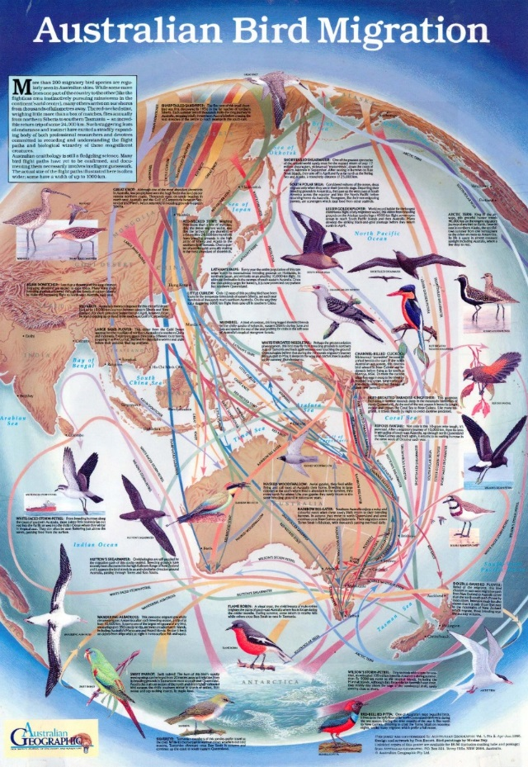

Slide 31
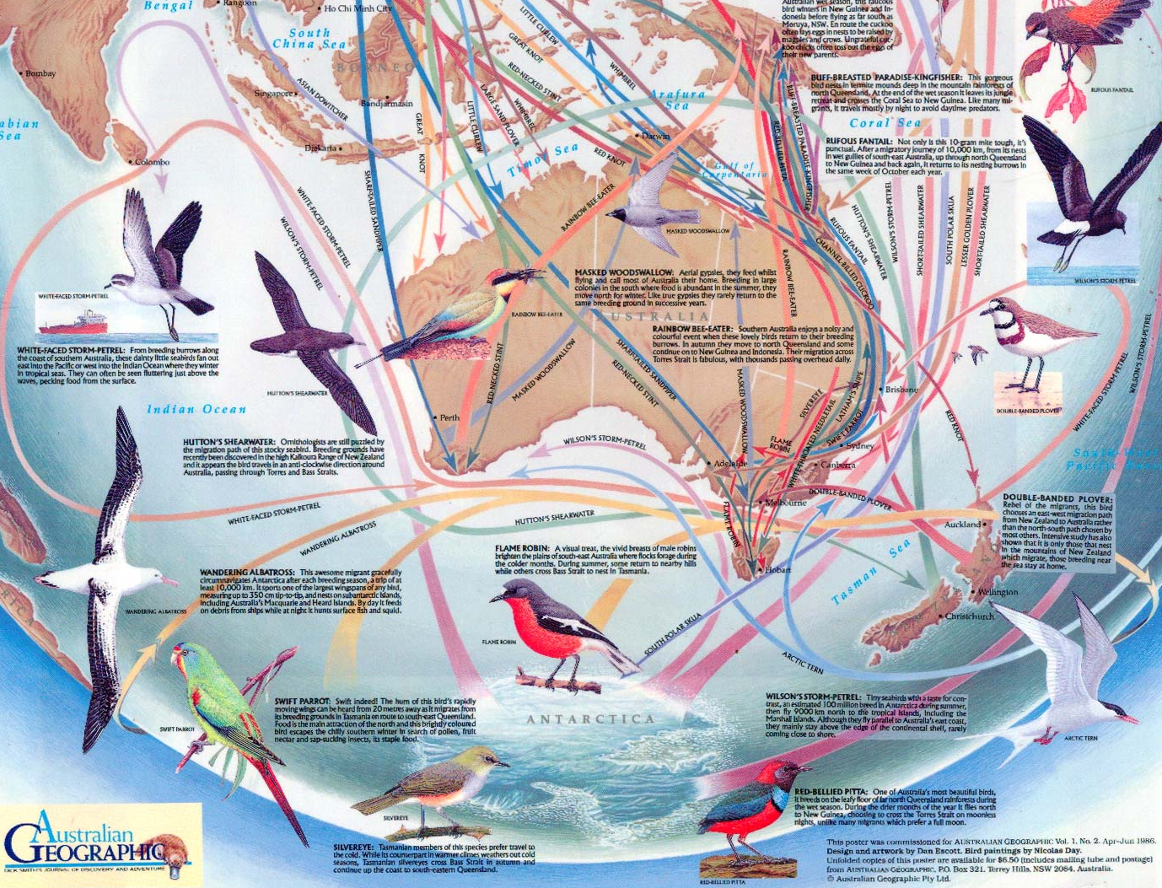

Slide 32


Slide 33
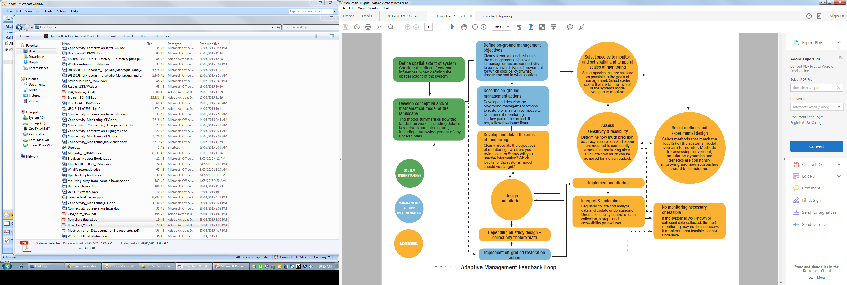

Slide 36

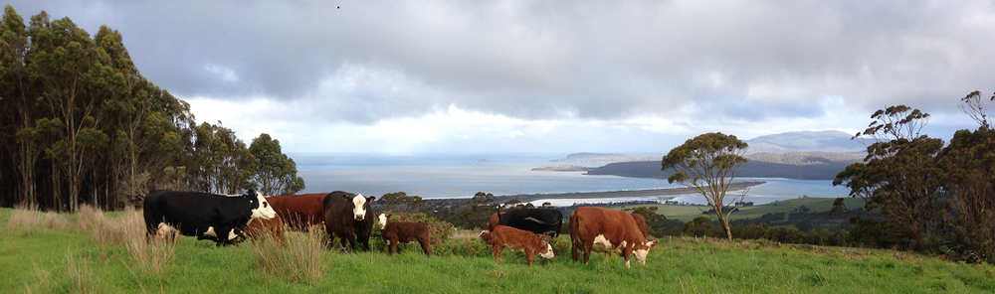

Slide 37
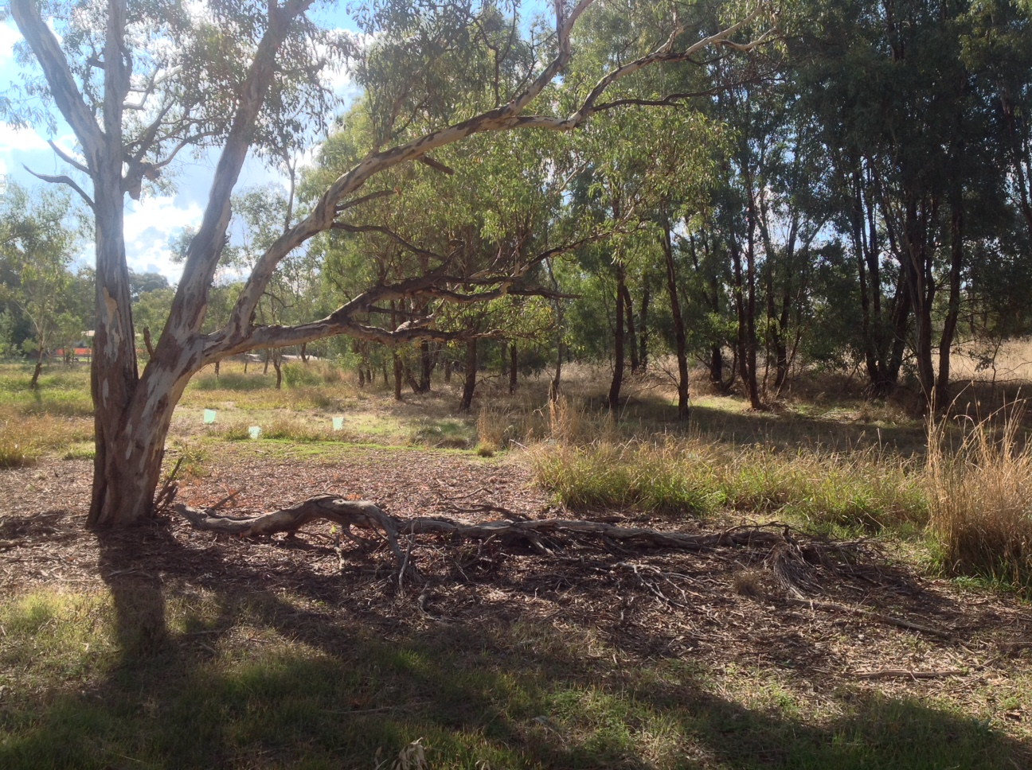

Slide 38
Diverse habitat
Messy

Slide 39
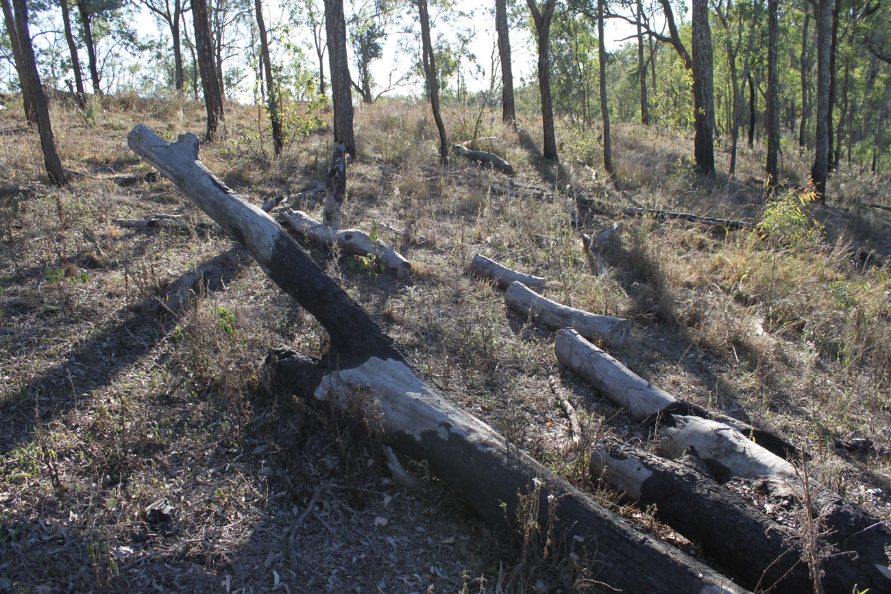

Slide 40
Coarse woody debris
Pest harbour

Slide 41

Facilitating recovery
Many landholders feel obliged to “tidy up” their farms
  Coarse woody debris = harbour pests
  Habitat-rich farms/gardens = messy
  Structural complexity = fuel load
  Shrubby understory = woody weeds
Consider litter as part of property plan
  Litter = carbon = soil = profits
  Another reason to conserve big old trees
  Reveg with Acacia, Casuarina, native conifers
Beyond declining birds to entire food webs
  quolls(?), potoroos, bats, lizards, frogs…

Slide 42







DIVERSE
@D0CT0R_Dave www.ecosystemunraveller.com

