Slide 1
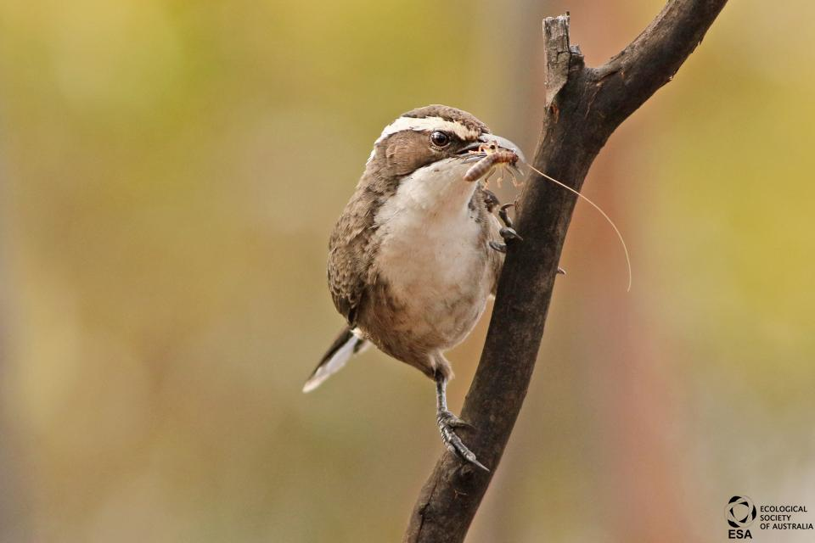


Measuring availability of litter-dwelling insects
David M Watson
Professor in Ecology
@D0CT0R_Dave

Slide 2
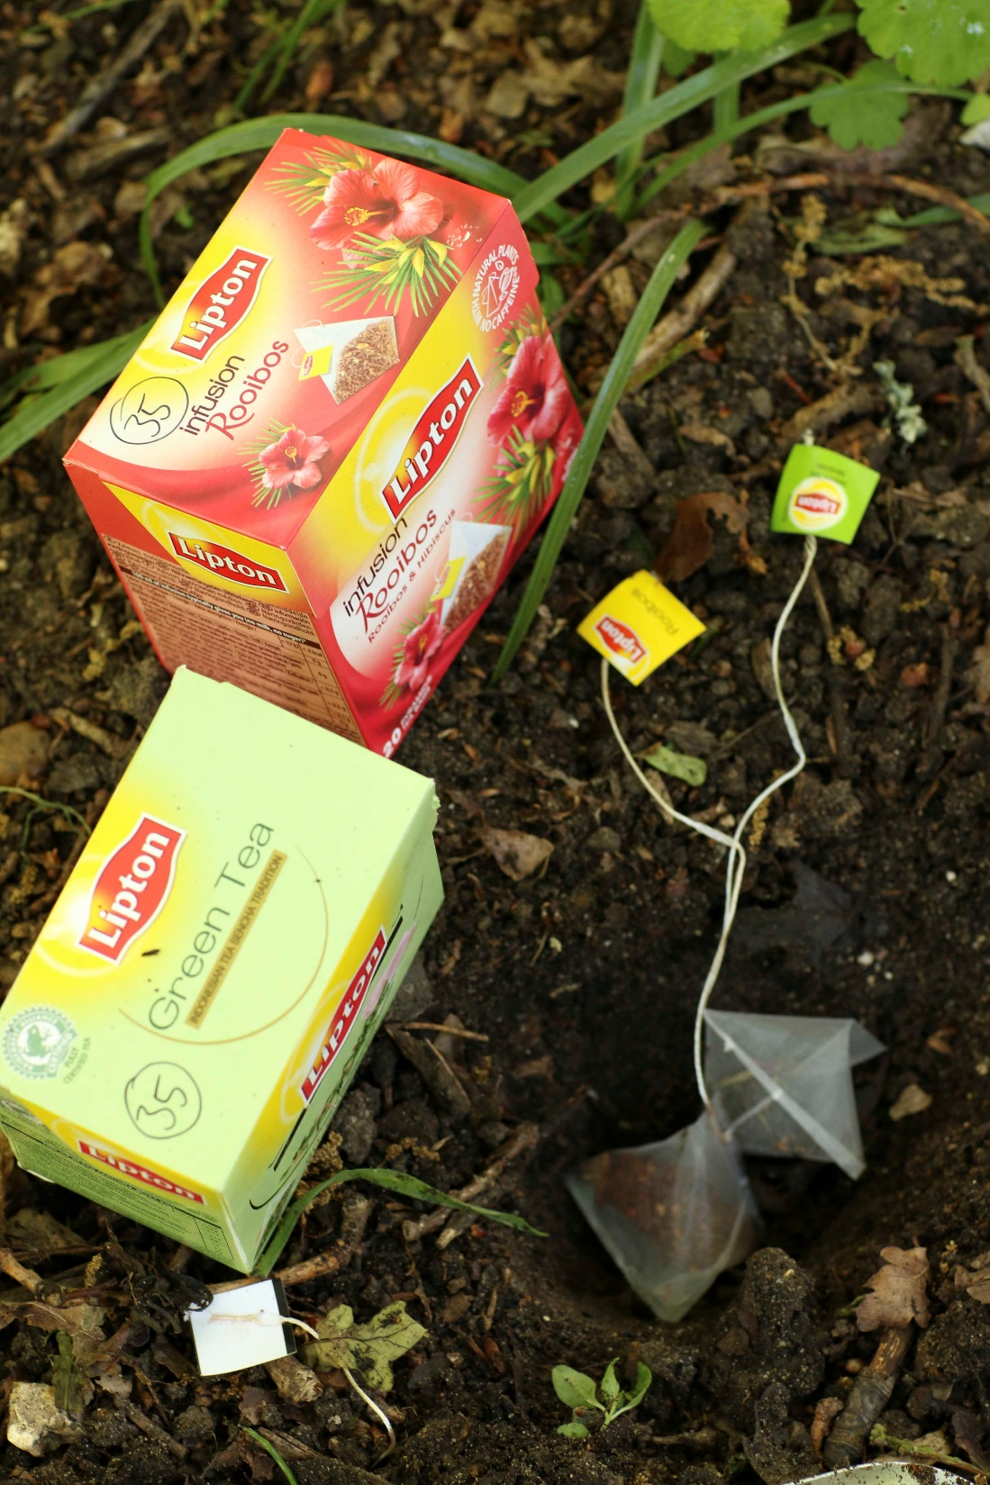
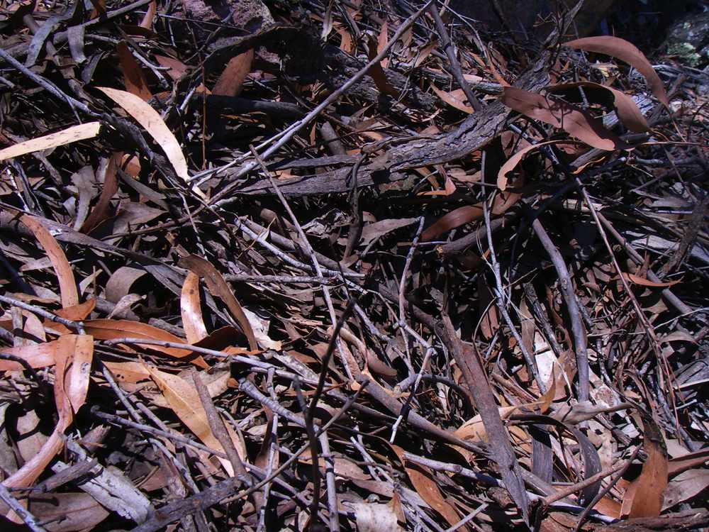
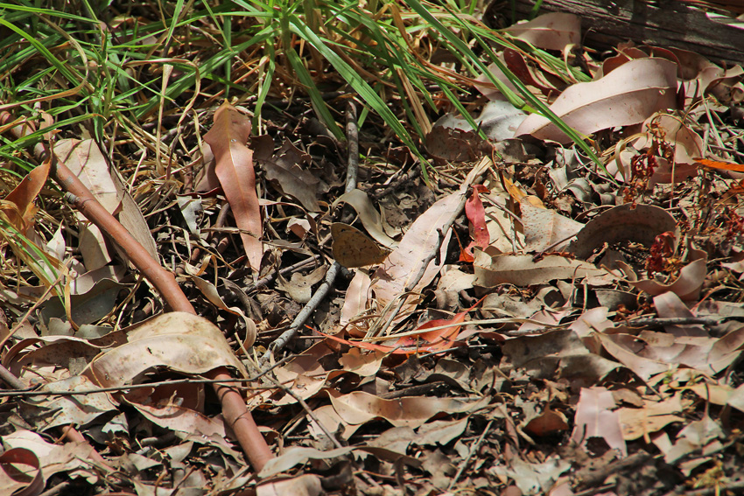

Slide 3
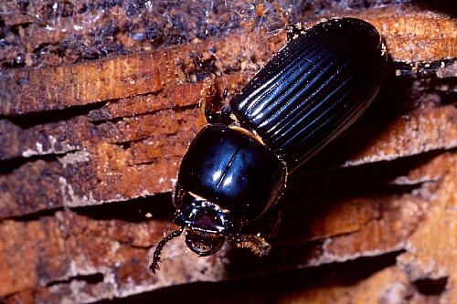
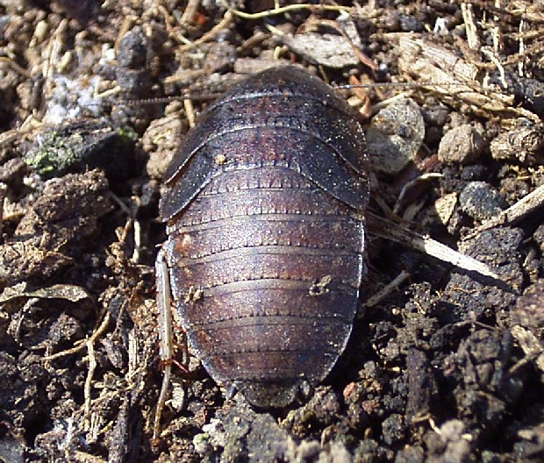
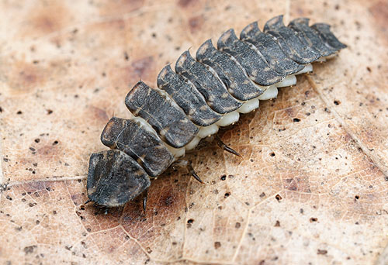
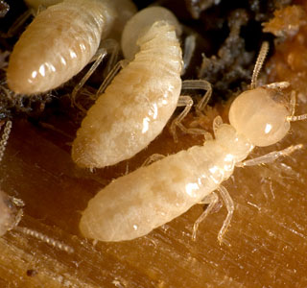

Slide 4
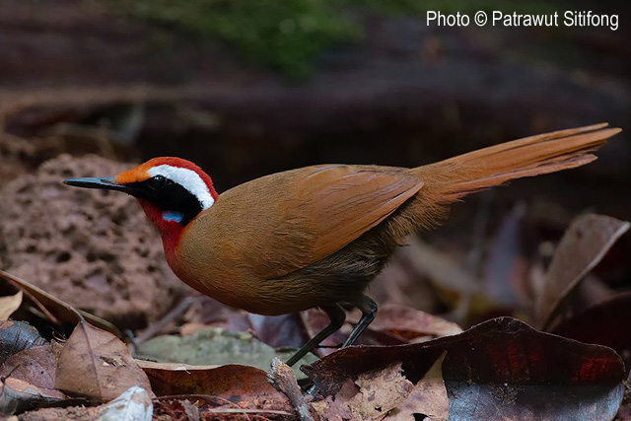

Slide 5
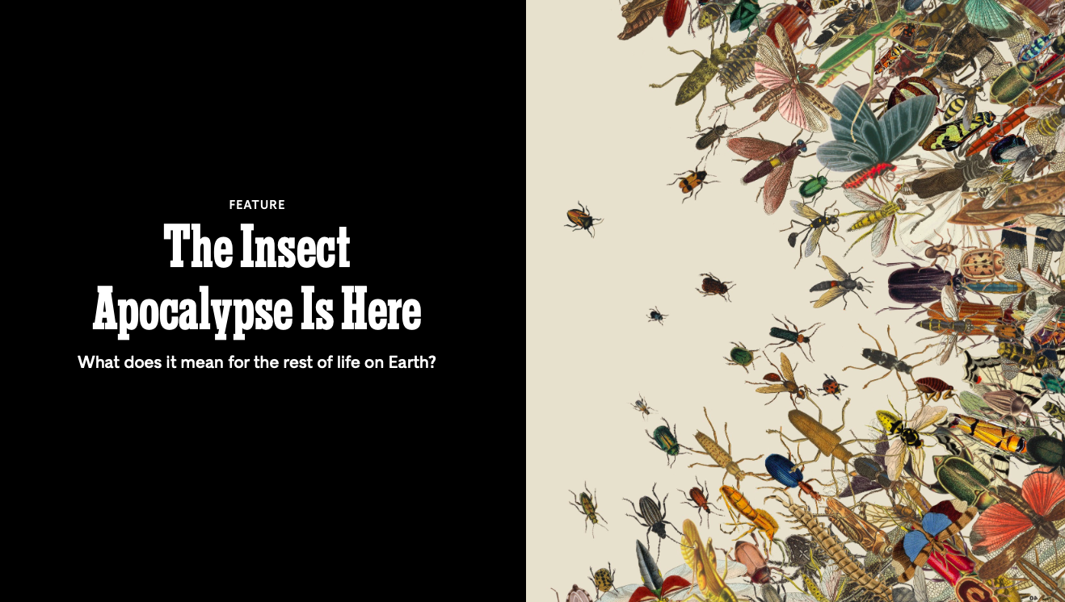

Slide 6
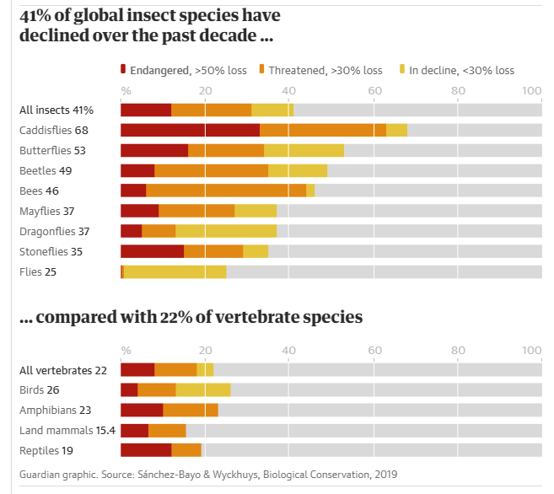

Slide 7
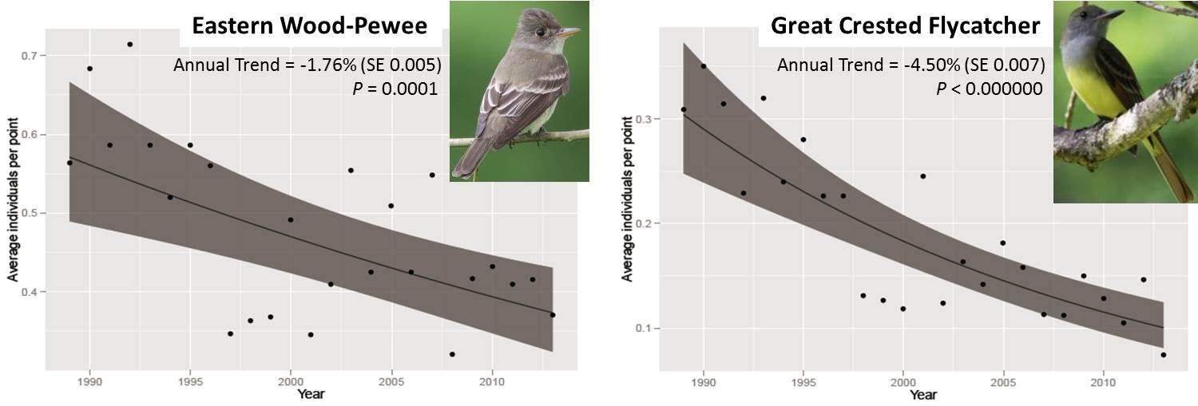

Slide 8


How many fruit ?

Slide 9
How many fruit ?
Five !

Slide 10

How many fruit ?
Five !

Slide 11
How many fruit ?
Five !
Ten !

Slide 12
How many fruit ?
Five !
Ten !
Standing crop
Total

Slide 13
How many fruit ?
Five !
Ten !
Standing crop
Total
Difference (5) = number consumed

Slide 14
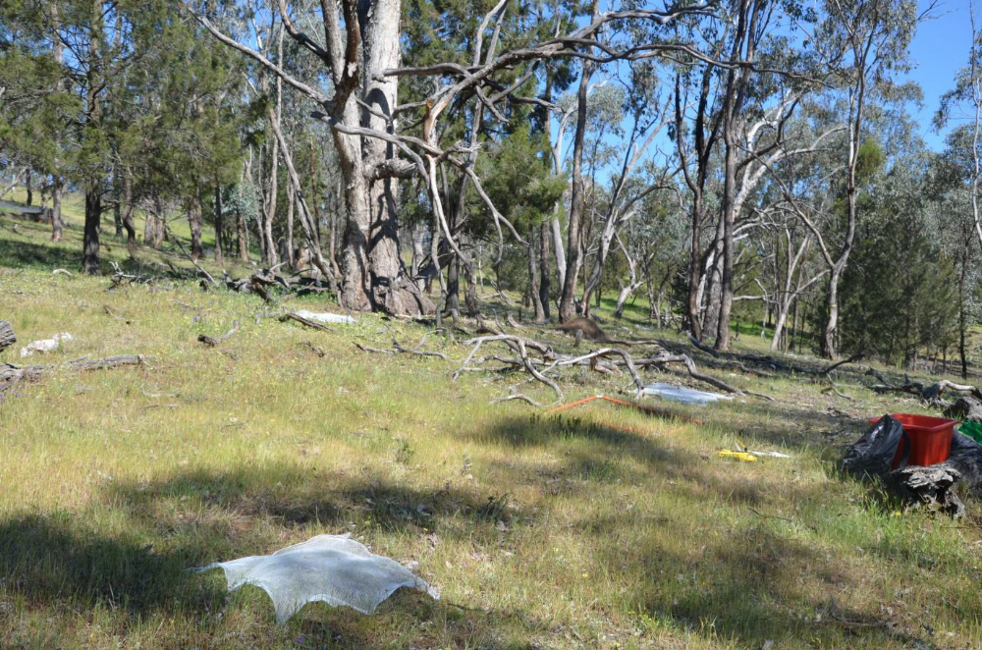
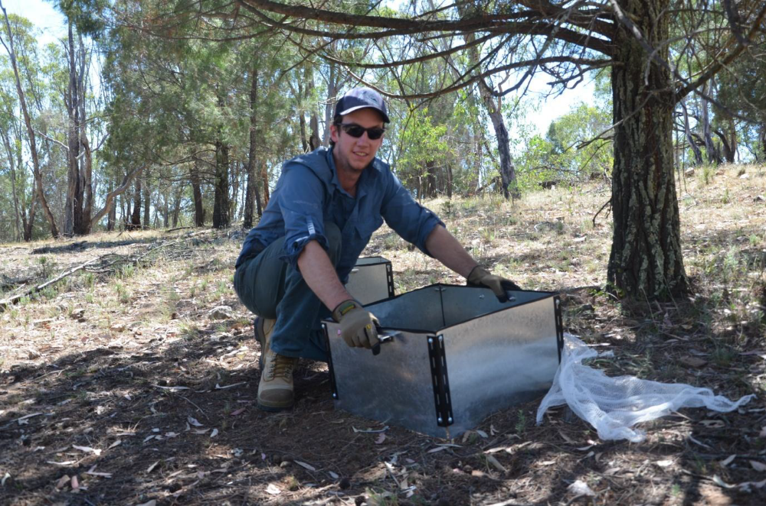
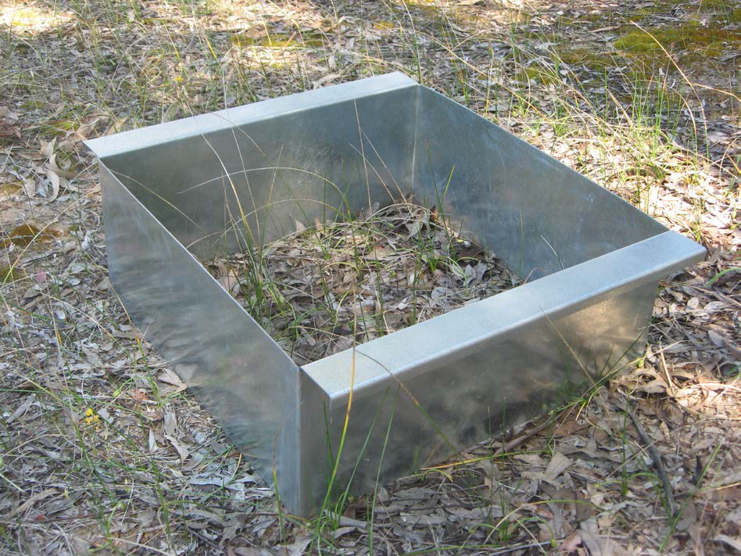
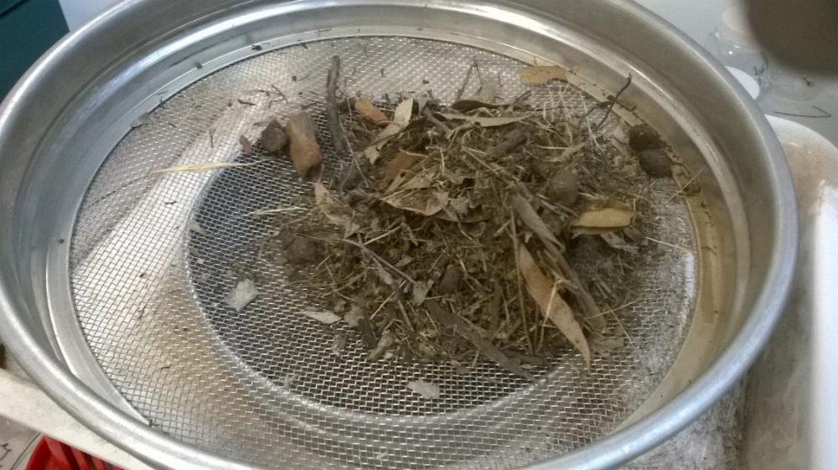

Slide 15
Insect abundance Grams per m² | Log | Dead tree | Live tree | Branch
Uncovered (standing crop) | 4.5 | 7.5 | 8.0 | 5.0
Covered (total) | 14.5 | 19.0 | 12.6 | 8.0
Difference (consumed) | 10.0 | 11.5 | 4.6 | 3.0
Insects (standing crop): live tree > dead tree > branch > log
Insectivory (consumed): dead tree > log > live tree > branch

Slide 16
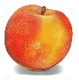




How many fruit ?
What kind of fruit ?

Slide 17
What kind of fruit ?
Frugivores preferentially consume larger fruit

Slide 18
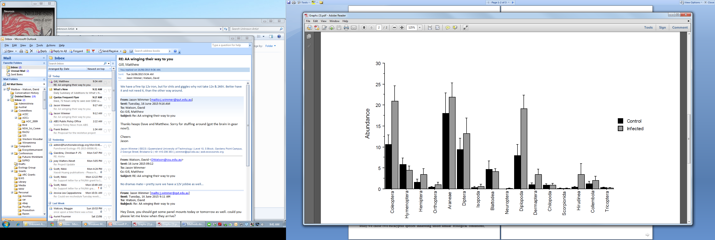





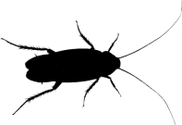
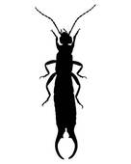









Preferential consumption
Beside exclosure
Beneath exclosure
Mellado García, Hobby, Lázaro-González & Watson, in press

Slide 19


Litter bugs matter!
@D0CT0R_Dave
Mellado García, Hobby, Lázaro-González & Watson, in press

