Slide 1
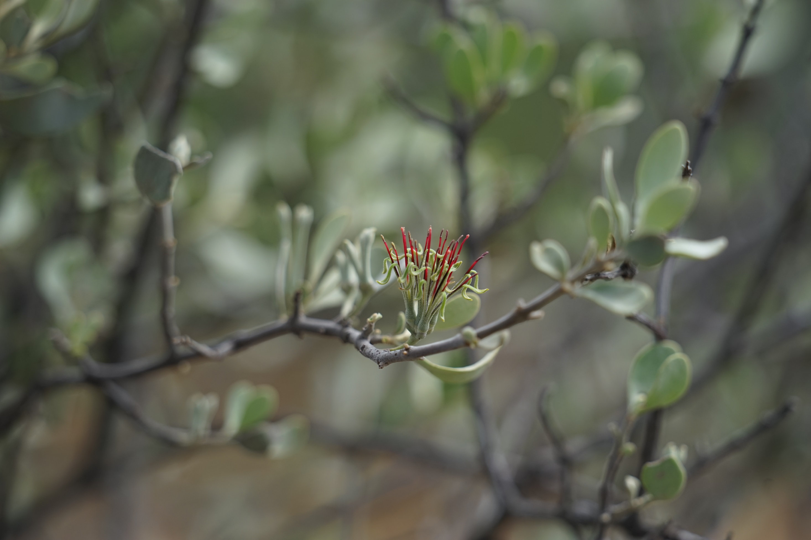


Who brought the first mistletoes to the tree-tops?
David M Watson
Professor of Ecology
Charles Sturt University
@D0CT0R_Dave

Slide 2
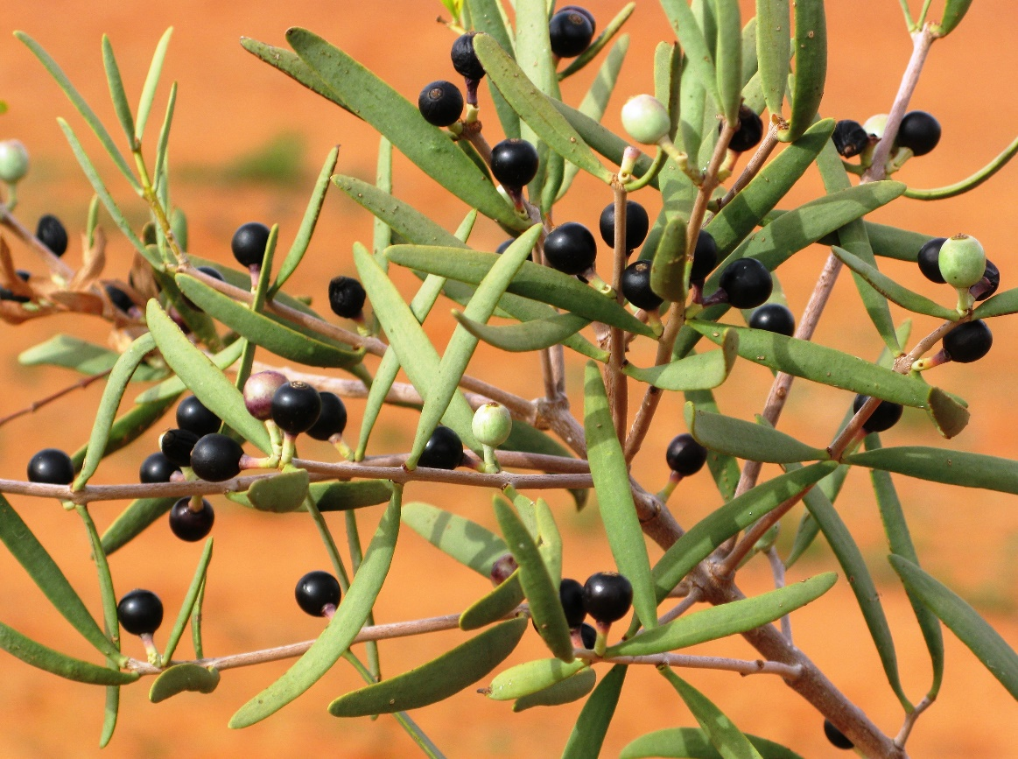
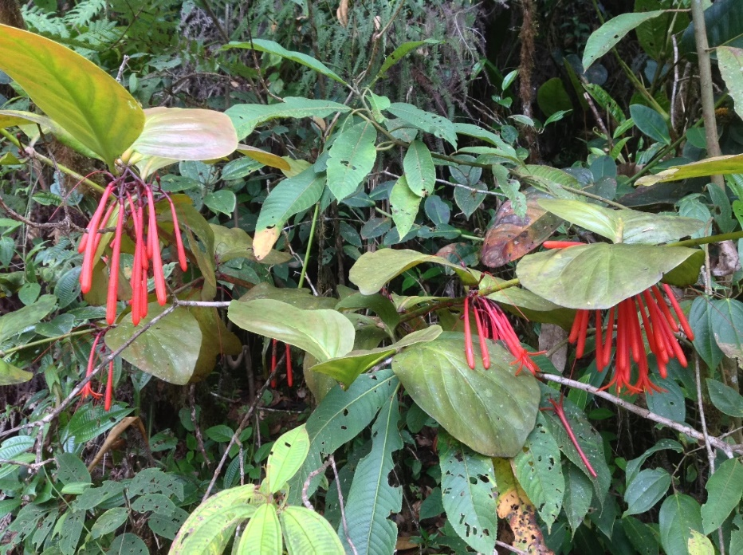
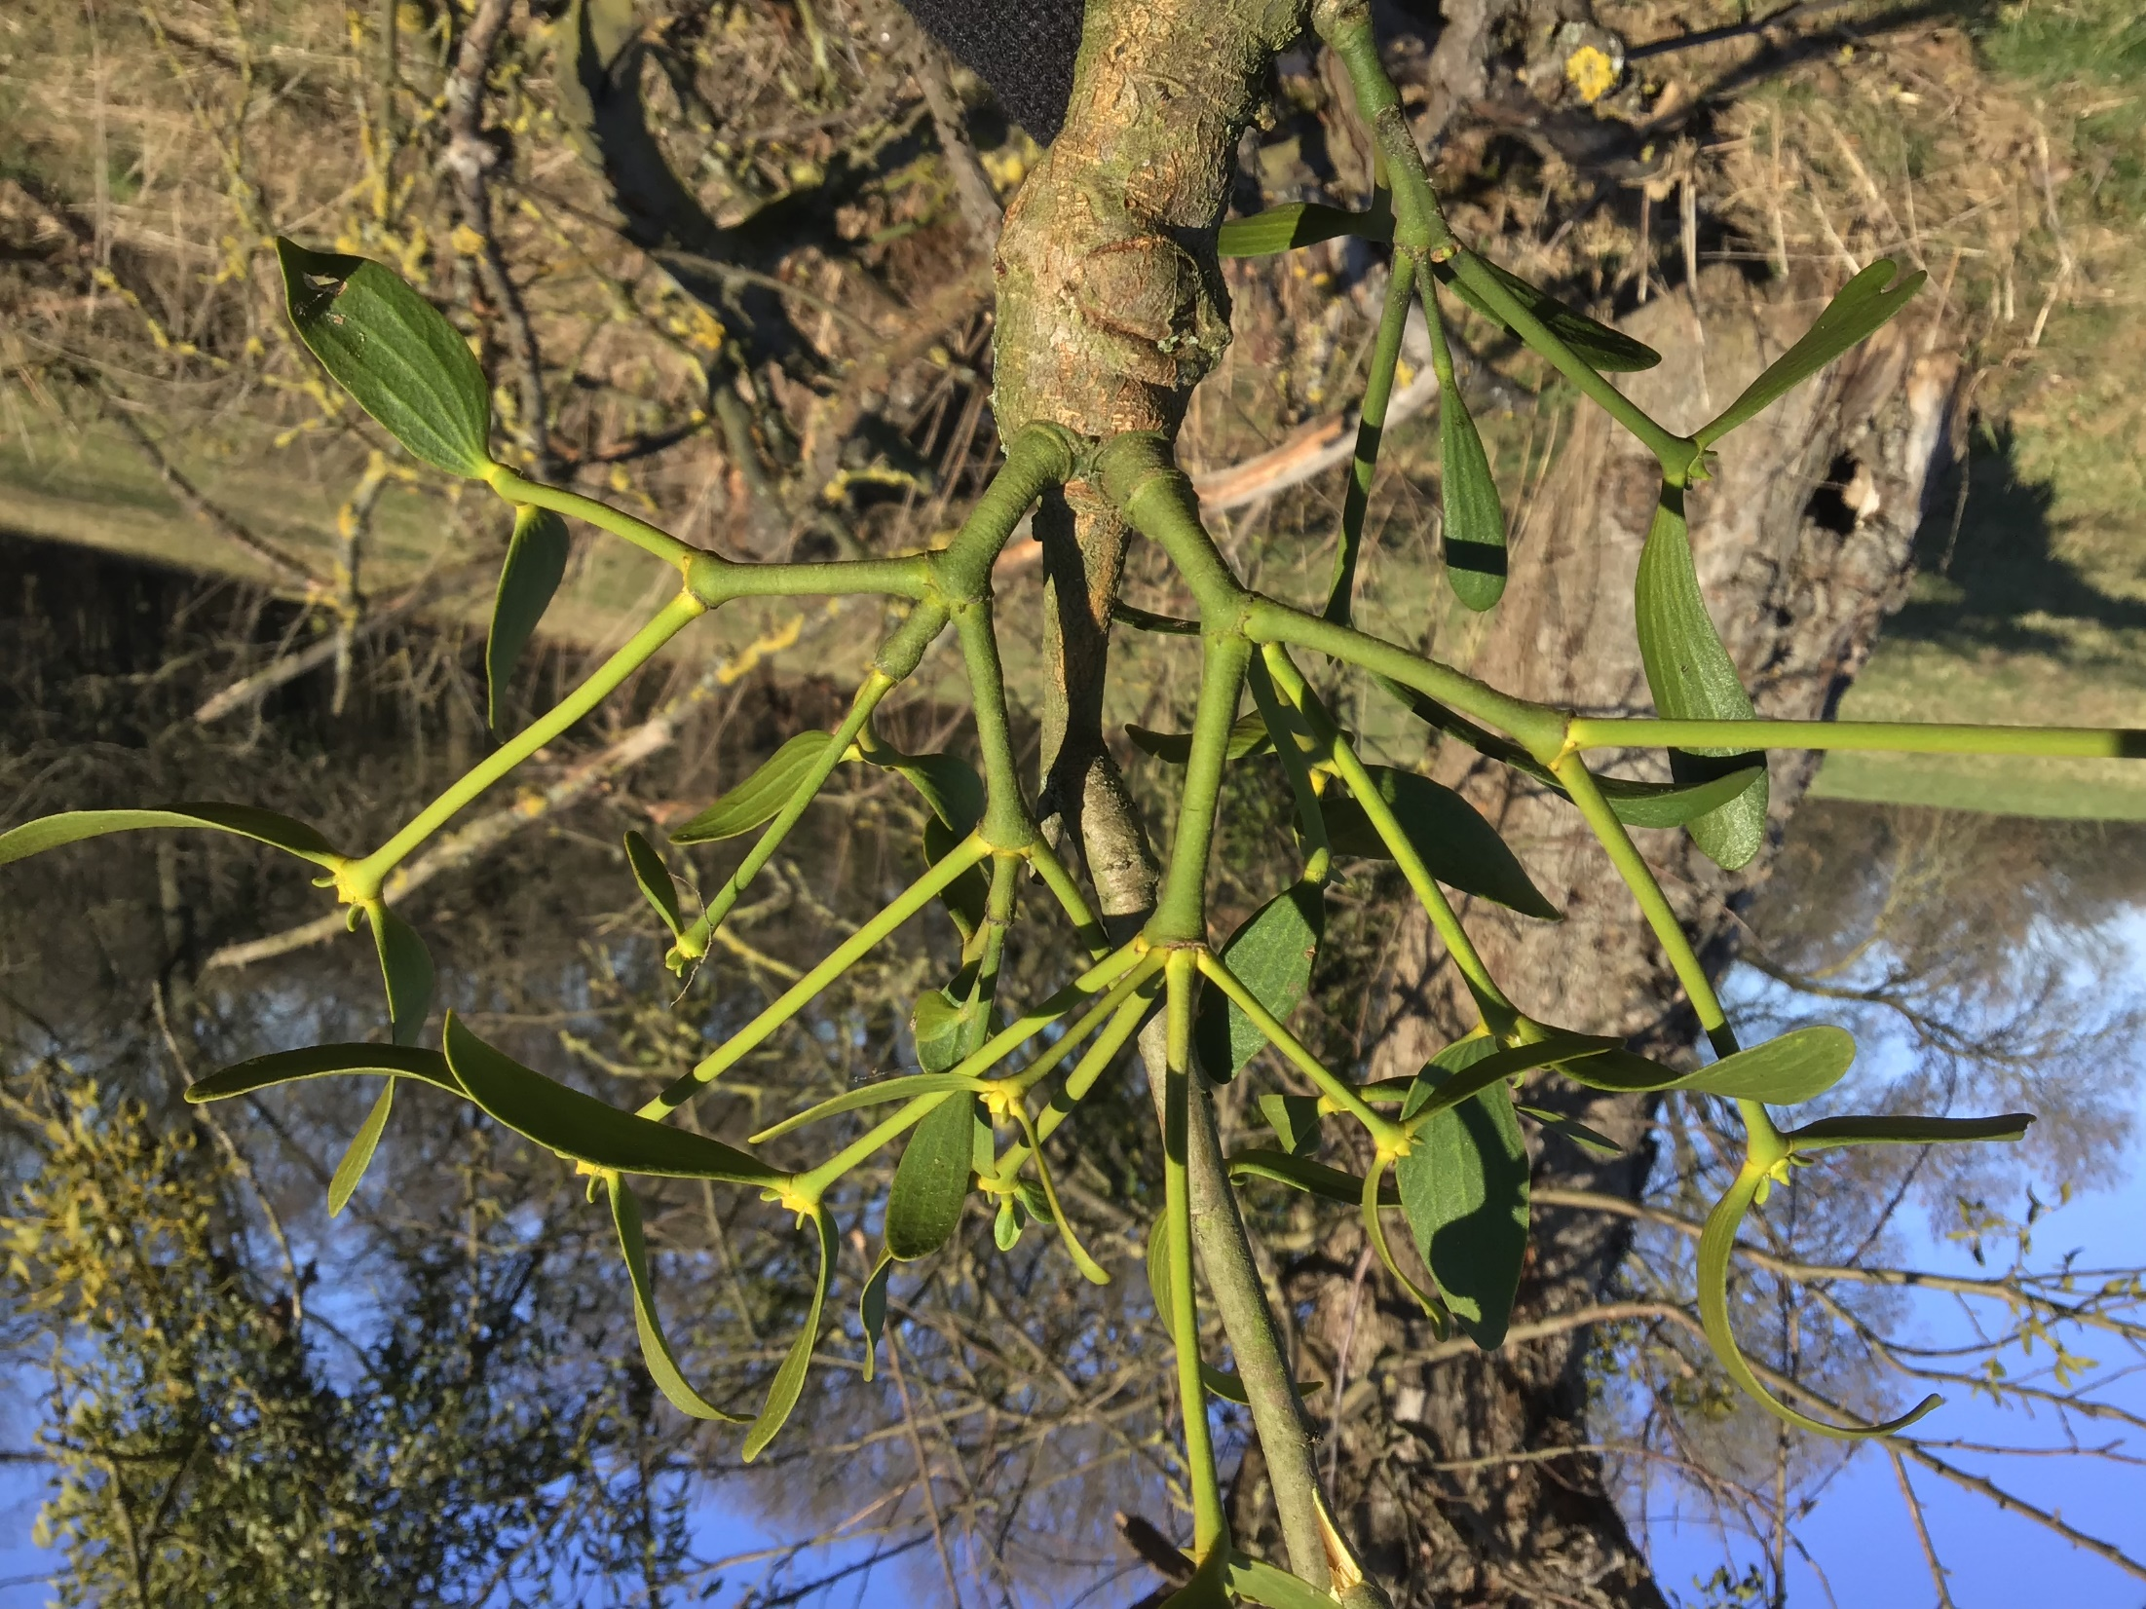
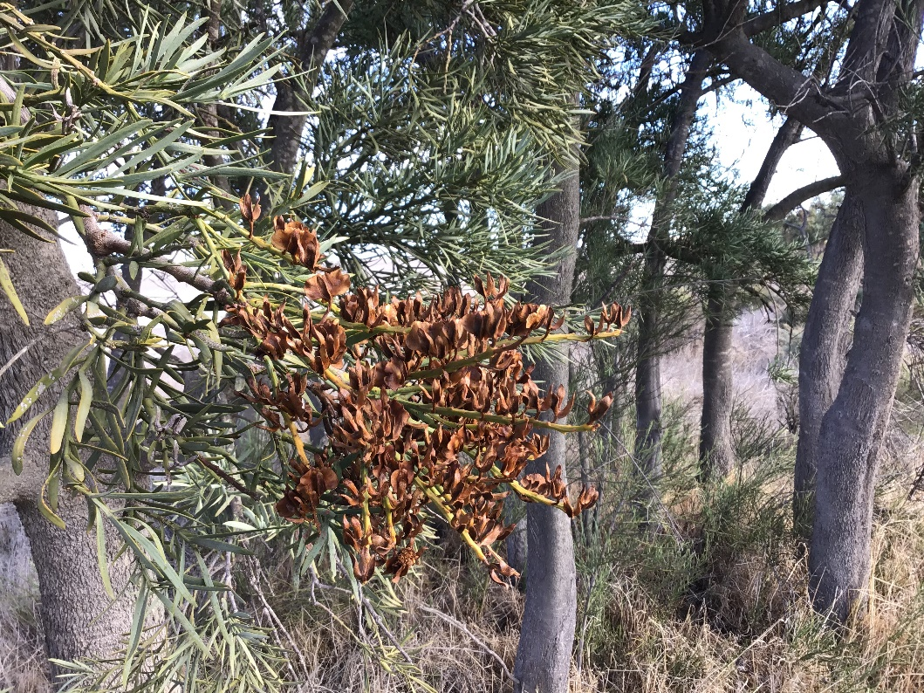
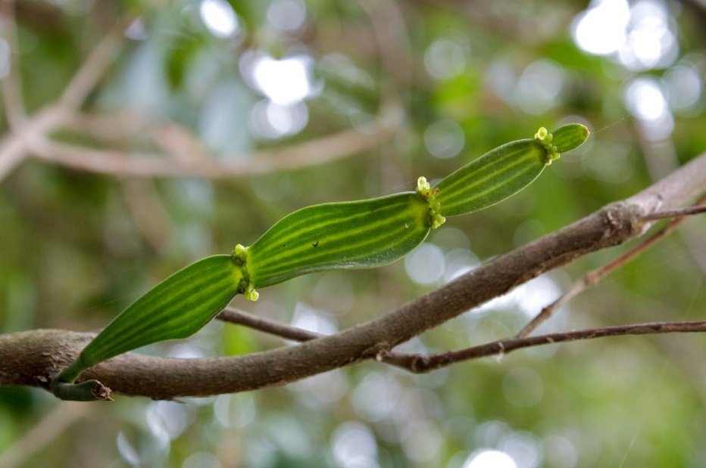
Psittacanthus
Lysiana
Amyema
Nuytsia
Korthalsella
Viscum

Slide 3
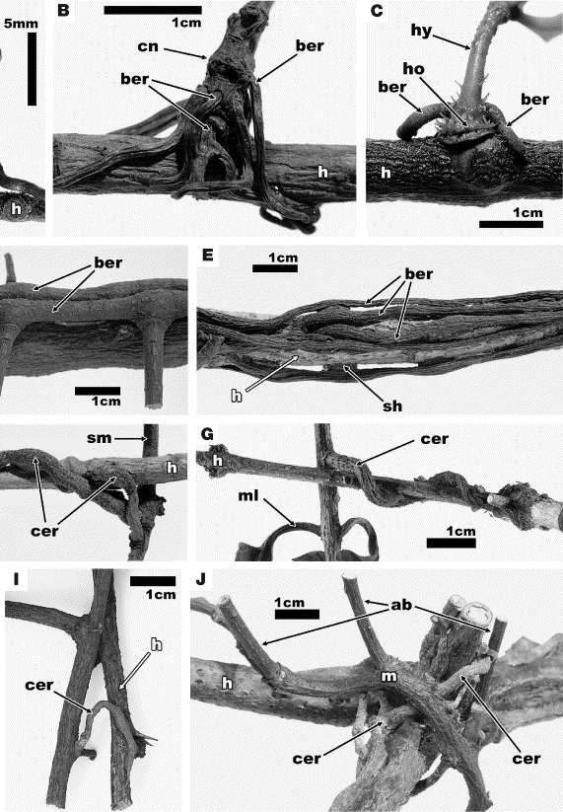
Calvin & Wilson 2006 Flora 201: 51–64
Viscum

Slide 4
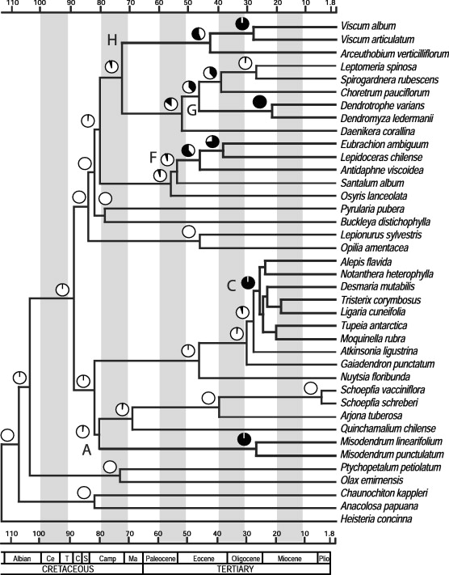
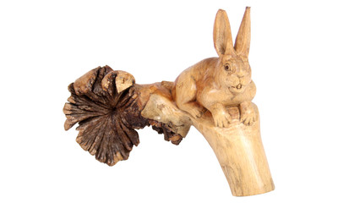
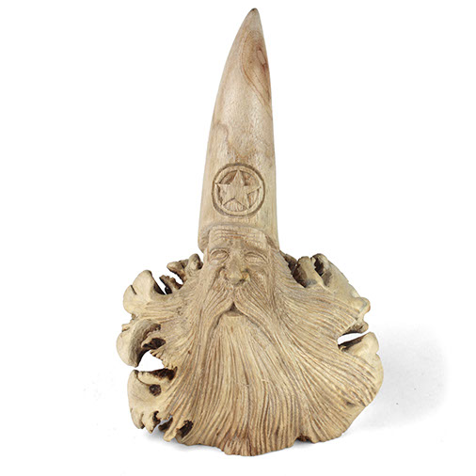
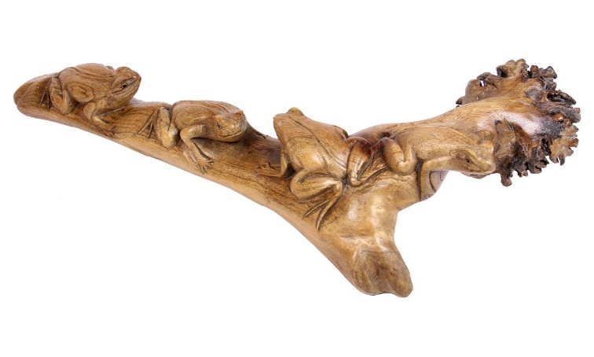
Vidal-Russel & Nickrent 2008 Mol. Phylogenet. Evol. 47: 523–537
Viscum

Slide 5
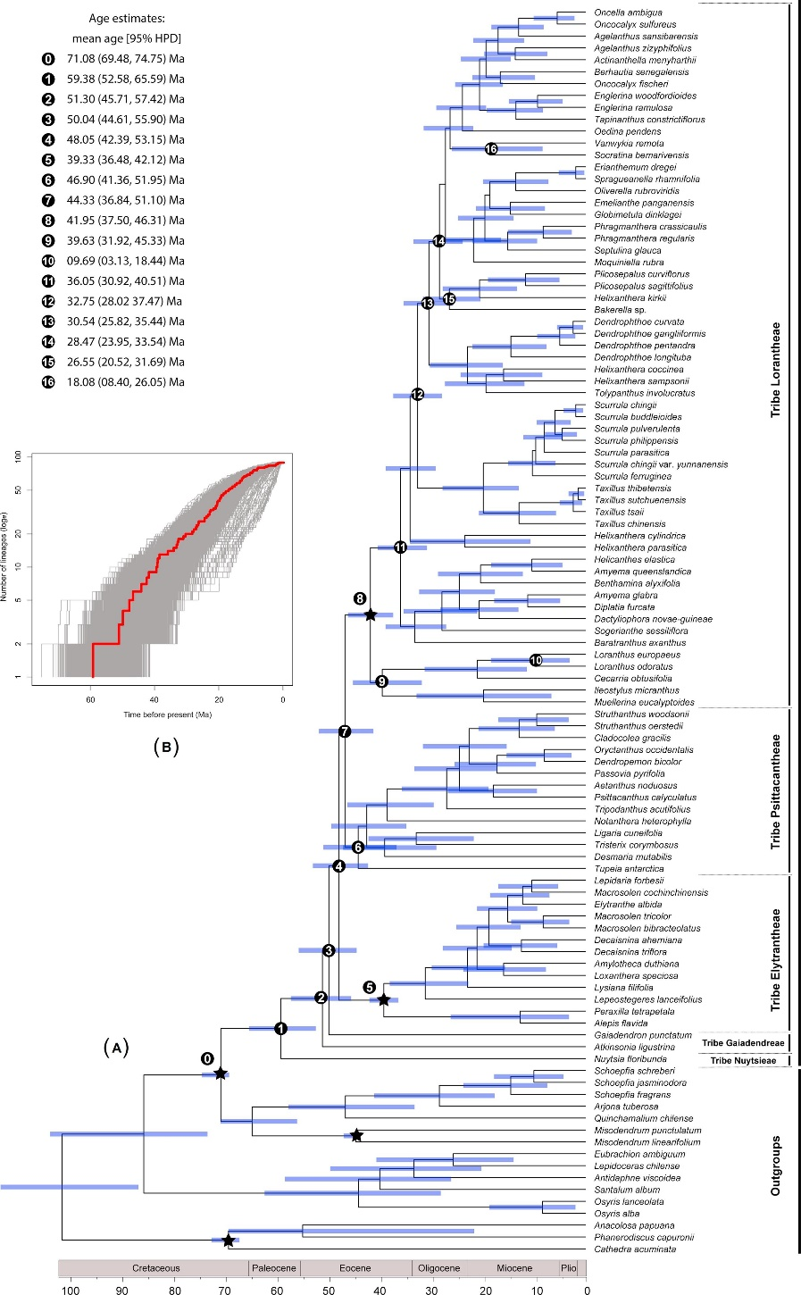
Liu et al. 2018 Mol. Phylogenet. Evol. 124: 199–212
Vidal-Russel & Nickrent 2008 Mol. Phylogenet. Evol. 47: 523–537

Slide 6
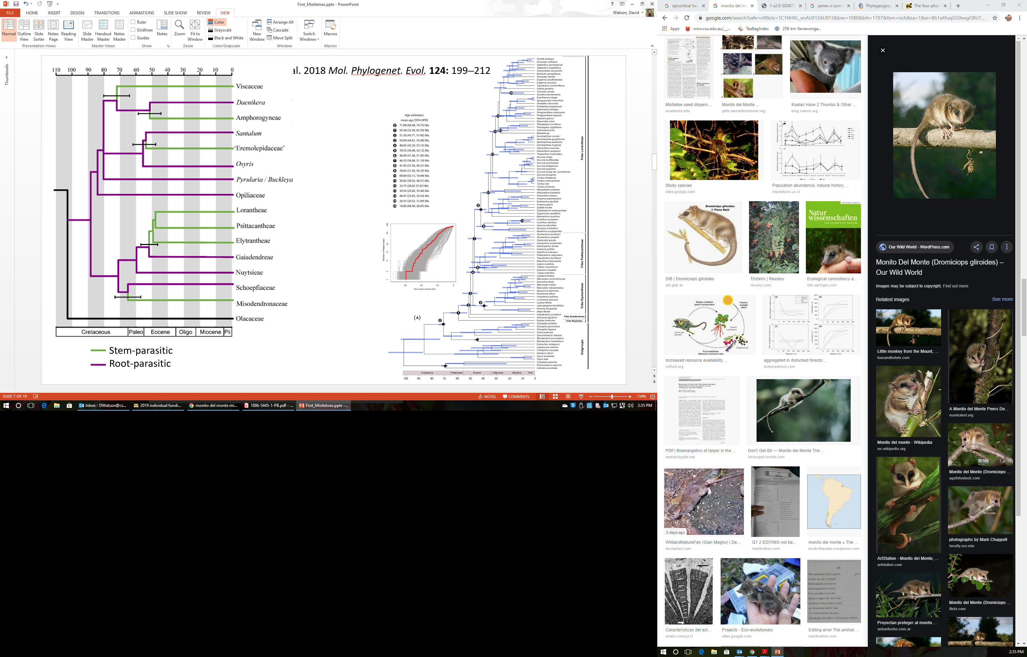
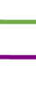
Liu et al. 2018 Mol. Phylogenet. Evol. 124: 199–212
Stem-parasitic
Root-parasitic
Watson 2019 Mistletoes of Southern Australia (2nd ed.) CSIRO Publishing

Slide 7
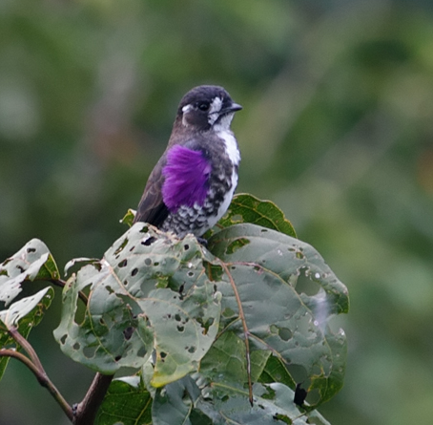
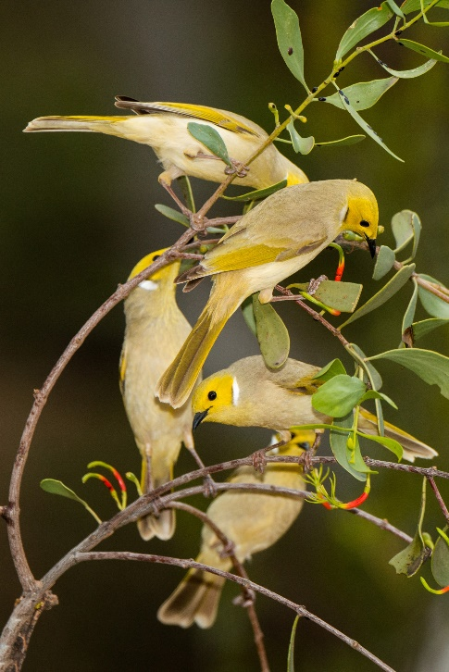
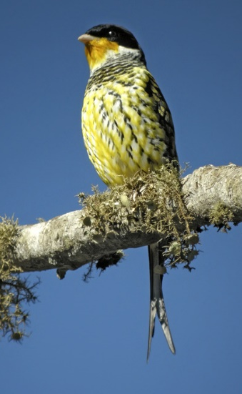
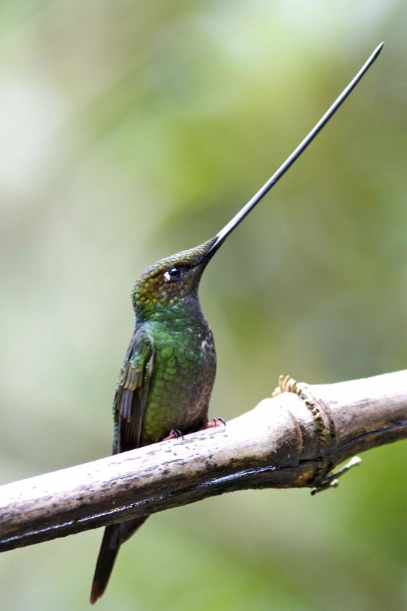
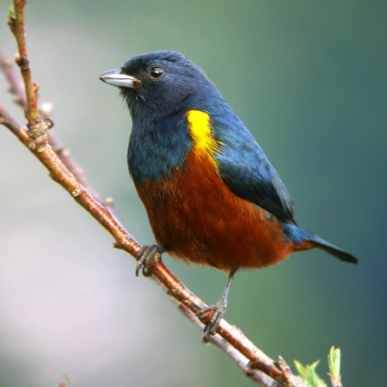
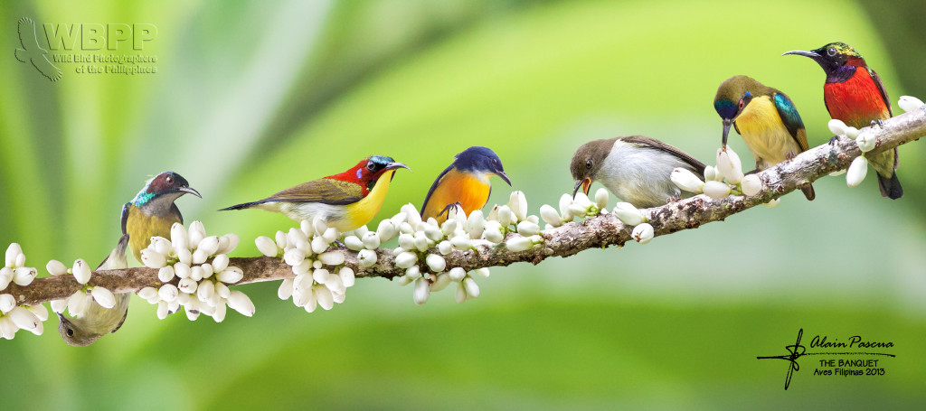
Viscaceae
Amphorogynaceae
‘Santalaceae’
Loranthaceae
Misodendronaceae
Which came first:
the chicken mistletoe or the egg disperser?

Slide 8
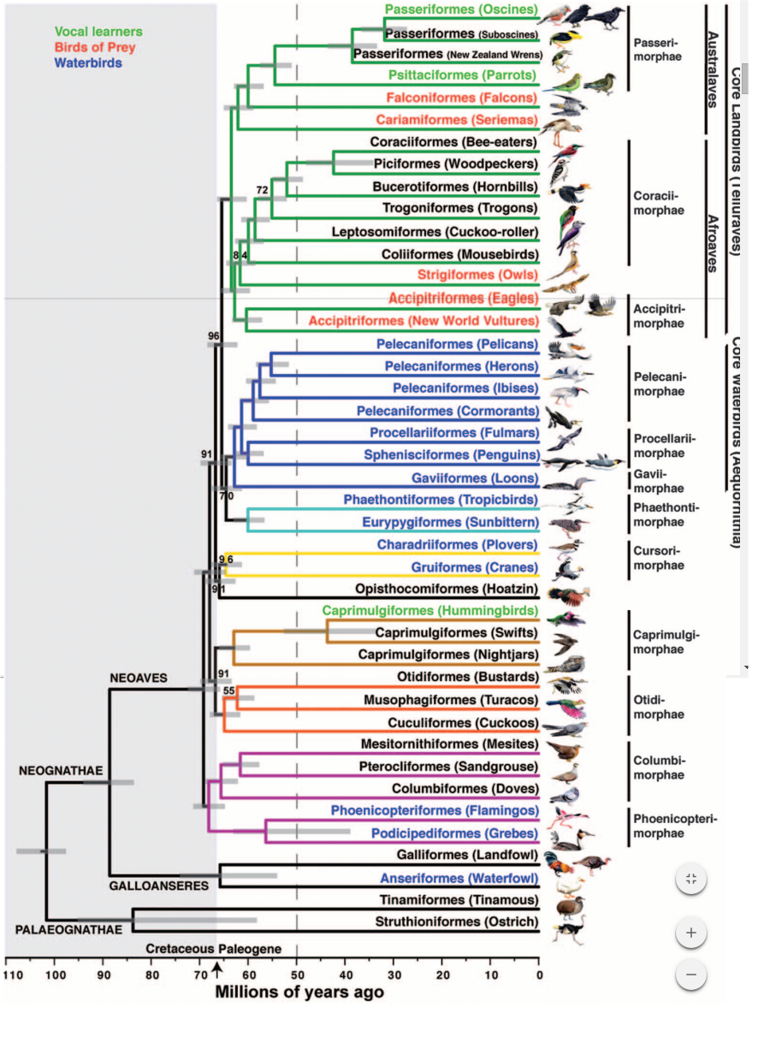
Jetz et al. 2012 Nature 491: 444–448

Slide 9
Jetz et al. 2012 Nature 491: 444–448

Slide 10
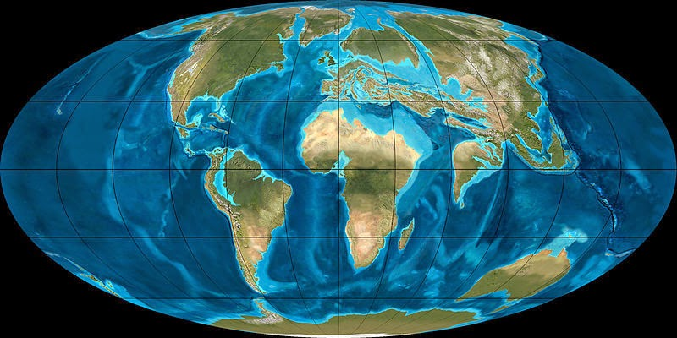
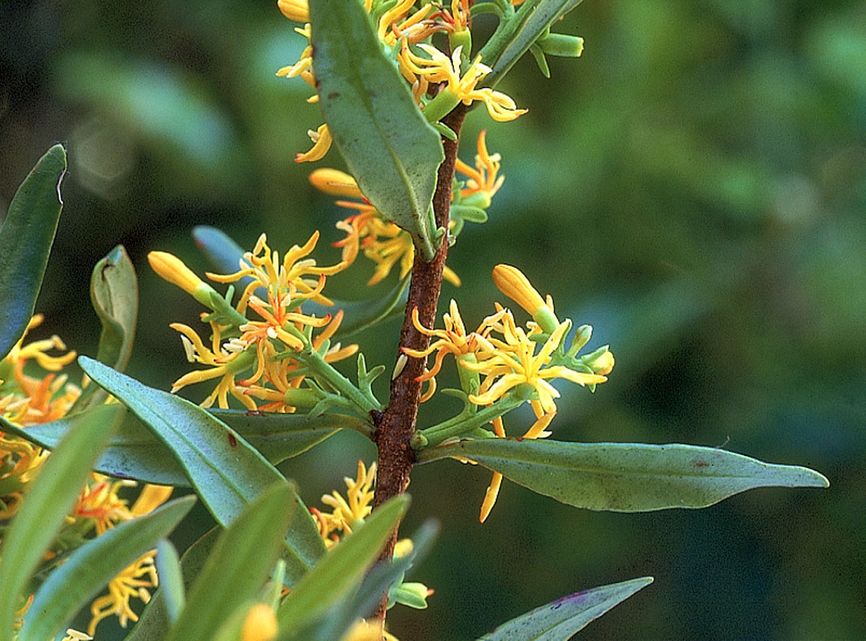
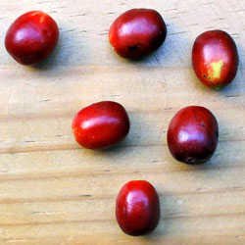
~55 mya
Liu et al. 2018 Mol. Phylogenet. Evol. 124: 199–212
Atkinsonia

Slide 11
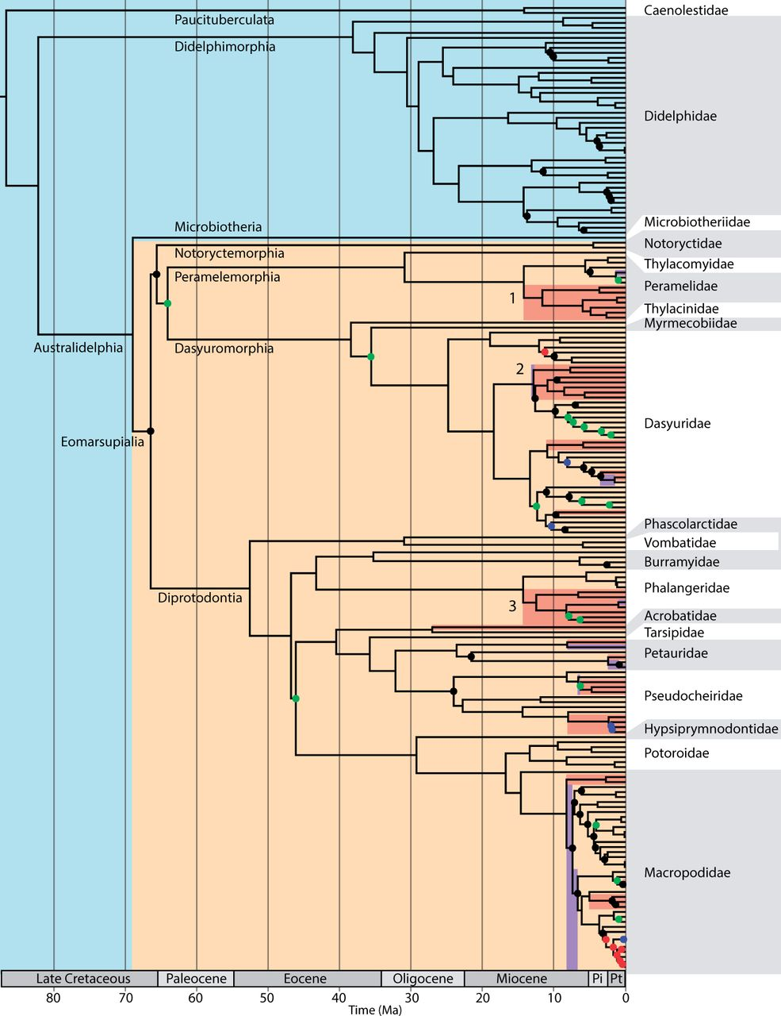
~55 mya
Mitchell et al. 2014 Mol. Biol. & Evol. 31: 2322–2330

Slide 12
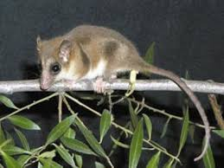
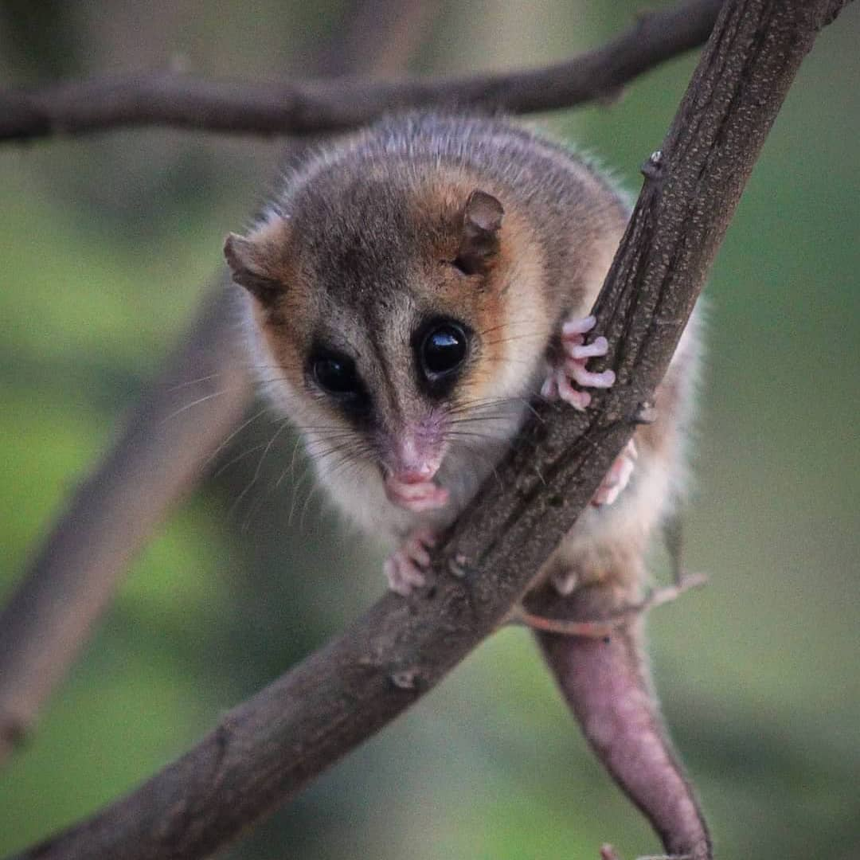
Amico & Aizen 2000. Nature 408: 929–930
Dromiciops
Javier Godoy-Güinao et al. 2018 Ecosphere 9: e02424

Slide 13
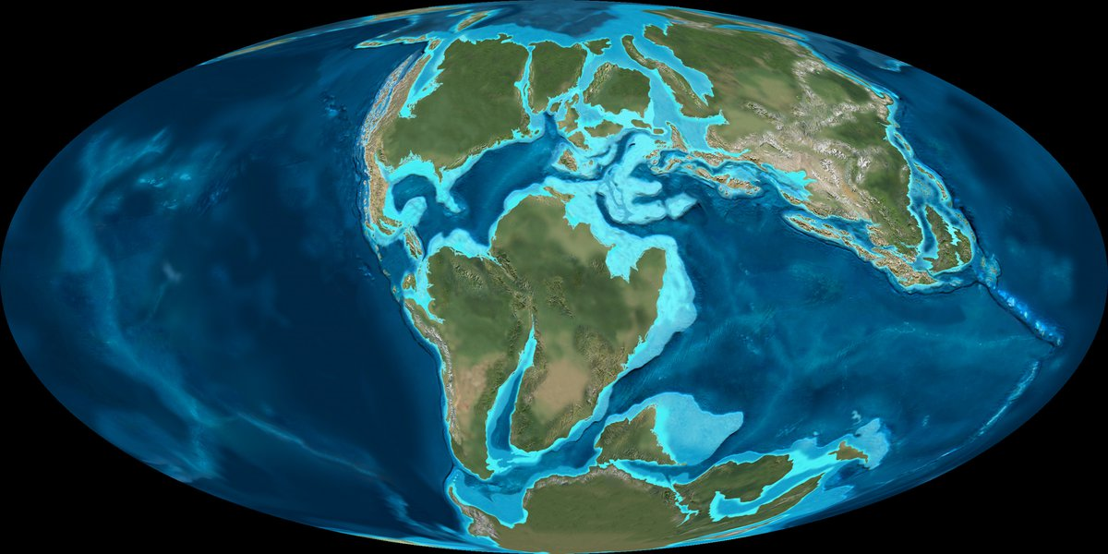
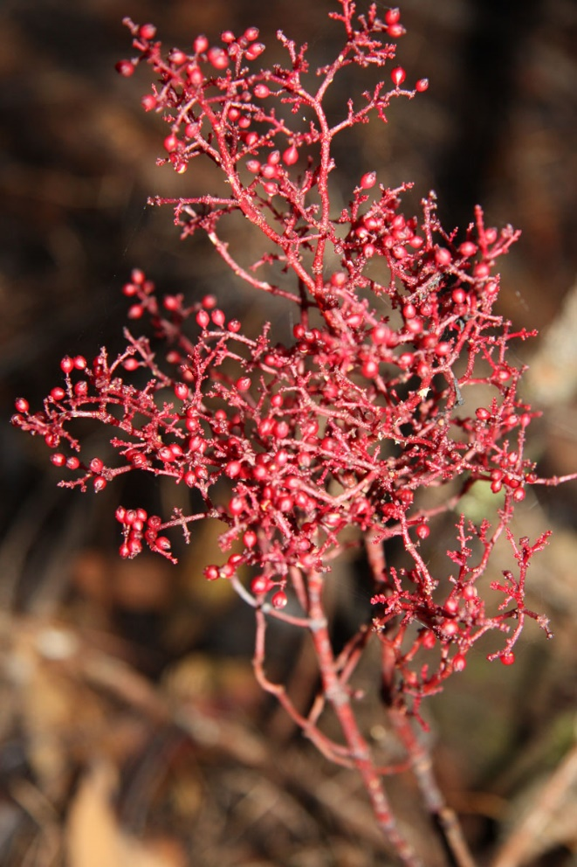
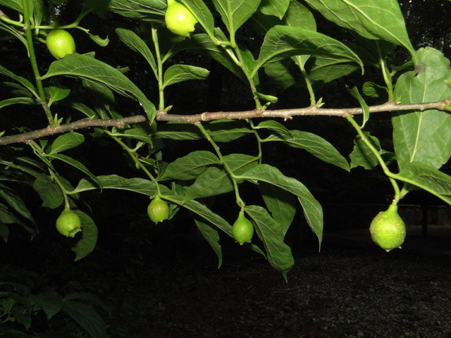
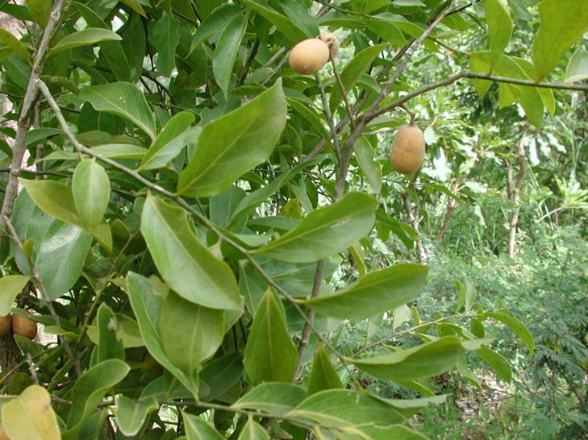
~70 mya
Pyrularia
Vidal-Russel & Nickrent 2008 Mol. Phylogenet. Evol. 47: 523–537
Daenikera
Opilia

Slide 14
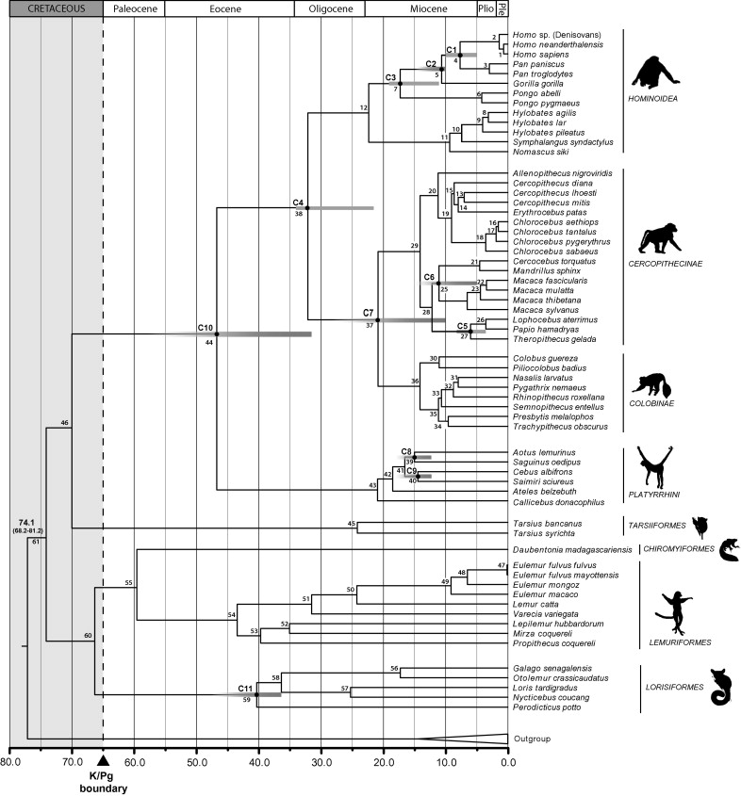
~70 mya
Pozzi et al. 2014 Mol. Phylogenet. Evol. 75: 165–183

Slide 15
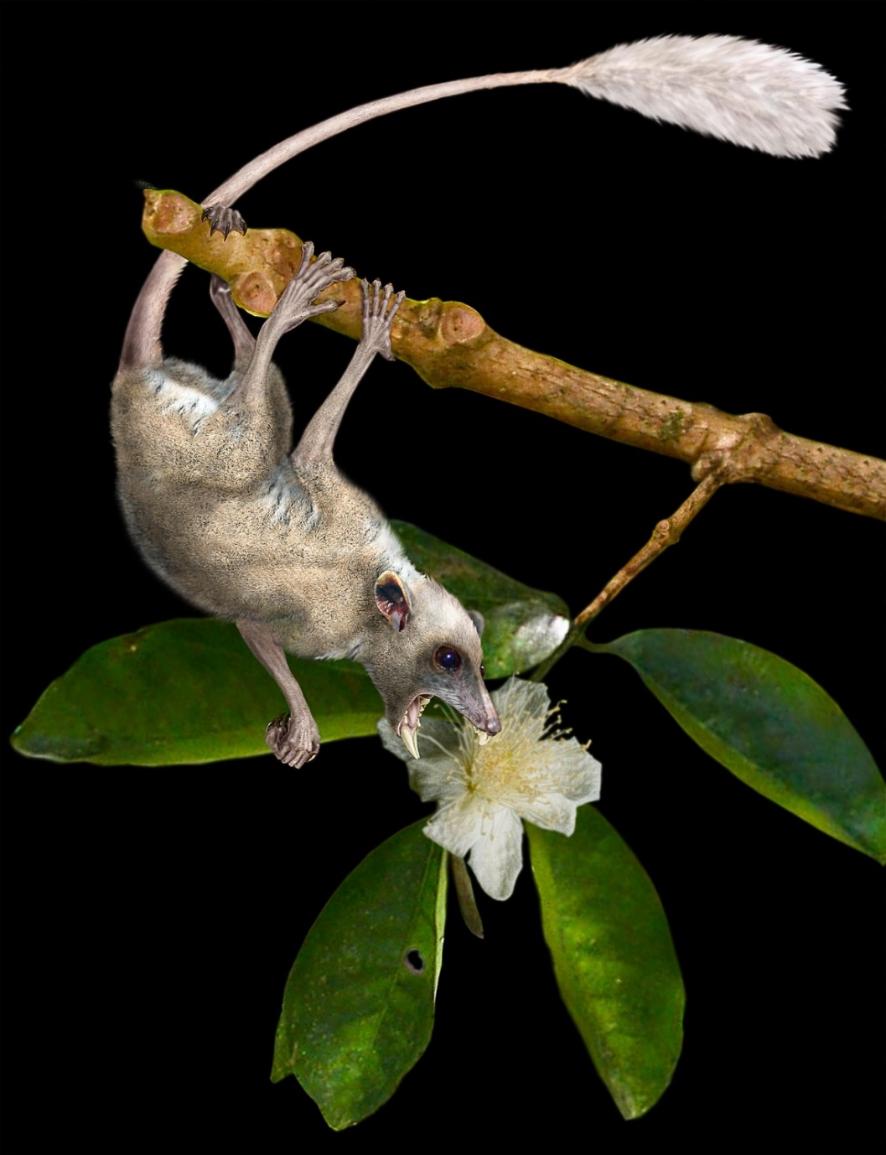
~70 mya
Purgatorius
Pozzi et al. 2014 Mol. Phylogenet. Evol. 75: 165–183

Slide 16
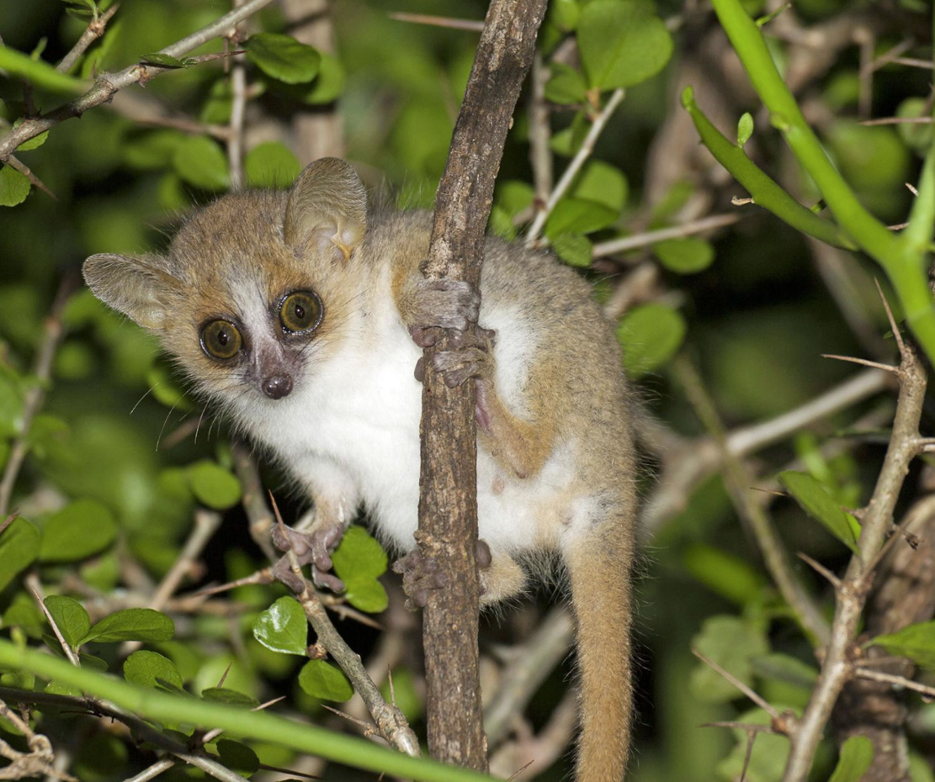
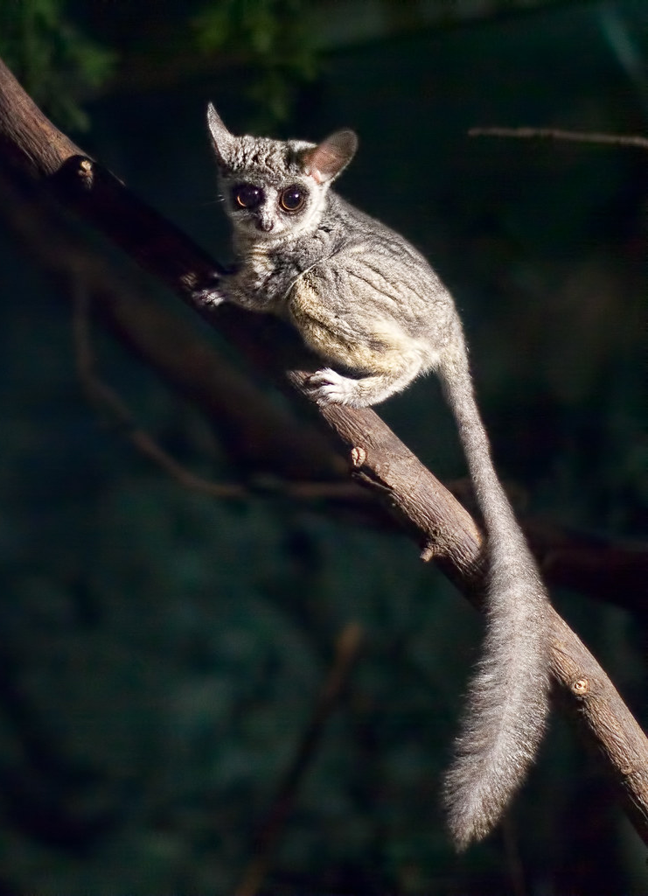
Microcebus
Génin and Rambeloarivony 2018 Biol. J. Linn. Soc. 124: 607–620
Galago

Slide 17
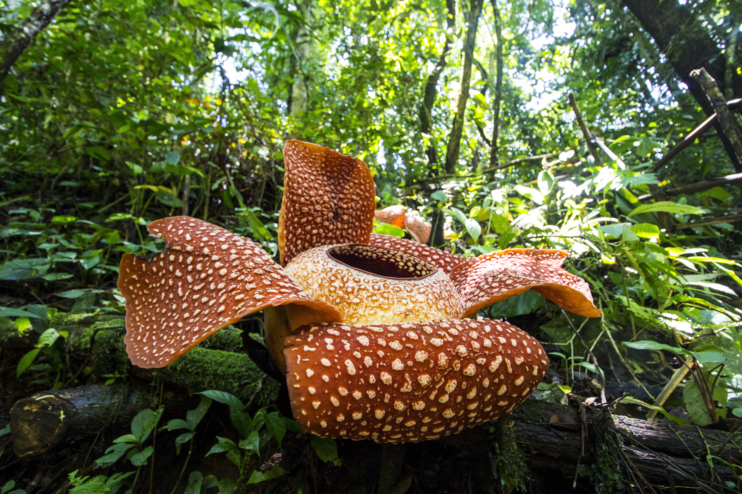
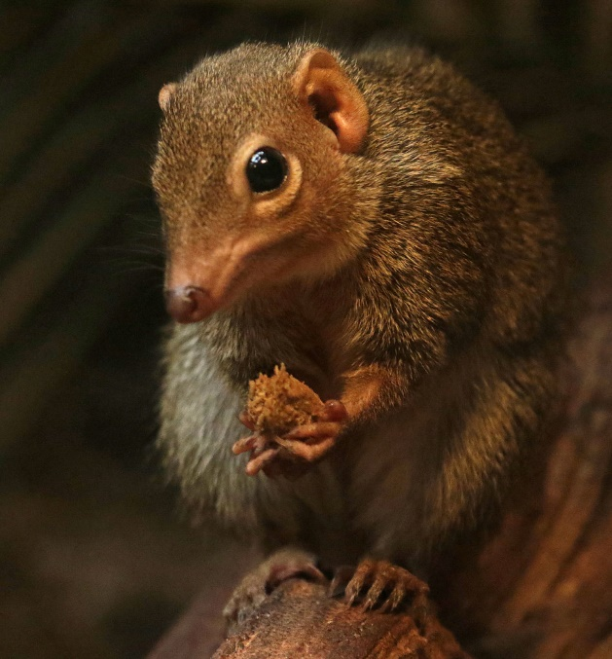
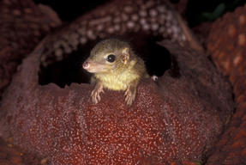
Tupeia
Rafflesia

Slide 18
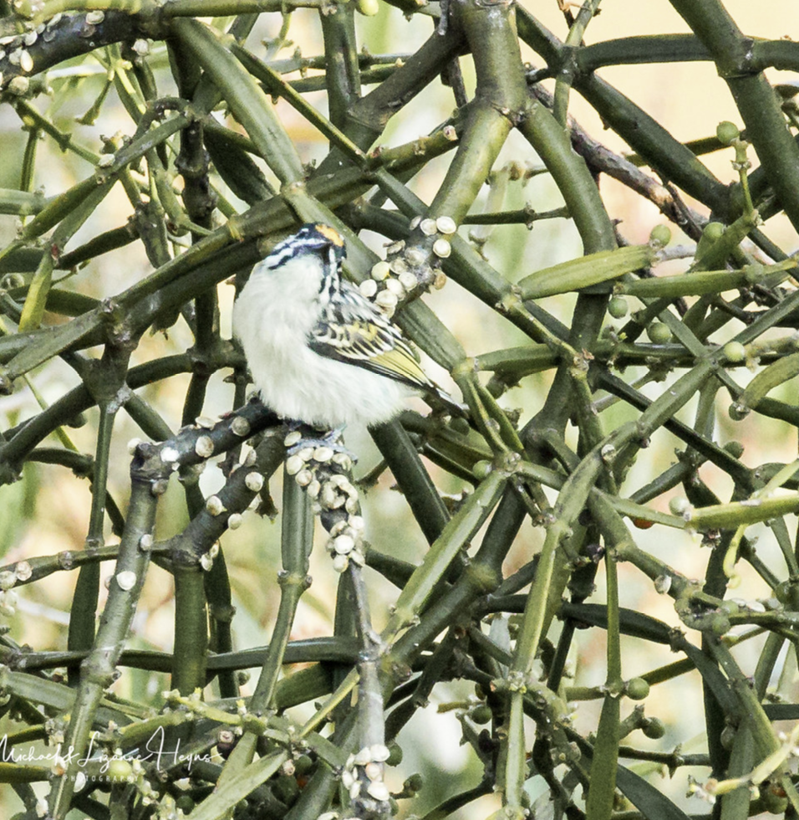
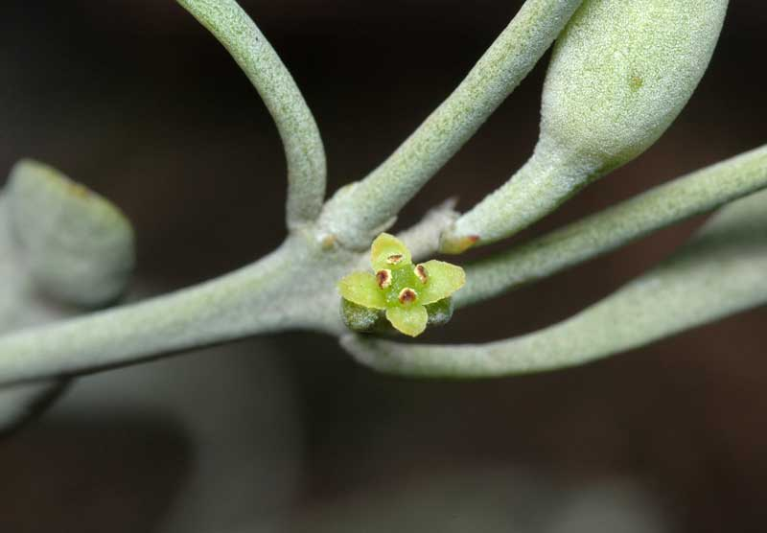
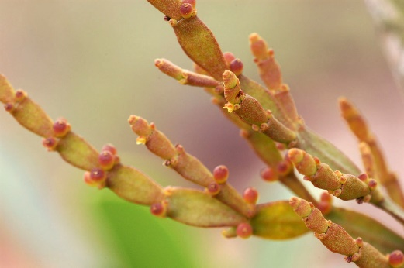
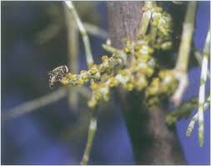
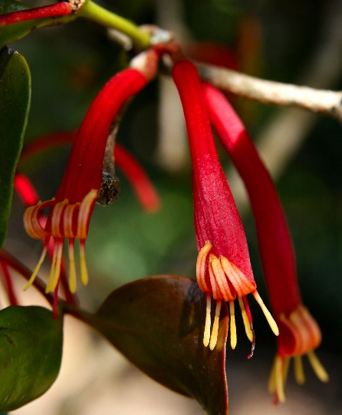
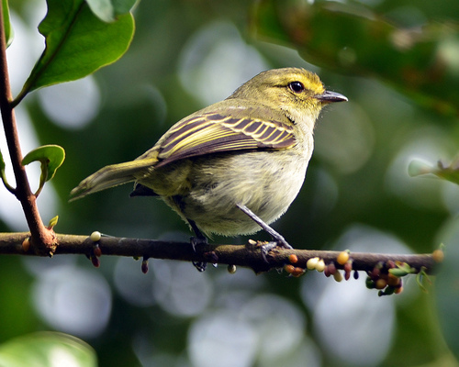
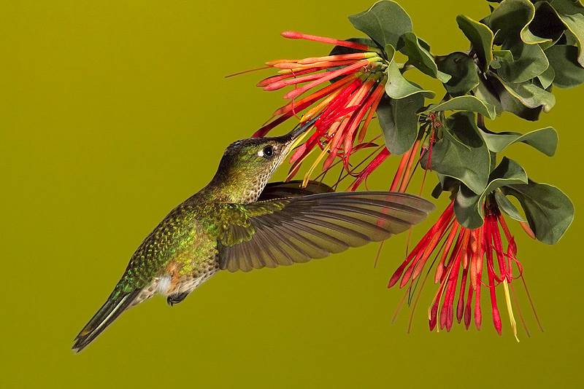
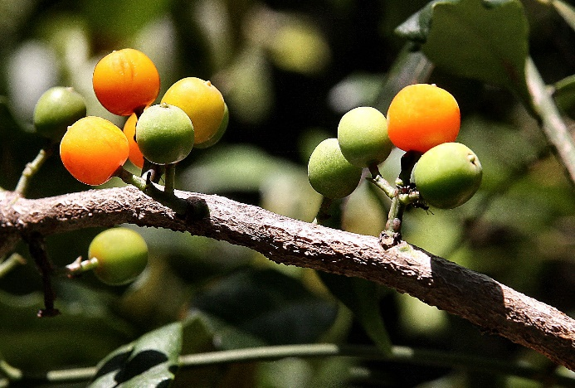
Viscaceae
—Laurasian
—Centre of diversity:
Africa, Eurasia
—Aerial habit: Cretaceous?
—Small seeds & fruit
—Small green flowers
Pogoniulus / Viscum
Notothixos
Phoradendron
Korthalsella
Loranthaceae
—Gondwanan
—Centres of diversity:
Australasia, Neotropics
—Aerial habit: Eocene
—Large seeds & fruit
—Large colourful
tubular flowers
Benthamina
Zimmerius / Struthanthus
@D0CT0R_Dave
Heliodaxa / Psittacanthus
Amylotheca

