Slide 1
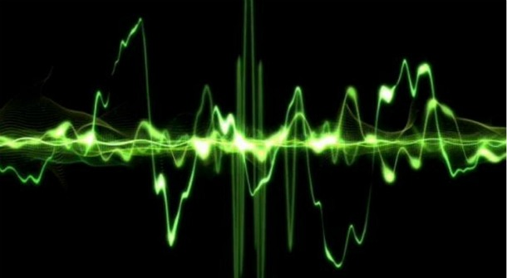

Taking the pulse of a continent:
the Australian acoustic observatory
@D0CT0R_Dave

Slide 2
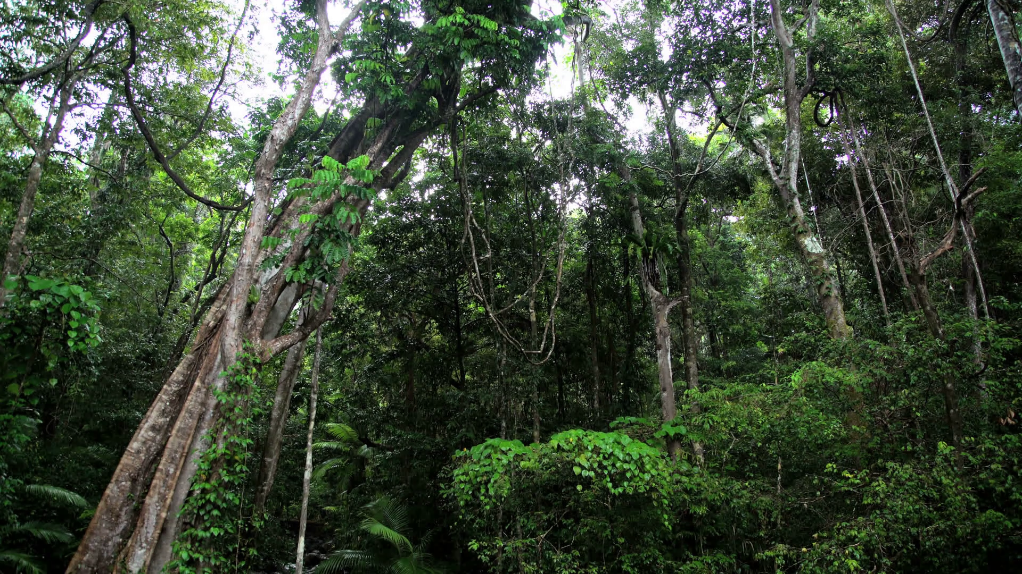


Slide 3
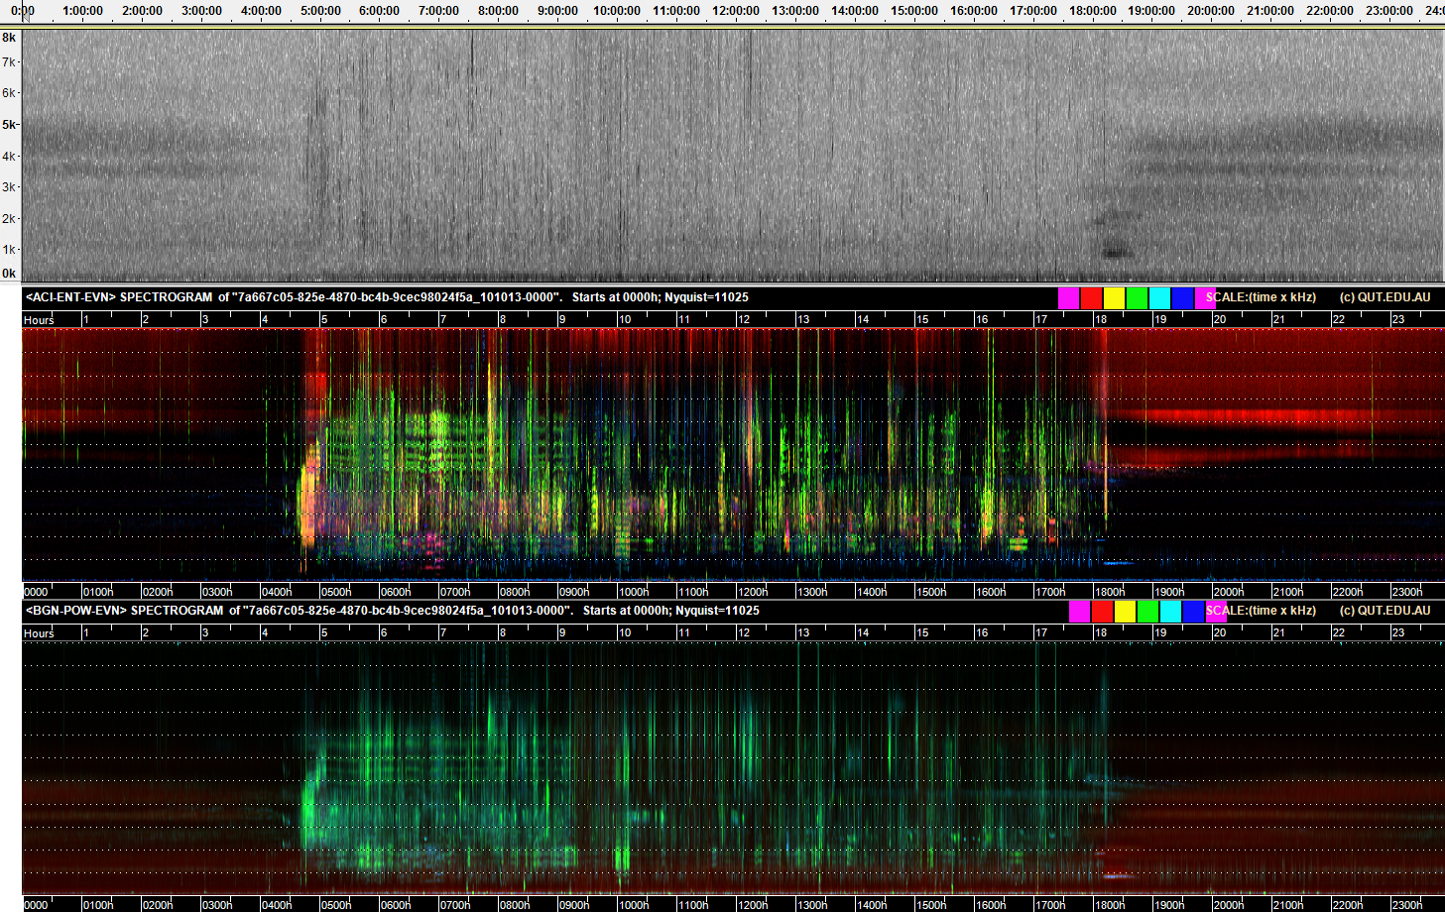
RGB = (ACI, ENT, EVN)
RGB = (BGN, AVG, CVR)

Slide 4
Crickets
Jet engine
Dawn chorus
Cicadas
Midday lull

Slide 5
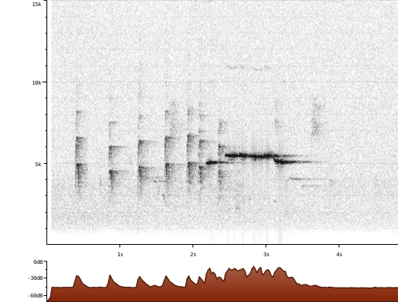
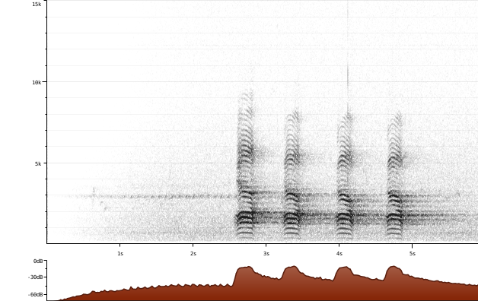
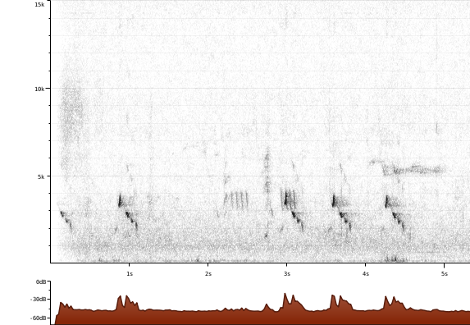
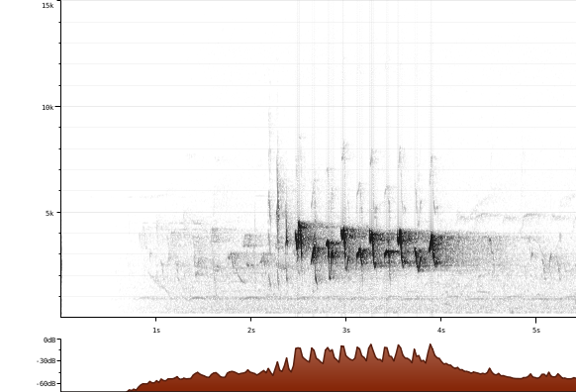
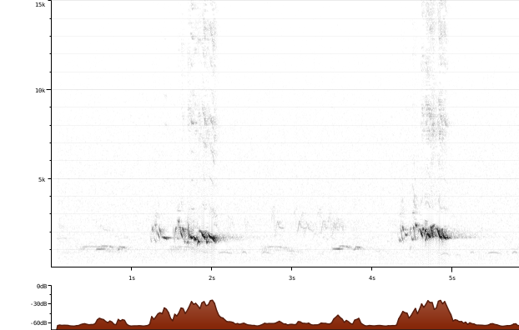
Grey Fantail
Torresian Crow
Striated Pardalote
Yellow-faced Honeyeater
Olive-backed Oriole

Slide 6
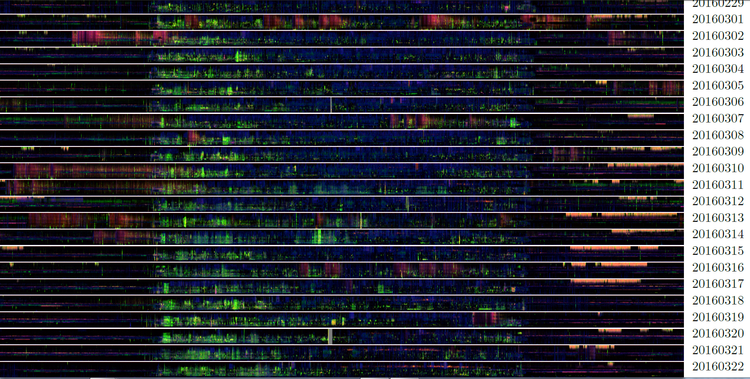
Notes:
Three weeks of data, here summarized in ribbons with a compressed frequency scale, multiple ribbons concatenated in time sequence to produce a ribbon plot. Really useful way to scan weeks or months of audio to detect changing soundscapes. Note pink traces at night, Nyctimene, eastern tube nosed bat just sneaking into the recordings—for these data, recorded at a sampling rate of 96kHz

Slide 7
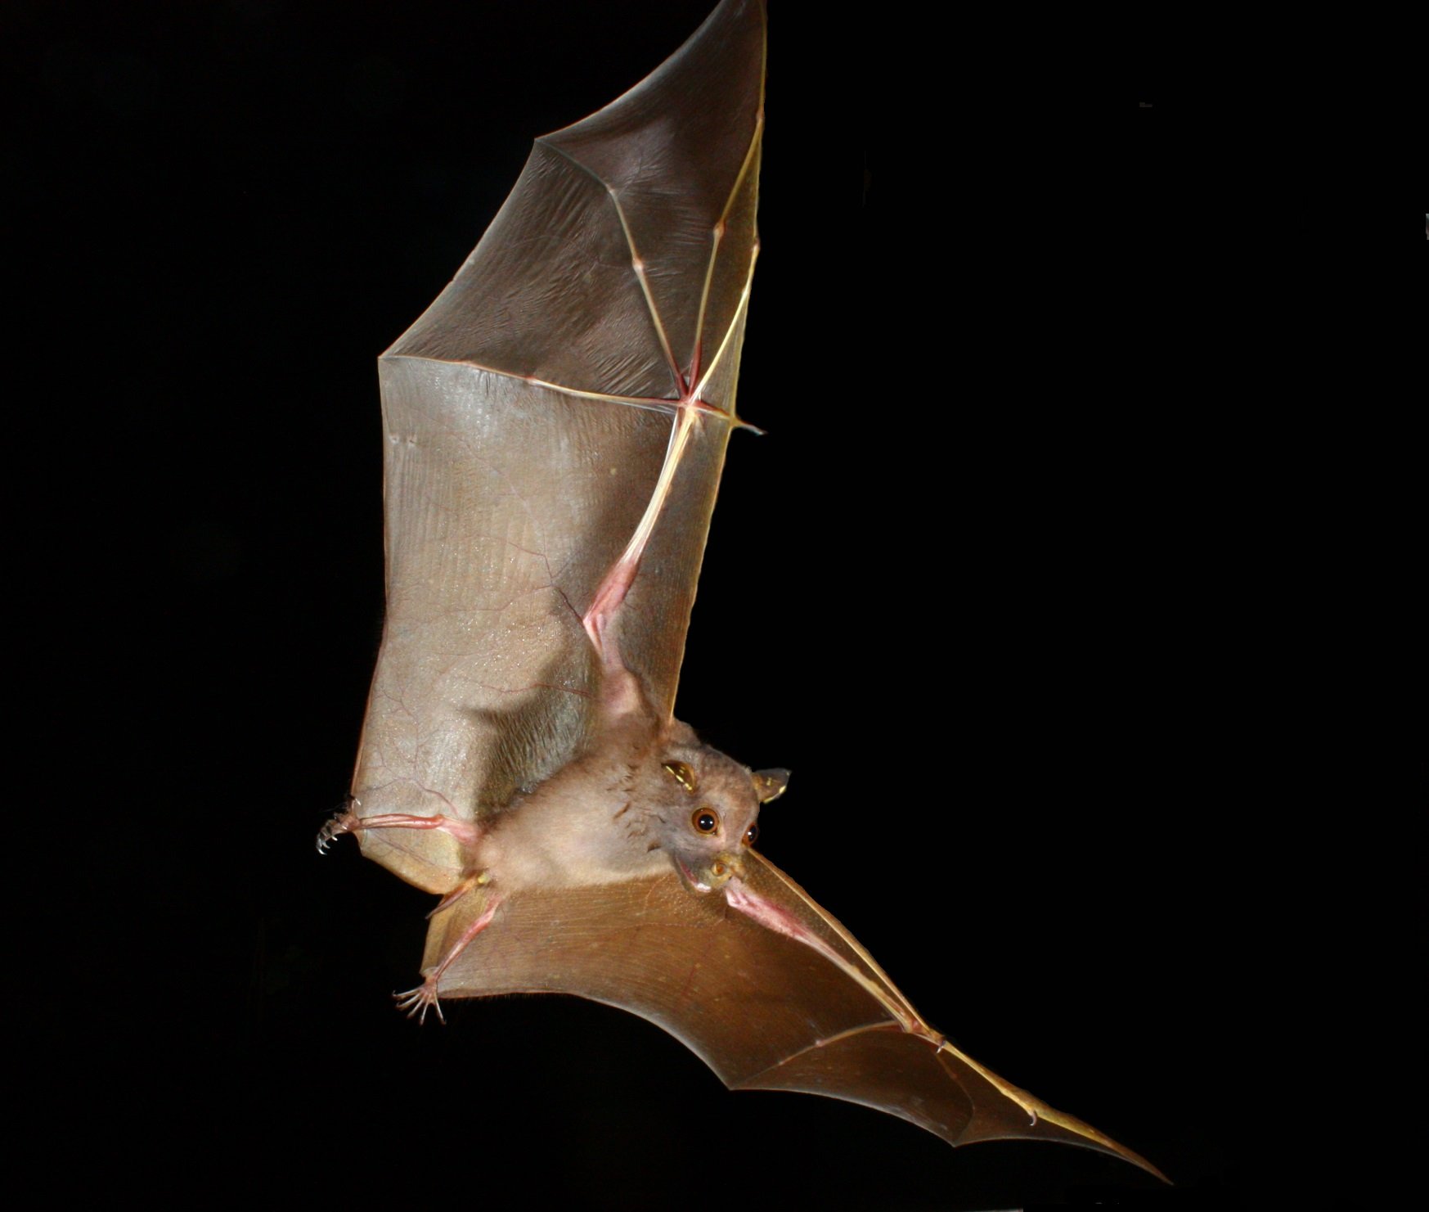
Notes:
Three weeks of data, here summarized in ribbons with a compressed frequency scale, multiple ribbons concatenated in time sequence to produce a ribbon plot. Really useful way to scan weeks or months of audio to detect changing soundscapes. Note pink traces at night, Nyctimene, eastern tube nosed bat just sneaking into the recordings—for these data, recorded at a sampling rate of 96kHz

Slide 8
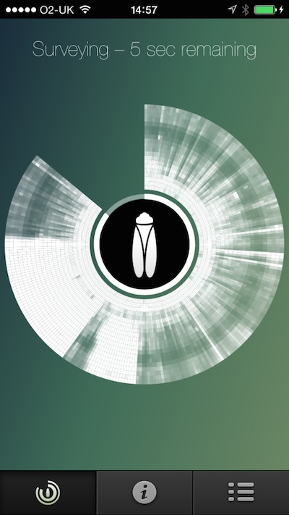
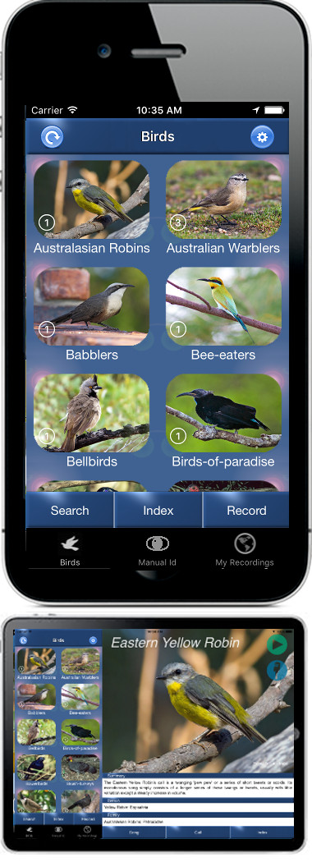
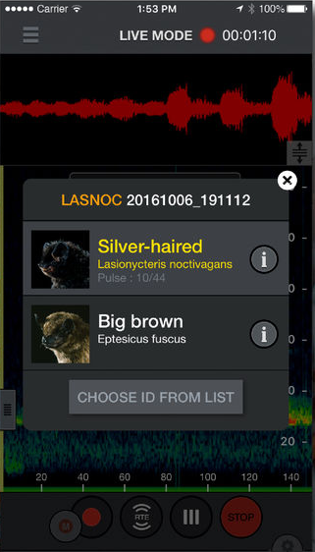
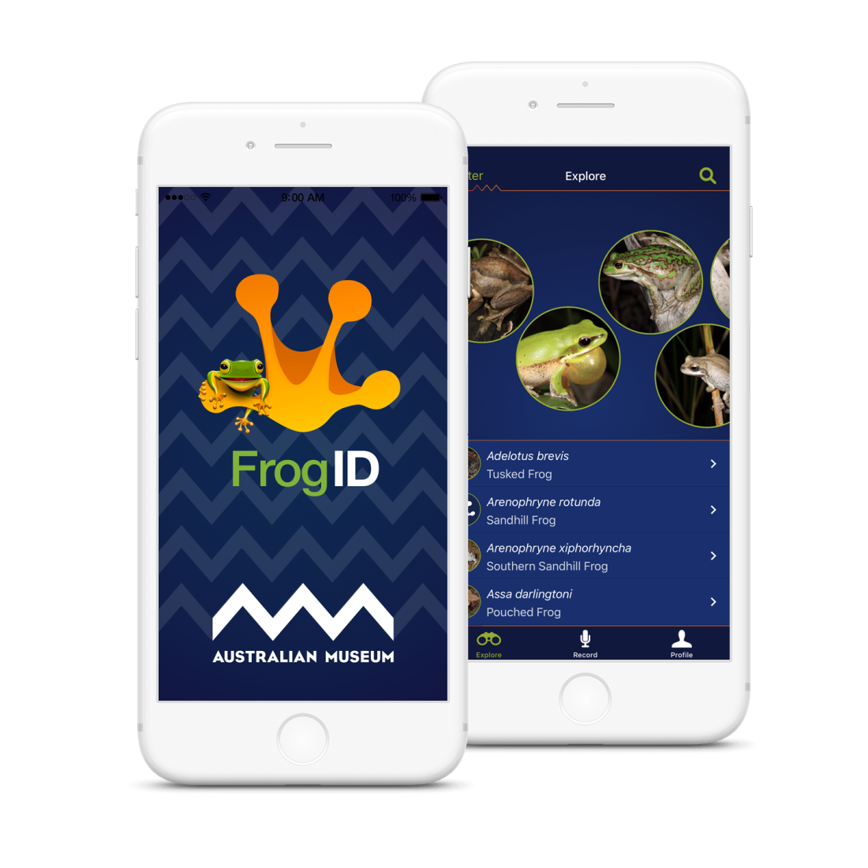
Notes:
Three weeks of data, here summarized in ribbons with a compressed frequency scale, multiple ribbons concatenated in time sequence to produce a ribbon plot. Really useful way to scan weeks or months of audio to detect changing soundscapes. Note pink traces at night, Nyctimene, eastern tube nosed bat just sneaking into the recordings—for these data, recorded at a sampling rate of 96kHz

Slide 9
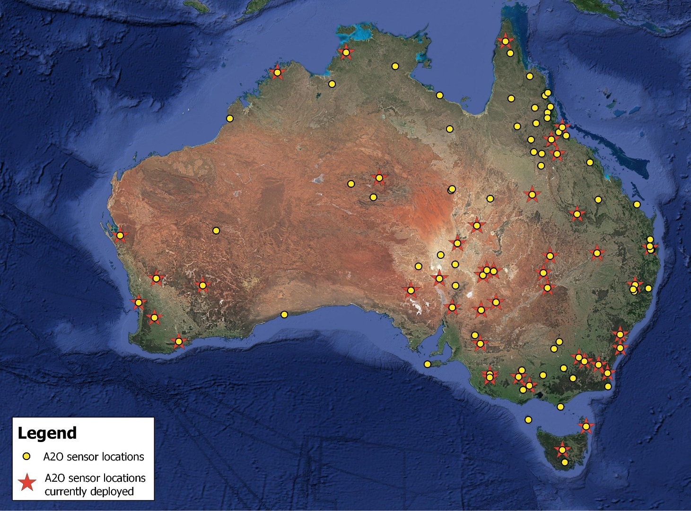
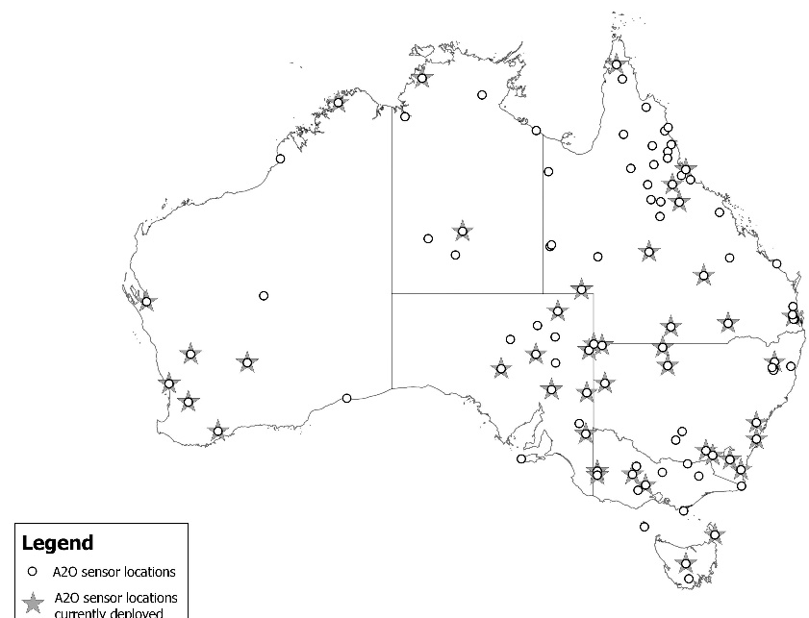
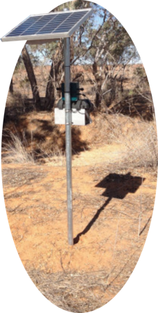

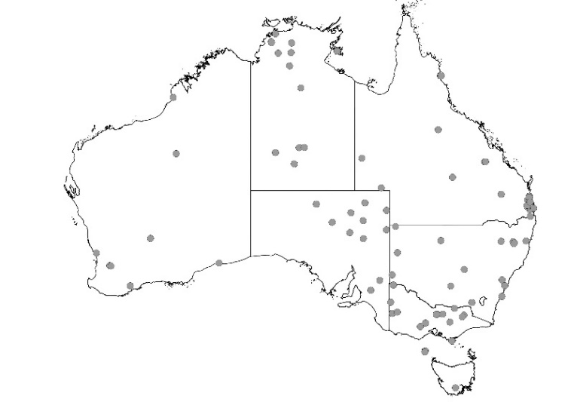

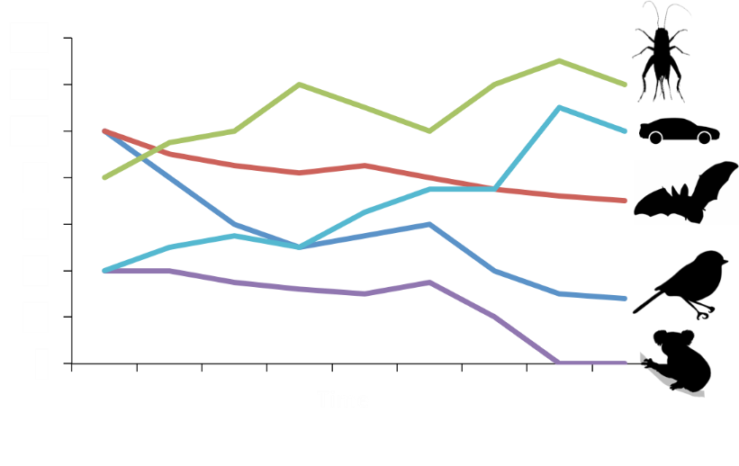

400 sensors
  1TB SD cards/sensor, 16 bit dynamic range
100 sites
  Stratified by ecoregion
4 sensors per site
  Stratified by productivity
2PB #openaccess data
  cloud storage with QCIF
> 2000 years of continuous sound
  Recorded at 22 KHz to optimize storage
www.acousticobservatory.org
Notes:
Recordings made at 22 KHz to optimize storage, 16 bit dynamic range

Slide 10
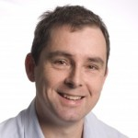
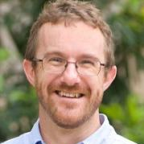
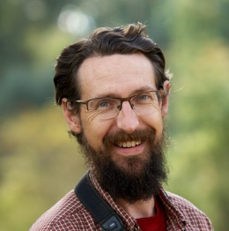
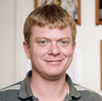
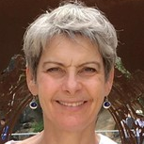






Chief Investigators, A20
QUT
  Paul Roe
  Margot Brereton
  Stuart Parsons
CSU
  David Watson
  Dale Nimmo
JCU
  Lin Schwarzkopf
  Marcus Sheaves
UQ
  Richard Fuller
  Berndt Janse van Rensburg
  Martine Maron
UNE
  Paul McDonald
Partners
  BirdLife Australia Ltd.
  Queensland Cyber Infrastructure Foundation Ltd.

Slide 11
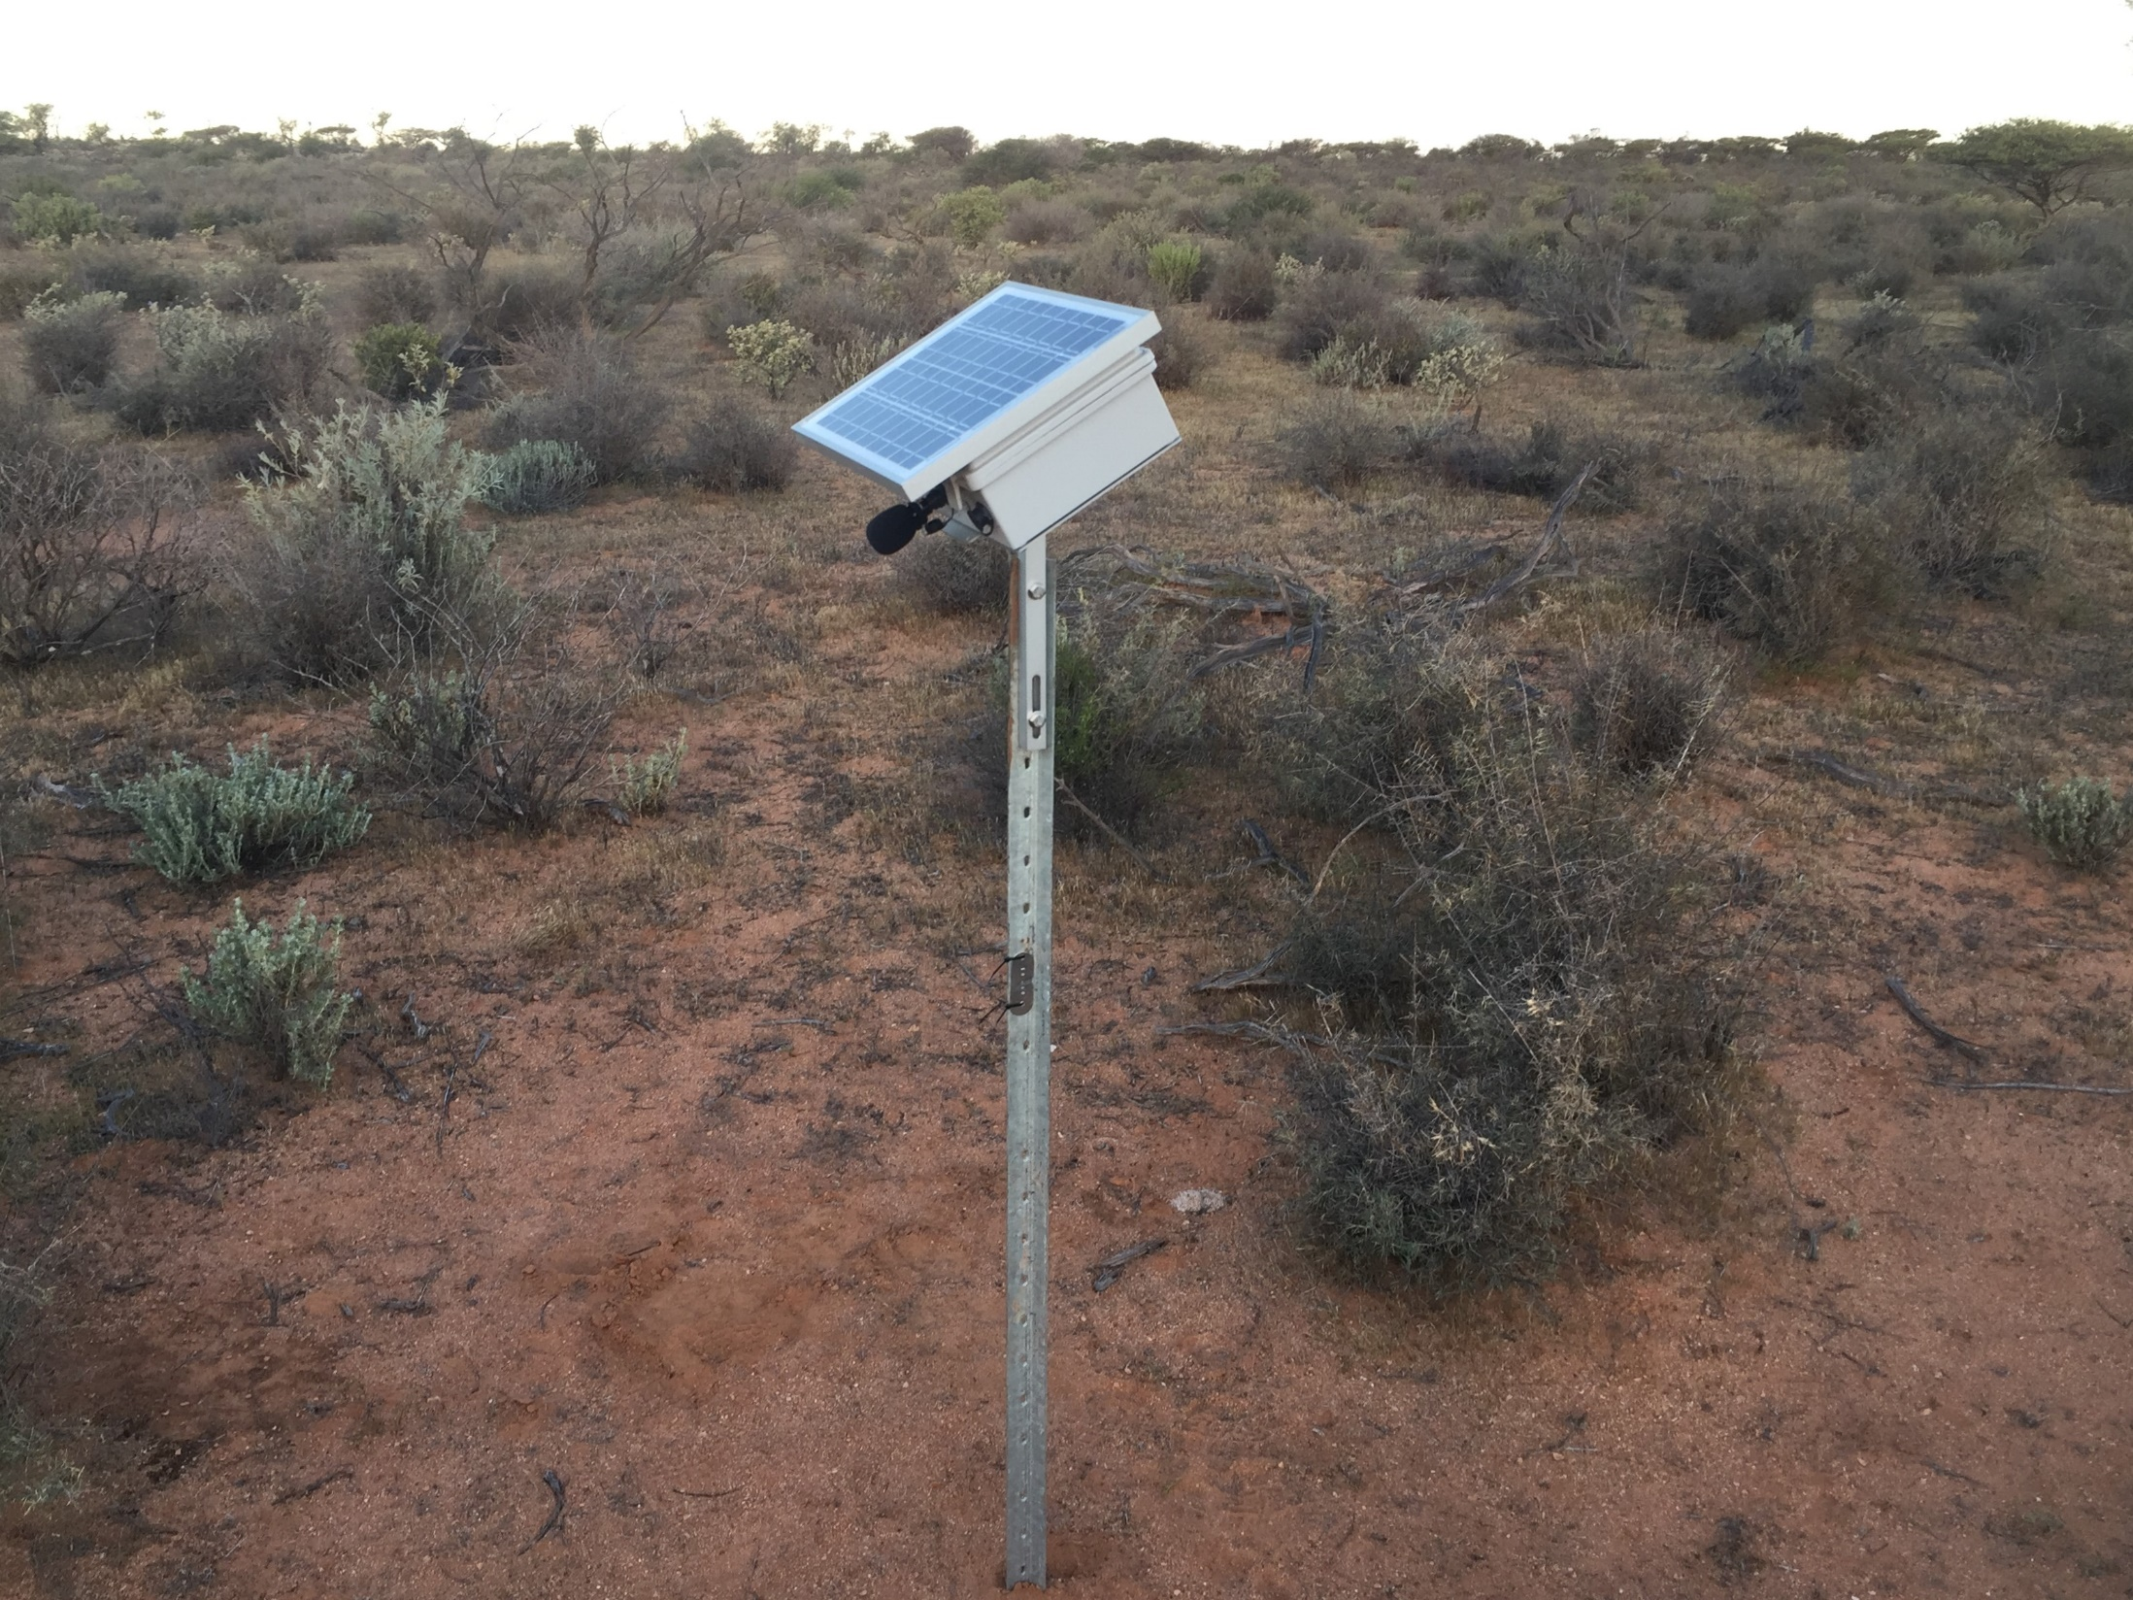
Chief Investigators, A20
QUT
  Paul Roe
  Margot Brereton
  Stuart Parsons
CSU
  David Watson
  Dale Nimmo
JCU
  Lin Schwarzkopf
  Marcus Sheaves
UQ
  Richard Fuller
  Berndt Janse van Rensburg
  Martine Maron
UNE
  Paul McDonald
Partners
  BirdLife Australia Ltd.
  Queensland Cyber Infrastructure Foundation Ltd.

Slide 12
Notes:
Eight months of continuous recordings combined into a single image, each pixel representing the dominant acoustic signal at each hour—at dawn (left) a morning bird chorus (blue) is obvious During spring and early summer, fading later on in the year. Horizontal green streaks indicate heavy rainfall as subtropical summer storms move through. Cicada activity is evident in spring and summer, whereas crickets dominate the night-time soundscape in Autumn, then more silent in winter.

Slide 13
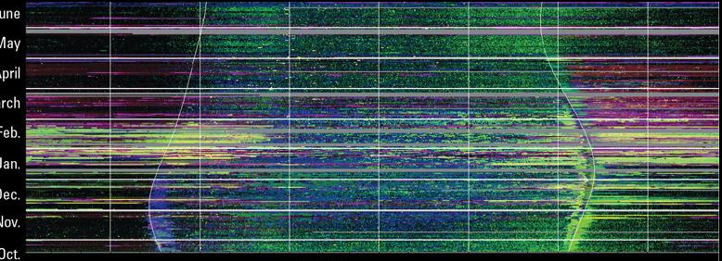
June
May
April
March
Feb.
Jan.
Dec.
Nov.
Oct.
Notes:
Eight months of continuous recordings combined into a single image, each pixel representing the dominant acoustic signal at each hour—at dawn (left) a morning bird chorus (blue) is obvious During spring and early summer, fading later on in the year. Horizontal green streaks indicate heavy rainfall as subtropical summer storms move through. Cicada activity is evident in spring and summer, whereas crickets dominate the night-time soundscape in Autumn, then more silent in winter.

Slide 14
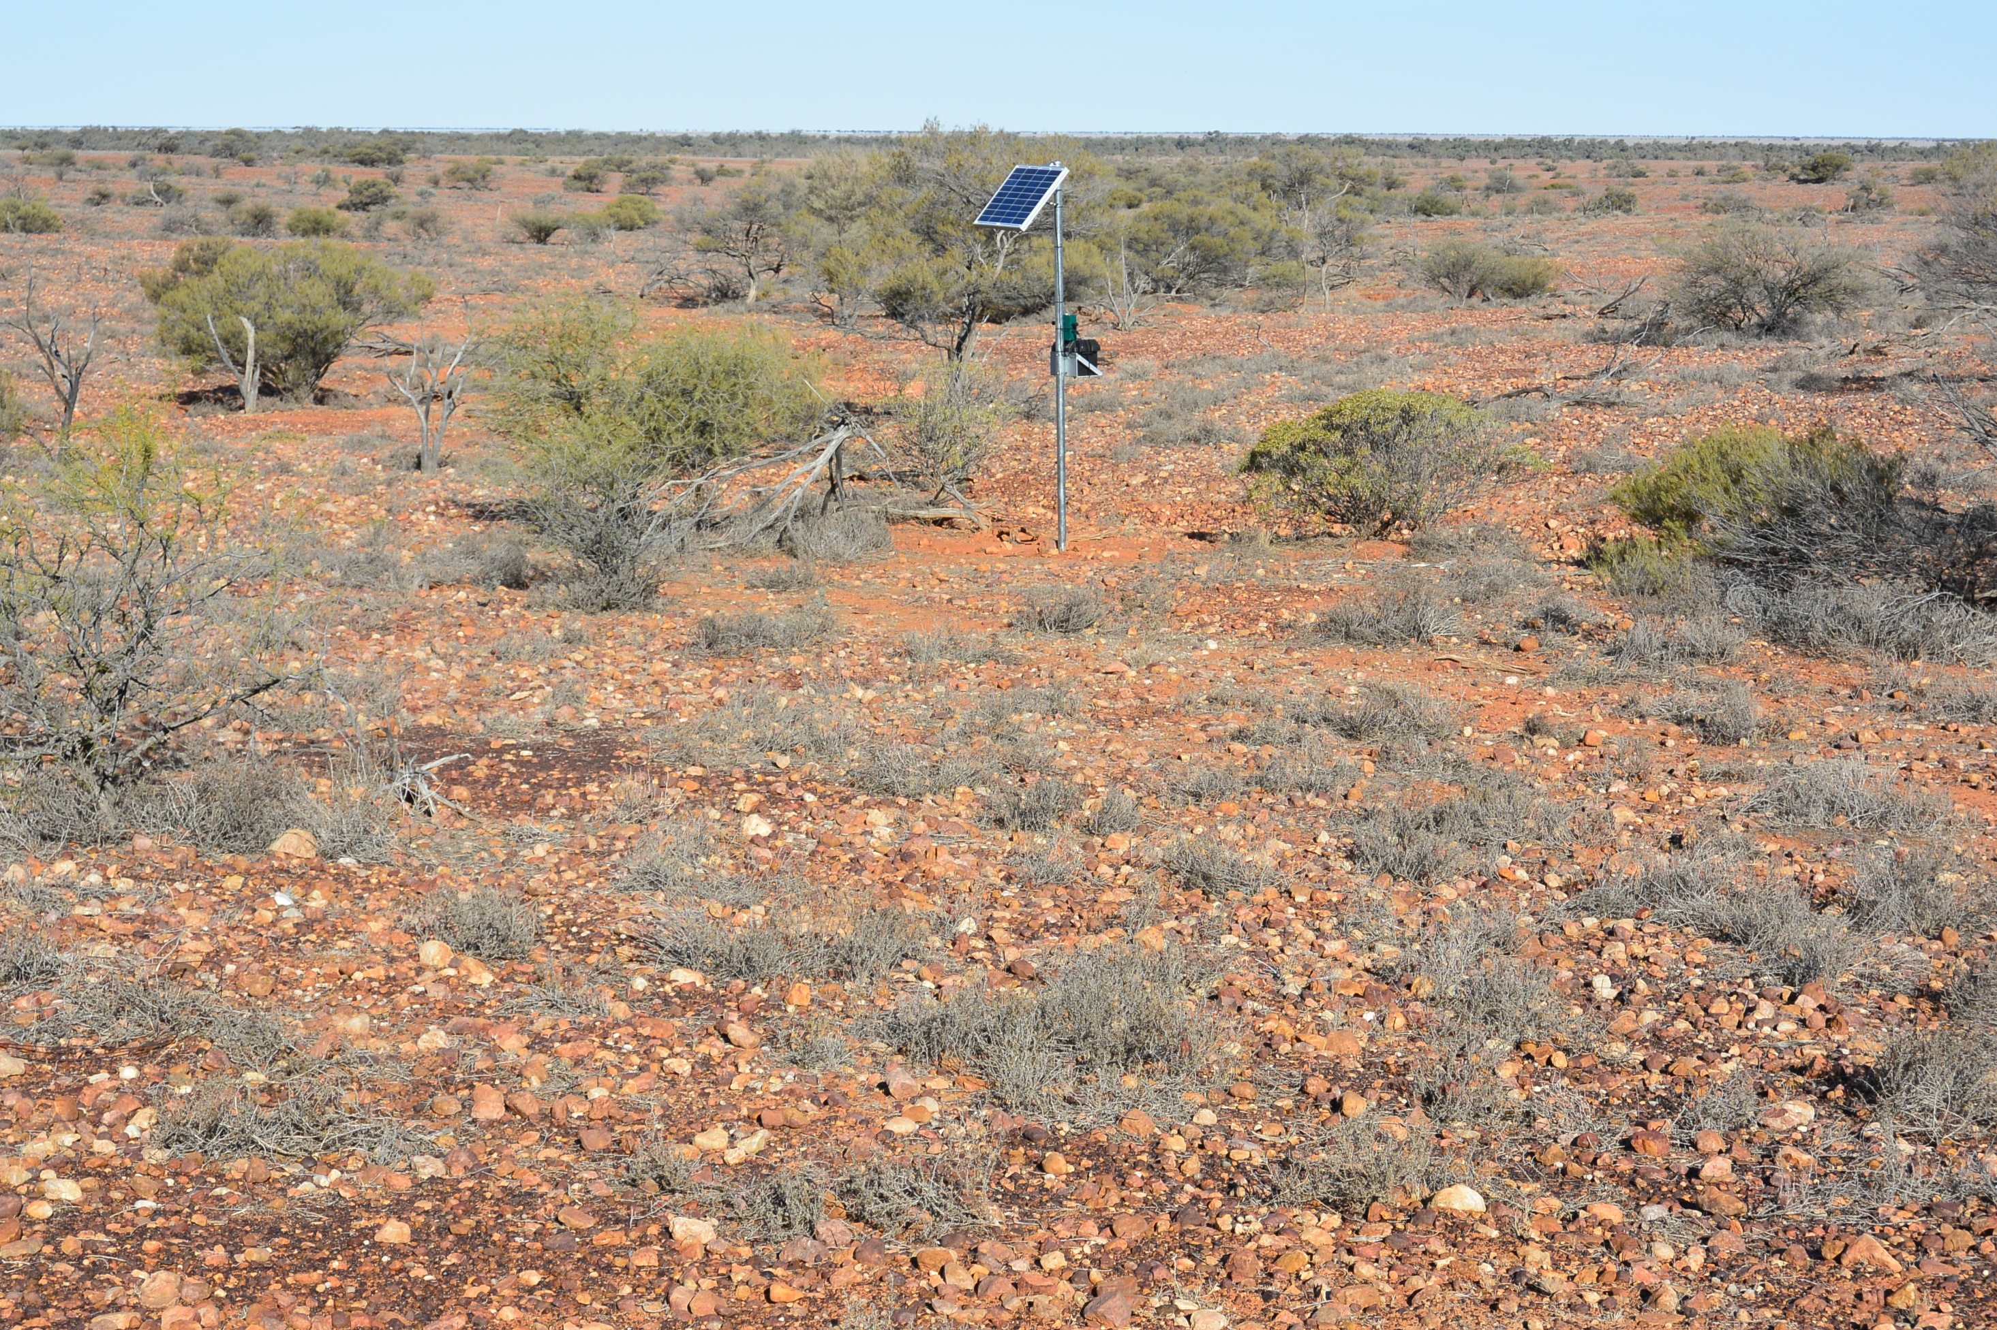
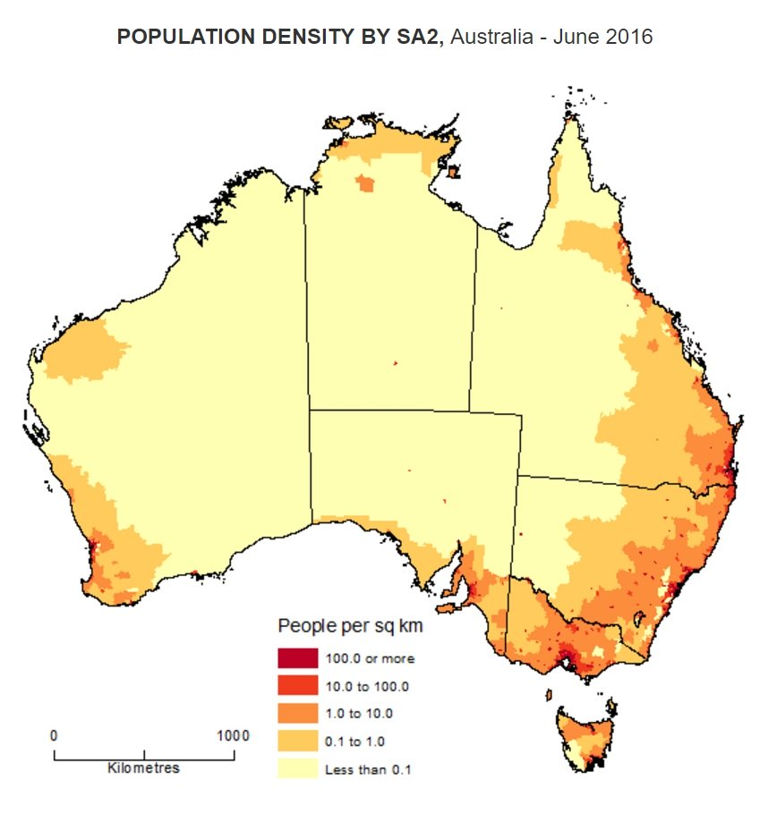

Slide 16
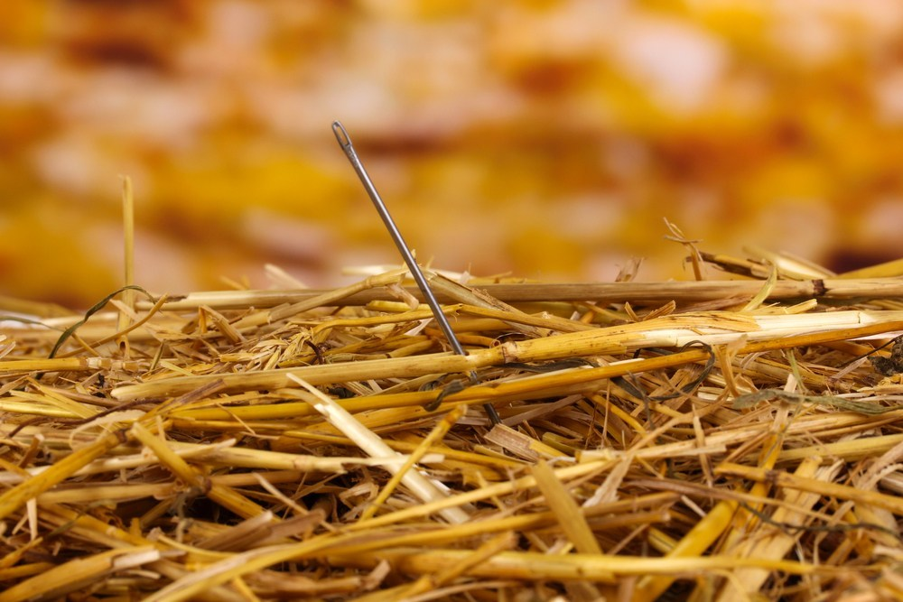

Slide 17
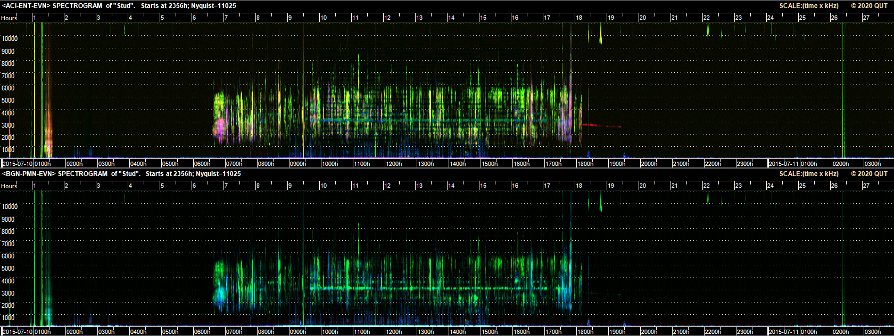
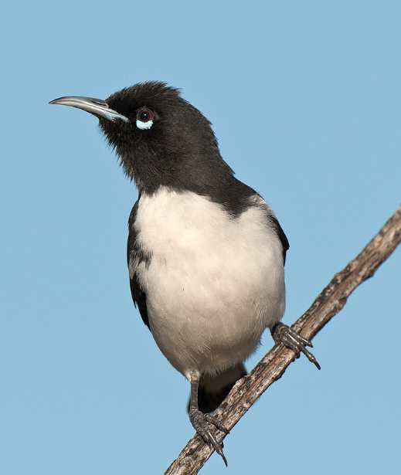

Slide 19
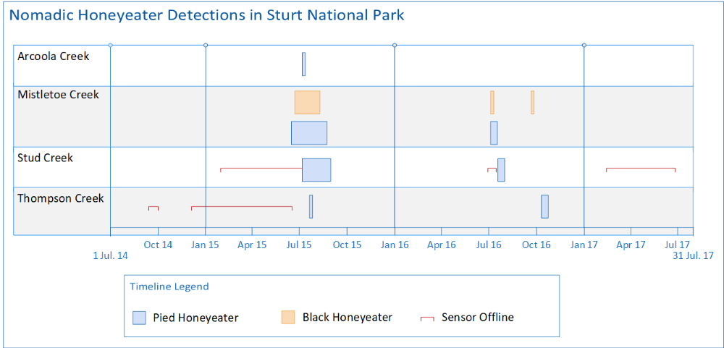

Slide 20
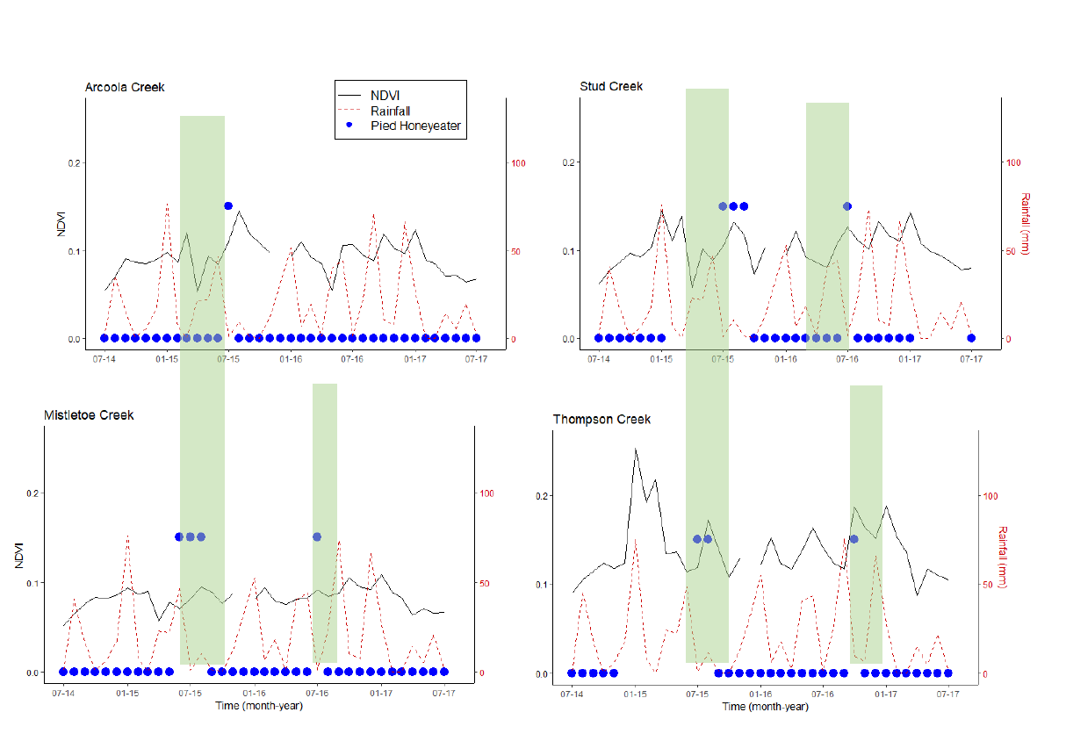

Slide 21
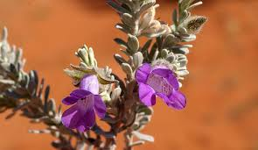

Slide 22
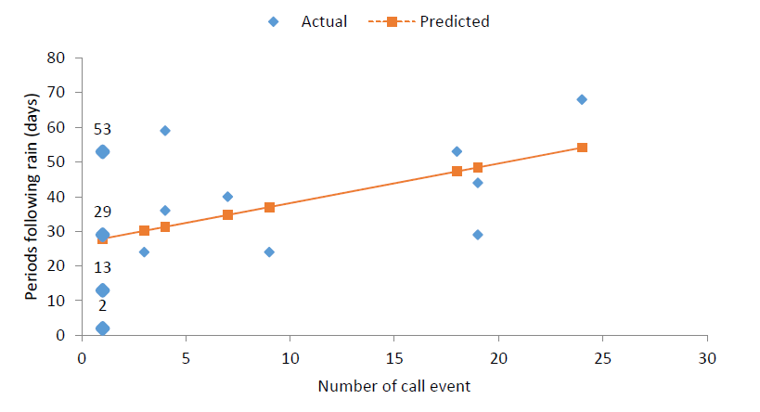

Slide 23
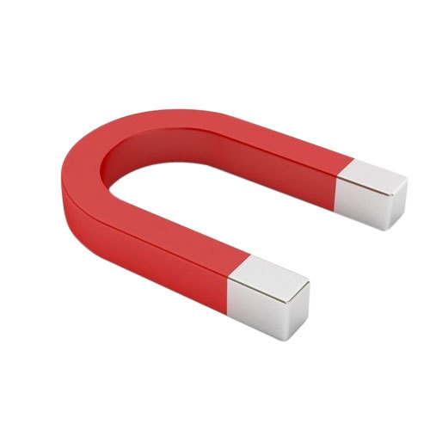
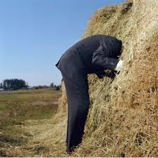

Slide 24
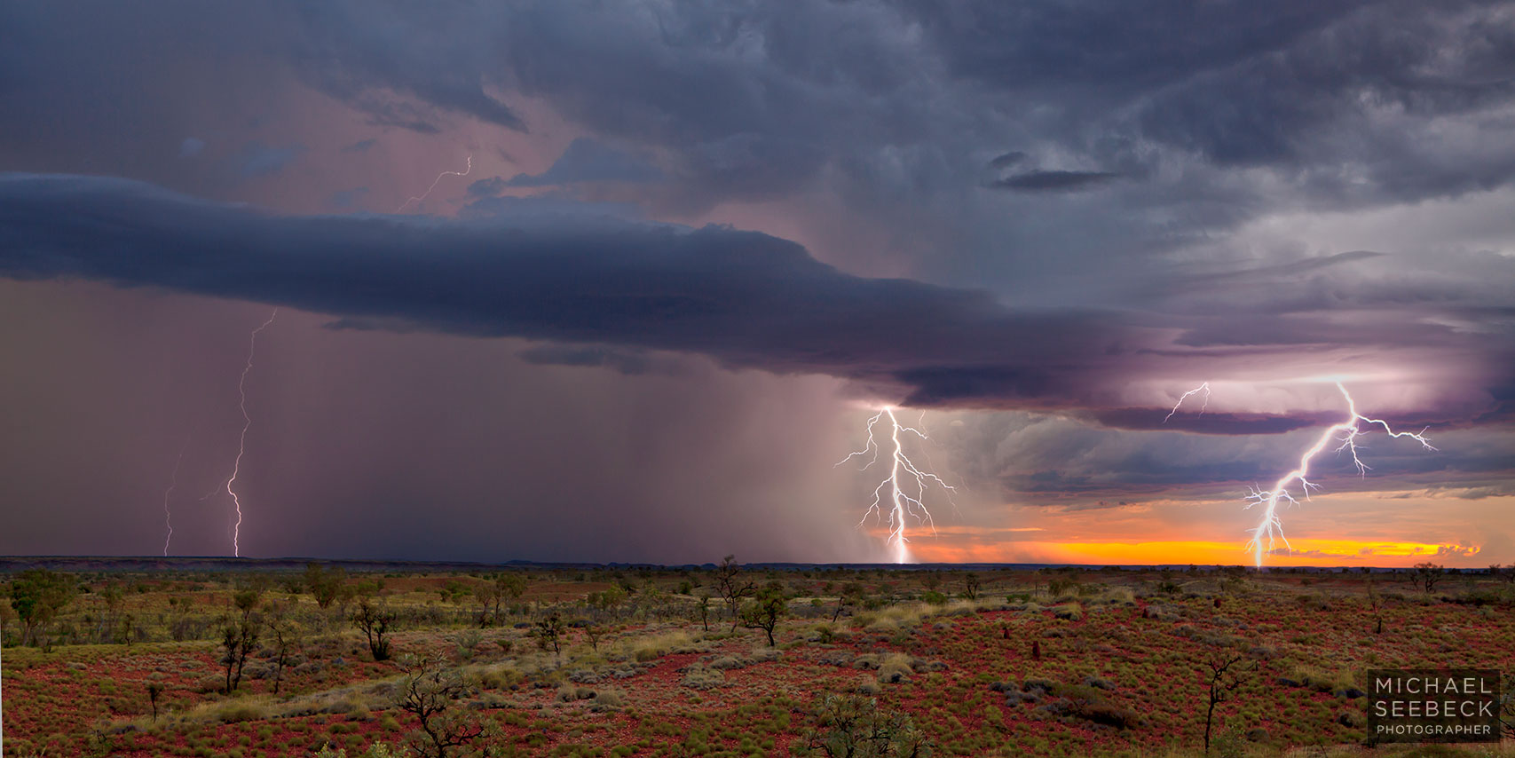

Slide 25


